Slide 1

Information Sharing
Marisa Talarico, M.Pl.
Special Projects Manager

Slide 2
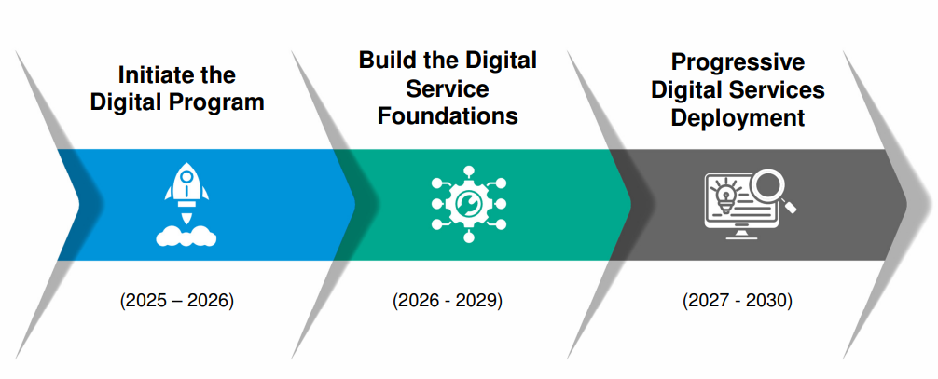
CGS Digital Transformation
IT presented the Digital Services Strategy to Council in October 2025
Notes:
The City is moving towards cloud-based solutions for providing services wherever possible.

Slide 3
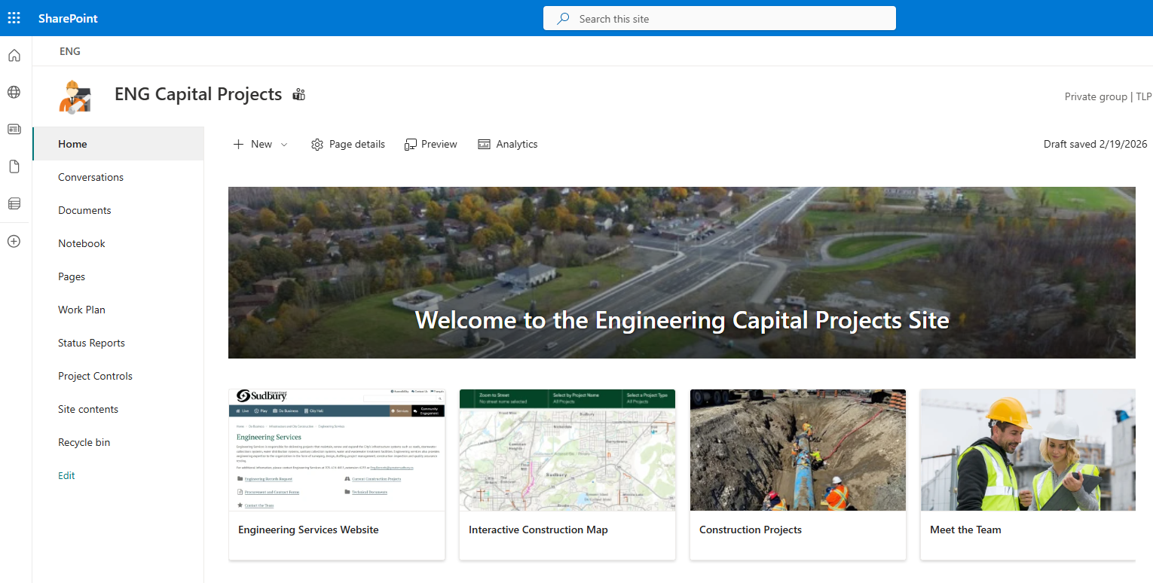
Sharepoint Tools
ENG making use of available project management tools
Document storage and sharing
Collaborative work planning
Project status reports and tracking
Notes:
Engineering Services is part of Phase 1 of the planned digital transformation

Slide 4
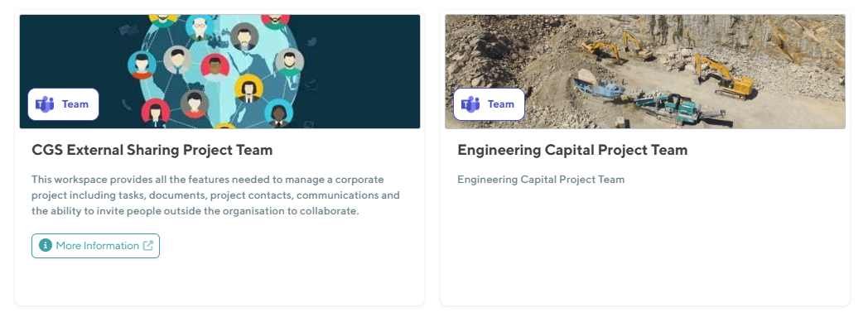
Coming soon: Sharepoint project sites
Notes:
- The next phase of digital transformation for Engineering Services is

Slide 5
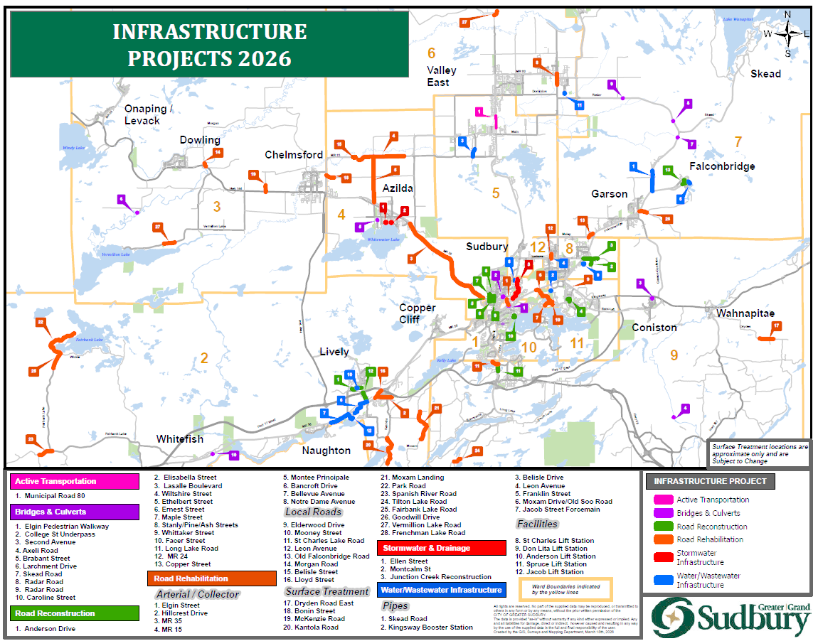
STATIC Map
Shows locations of all planned capital projects for 2026
Will be available soon on website

Slide 6
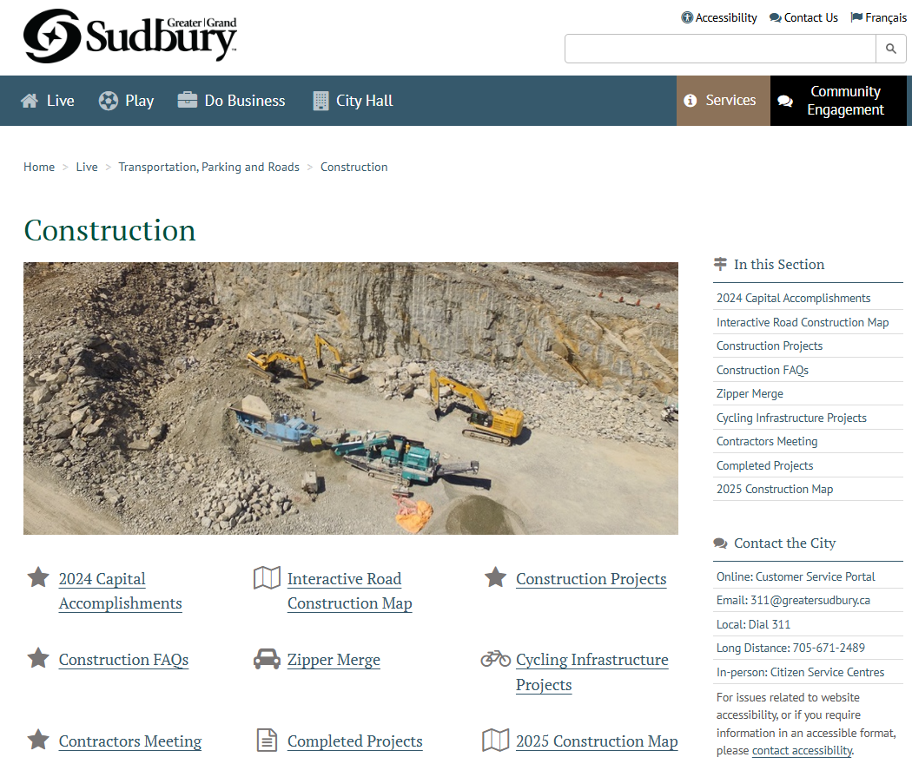
Interactive Map
We are in the process of updating and improving our interactive map
Goal is for it to be primary source of real time construction information for residents, businesses, etc.
Notes:
More real time updates for various projects, etc.

Slide 7
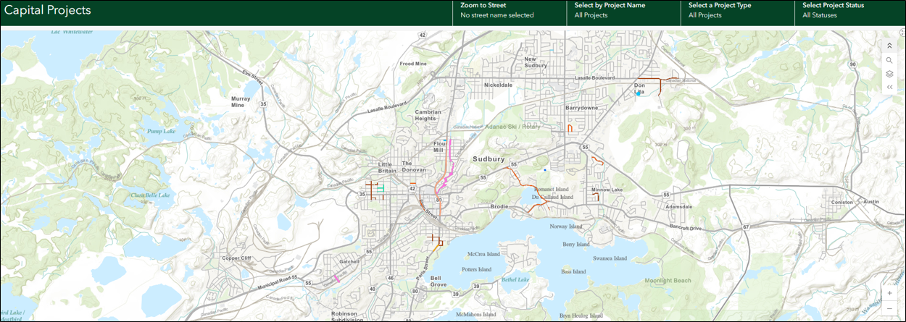
Interactive Map
Notes:
Provides more real time data.
We will be working to streamline and simplify the user experience for this map

Slide 8
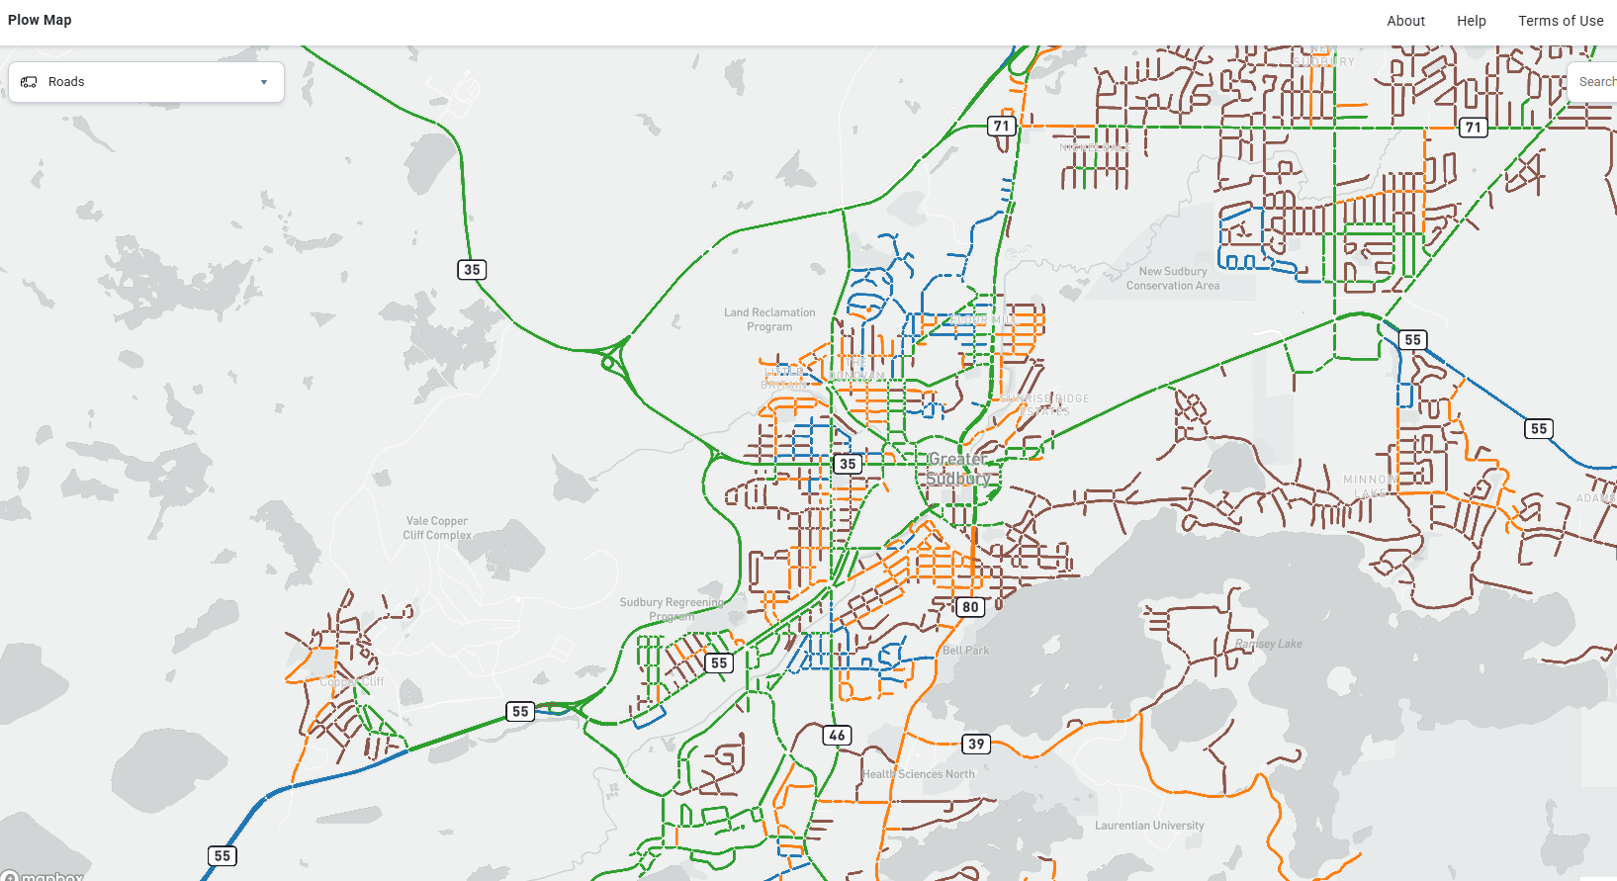
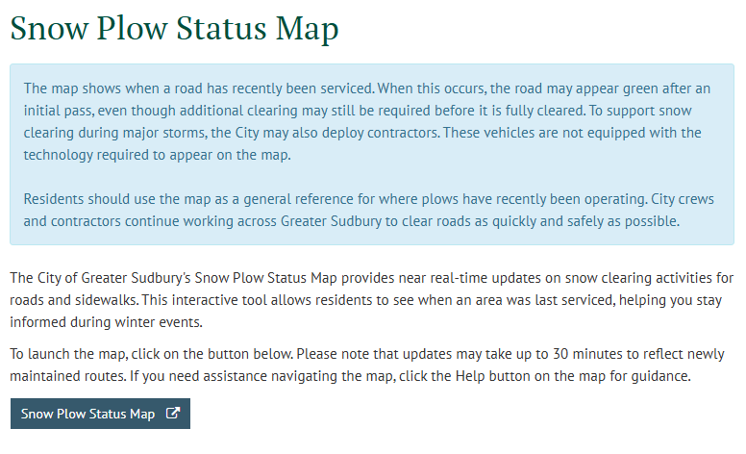
ArcGIS Online Apps
Notes:
To build on the interactive map
Pilot it for 2026
For some of the various location contracts, we are working with our IT staff to create an APP for real time updates for construction start up, and construction end, so the public can anticipate where the work is taking place each week/day etc
There will be a significant impact this year with the expanded spread laid patches program and we want to minimize traffic disruptions and communicate where work is taking place to the extent possible

Slide 9
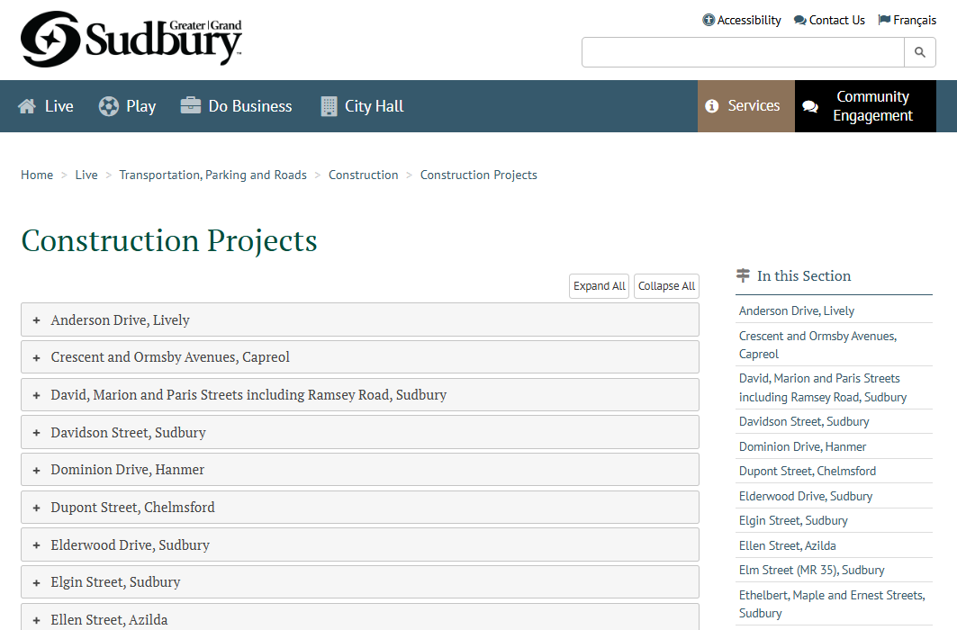
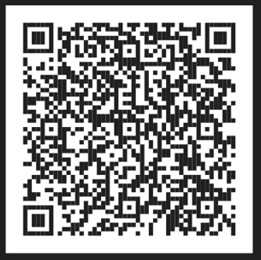
Ongoing Construction Projects

Slide 10
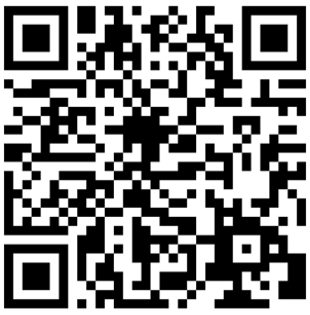
Engineering Edge Newsletter
Open your camera app and aim it at the QR code here or on the table.
Follow the link to the website.
Enter your information.
Confirm your e-mail address.

