Slide 1
Enbridge gas safe excavation
Aidan Hurrell
Damage Prevention Inspection
Enbridge Gas

Slide 2
PATH TO 0
14 contractor damages in 2025 while working for the City Of Greater Sudbury
As of August 1st, there was a total of 3 service line damages
2026 Goals & Strategy
Reduce plant damages
Consider contributing factors to latter half damage number increase
Increased proactive engagement
Collaboration between Utility-Municipality-Contractor

Slide 3
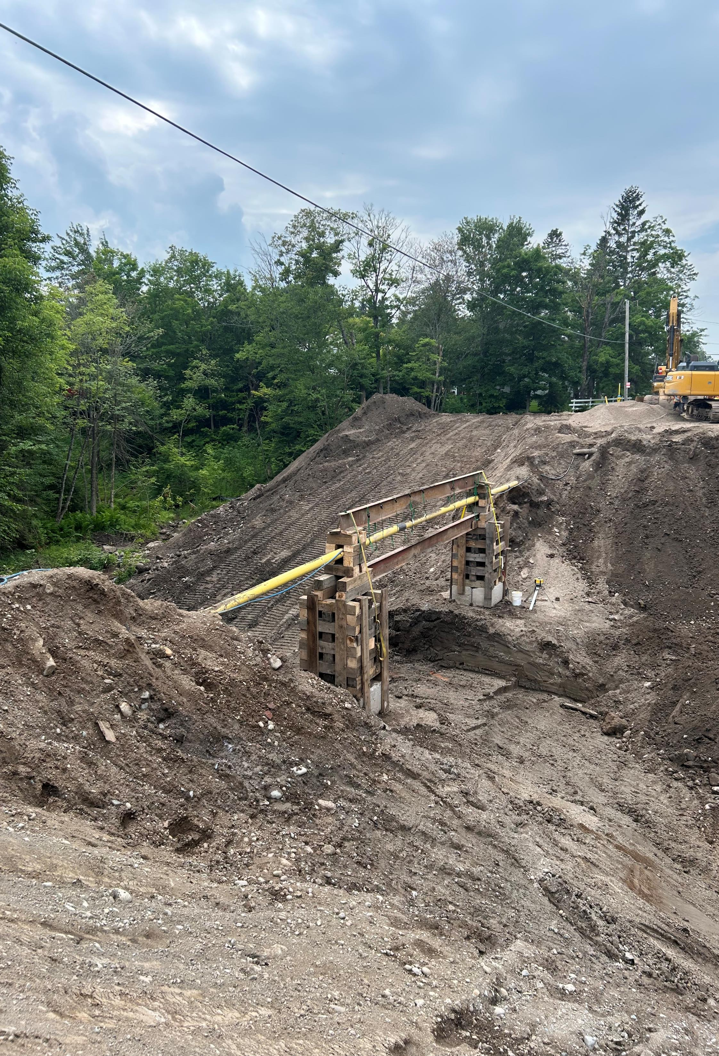
Gas line supports
Multiple damages occurred due to failure to support
Take the time to ensure gas lines are properly supported
Stress damage can occur due to sagging
PLASTIC OR STEEL

Slide 4

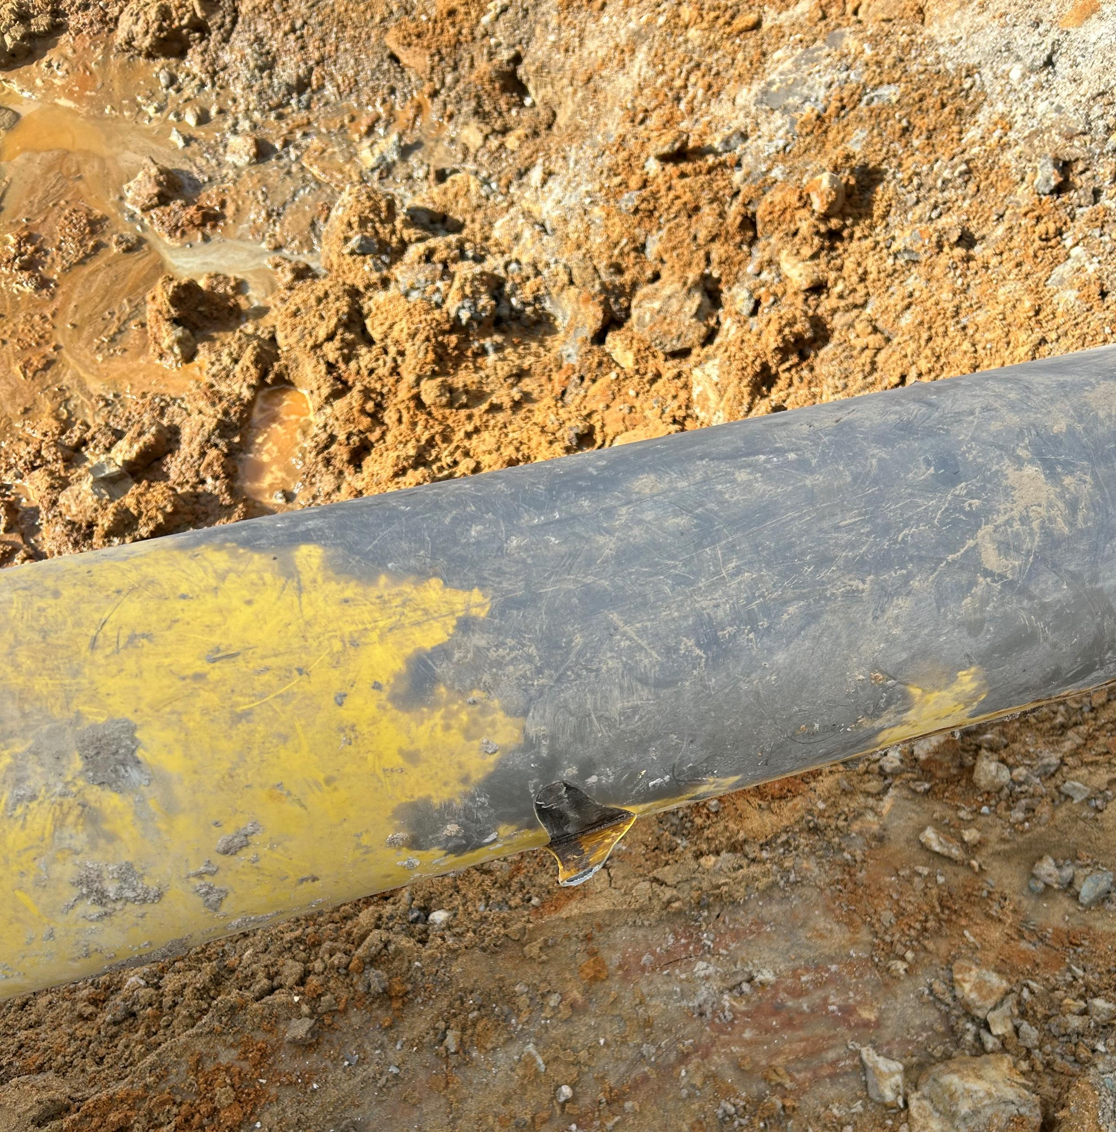
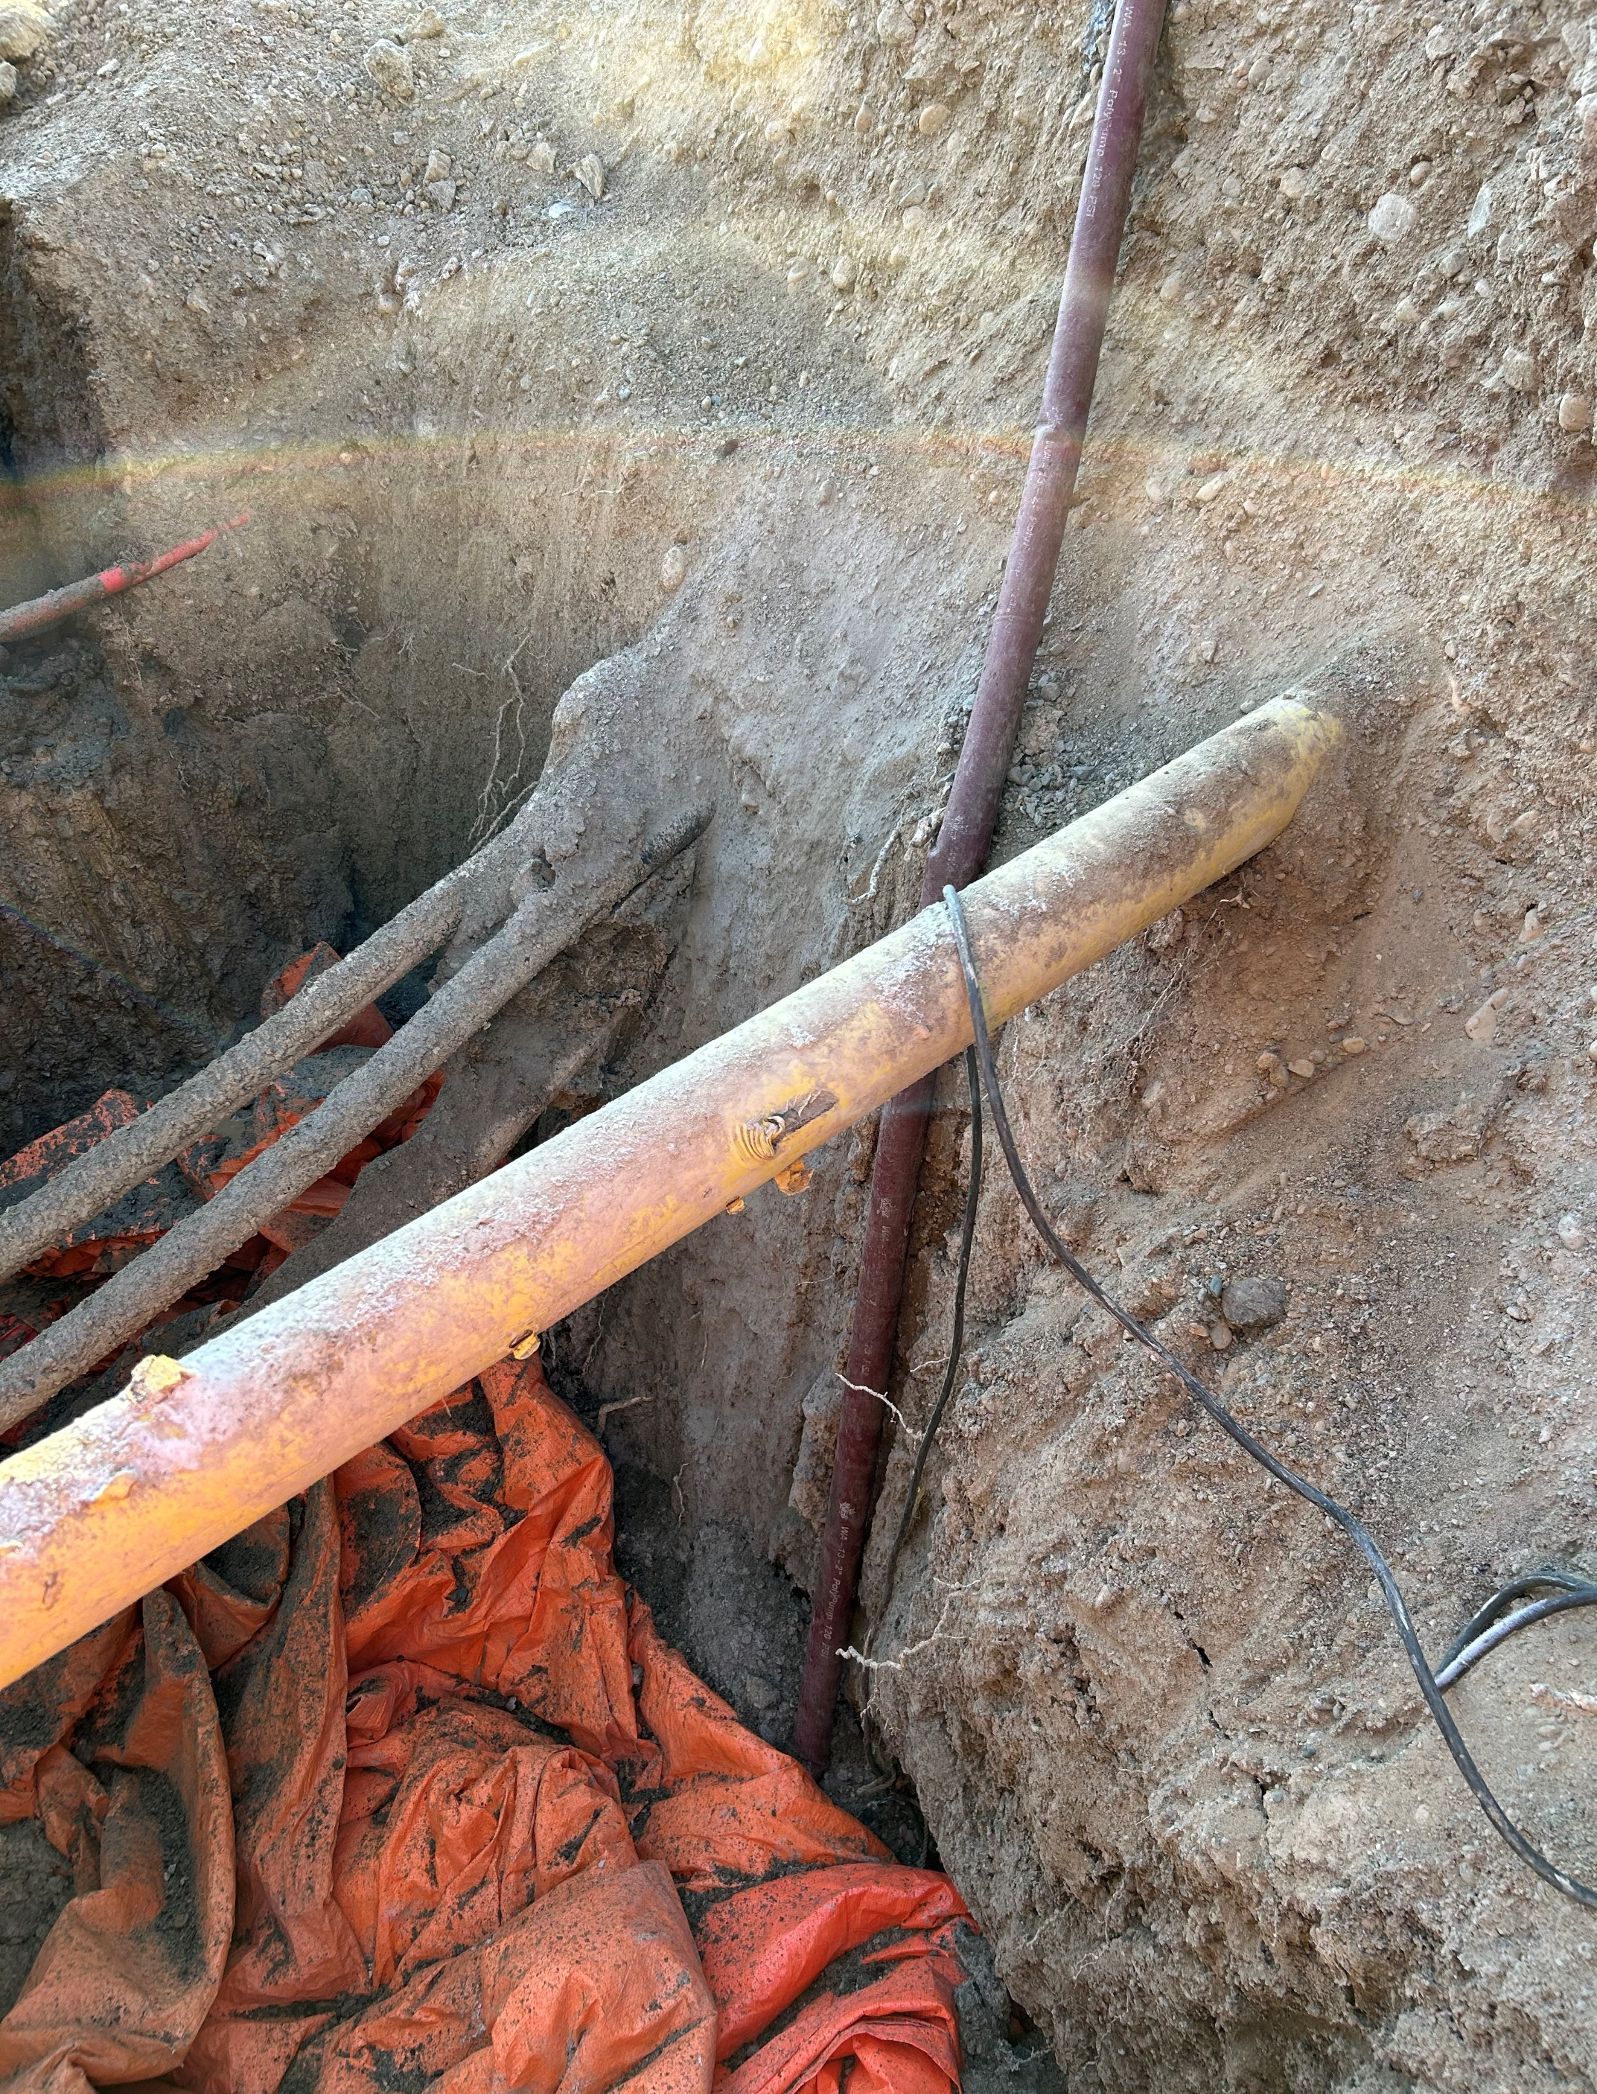
Coating damages
Early reporting prevents future leaks and protects both the public and the contractor
Call 1-888-421-9595 to provide details

Slide 5
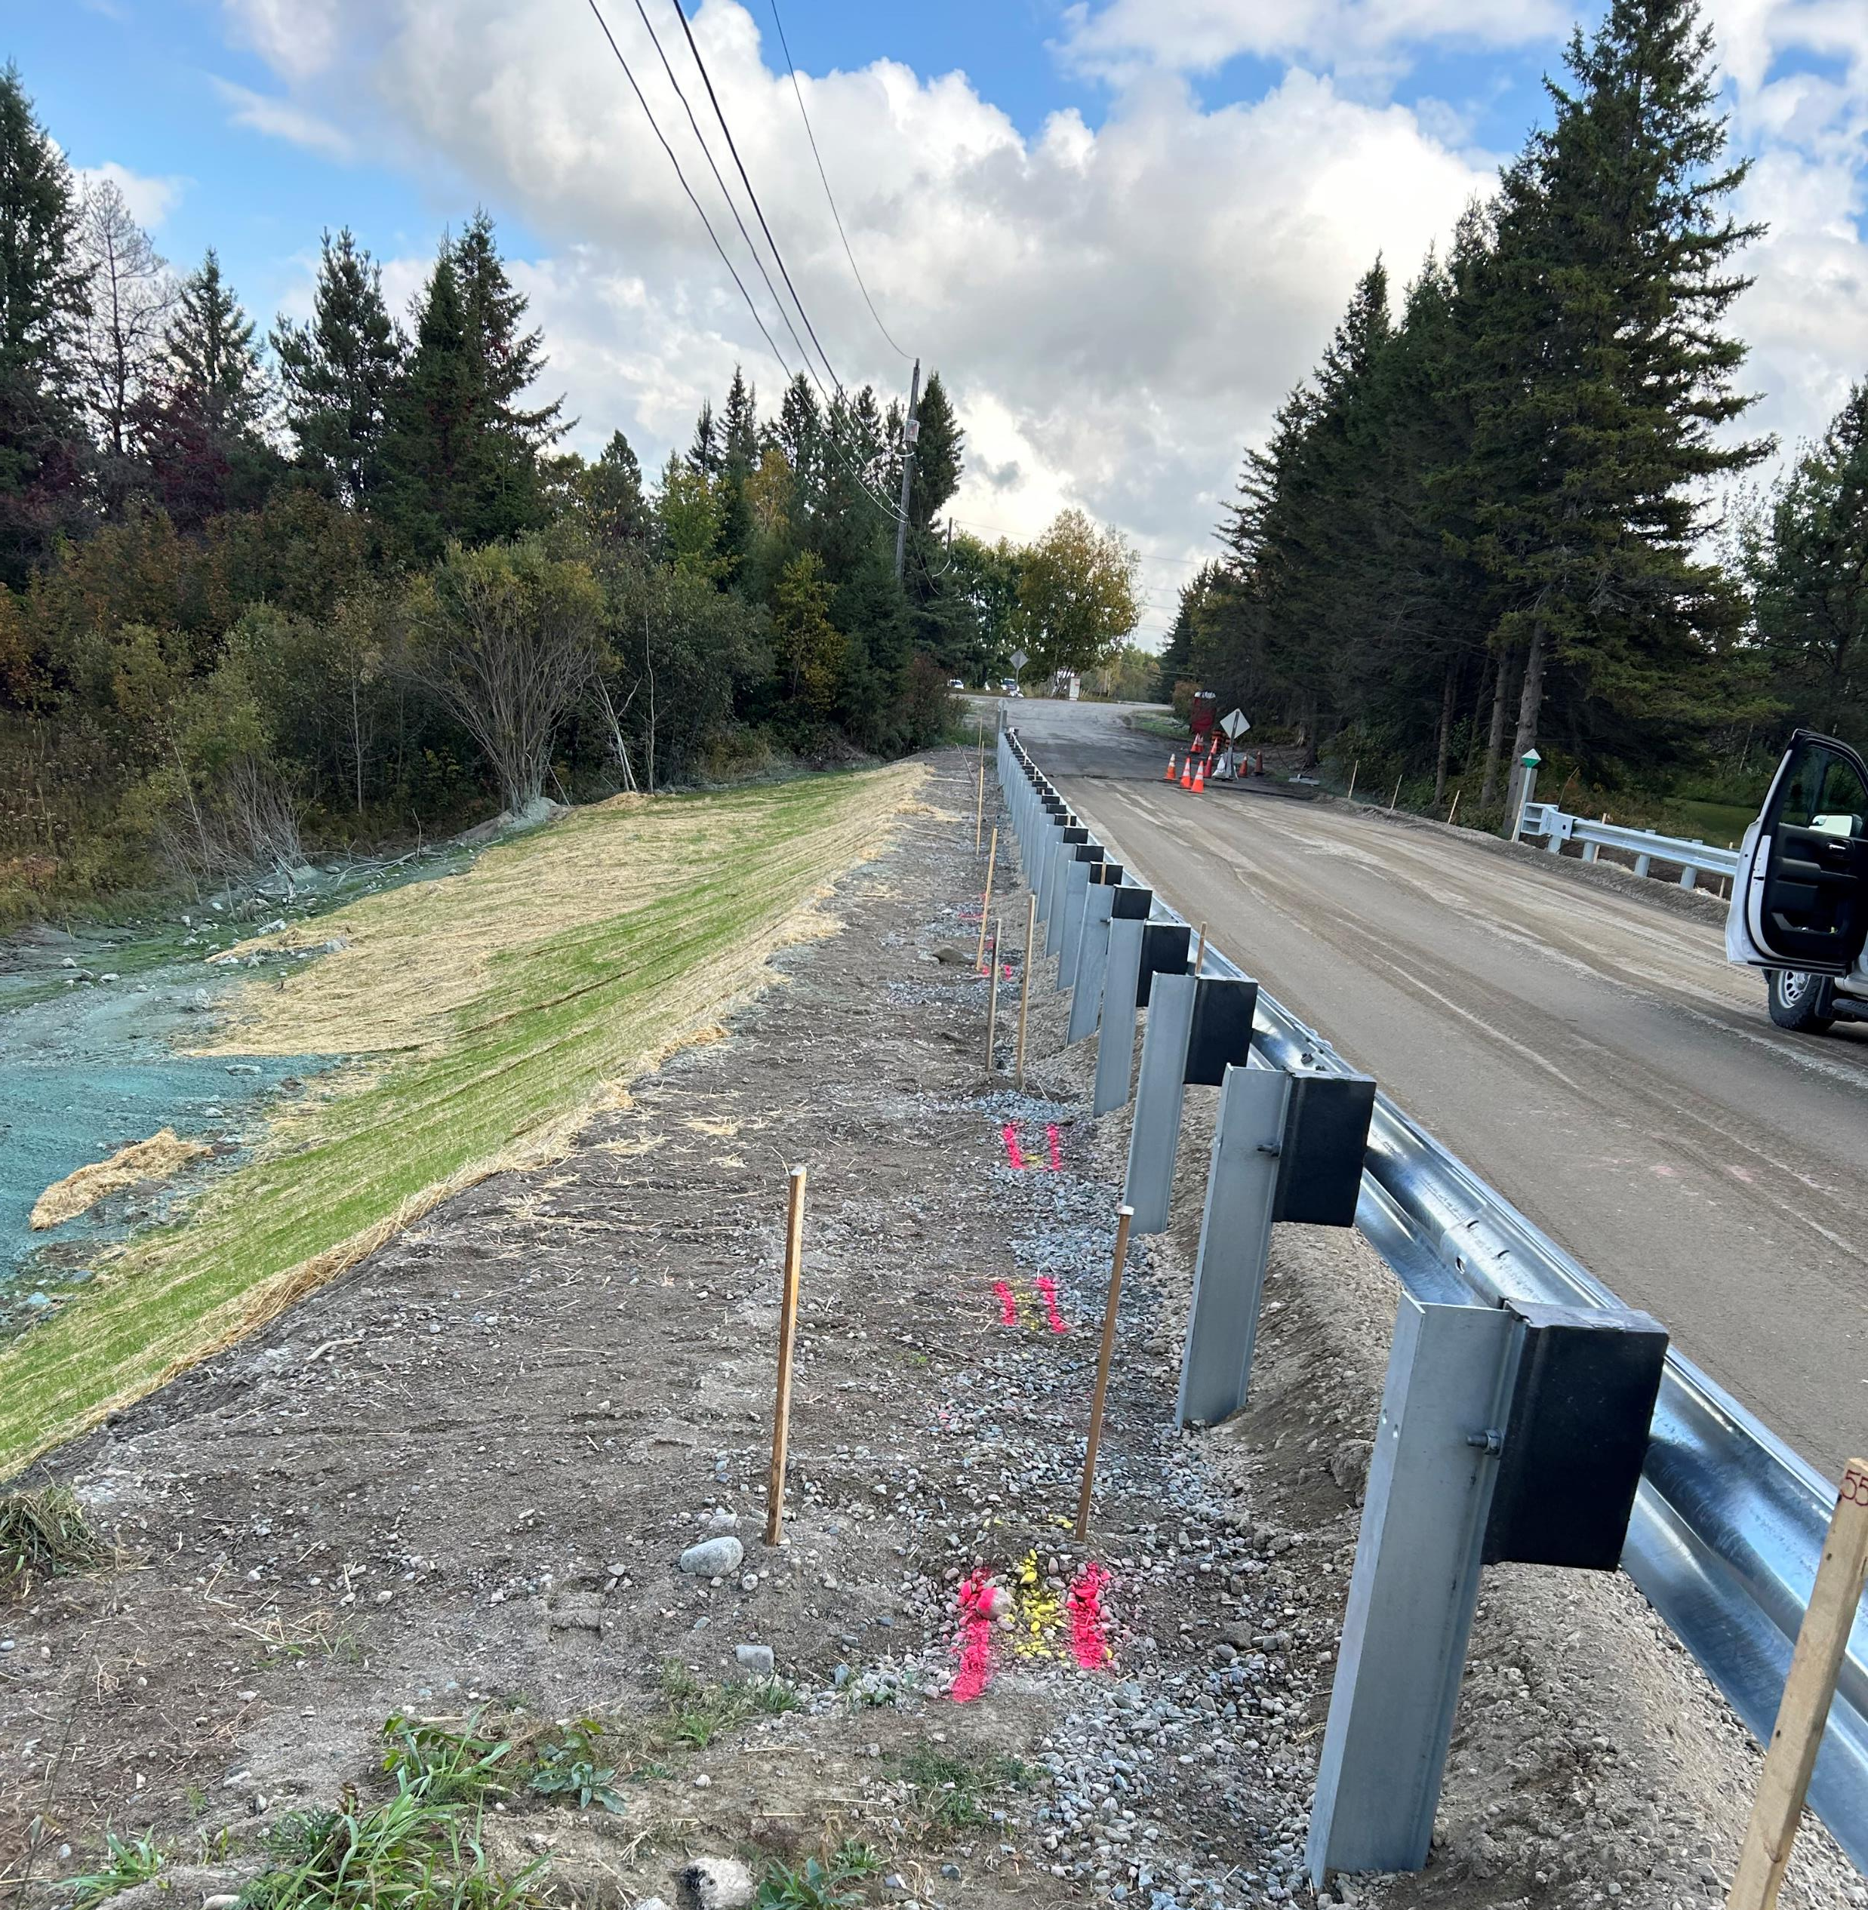
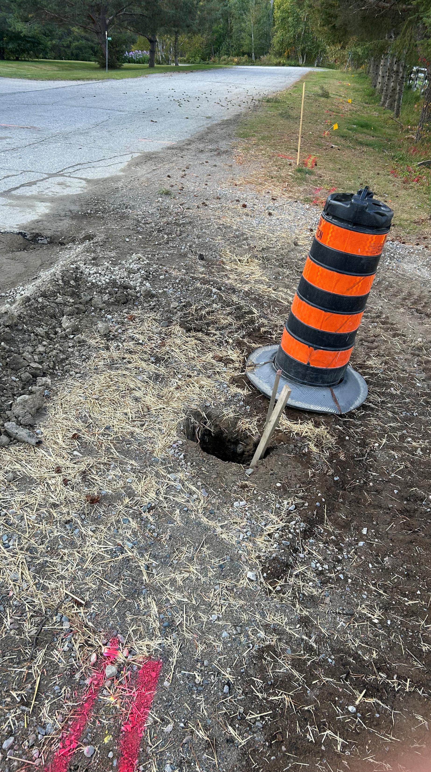
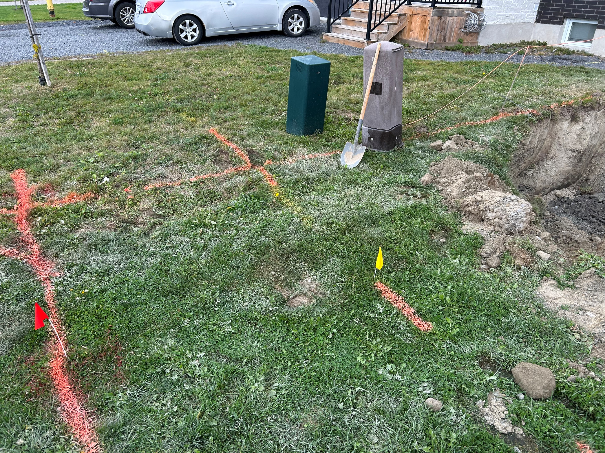
Locate Markings
Regularly maintain and refresh markings
Pink highlighted markings and stakes are a good visual reminder to excavator
Maintain locate limit boundary indicators

Slide 6
Contact Info
Aidan Hurrell
Damage Prevention Inspector
Aidan.Hurrell@enbridge.com
249-885-2241
Damage Prevention Office
1-866-922-3622

