Slide 1
Deep Excavation
Andrew Peltomaki (for Paul Bazinet)
Project Manager
Engineering Services

Slide 2
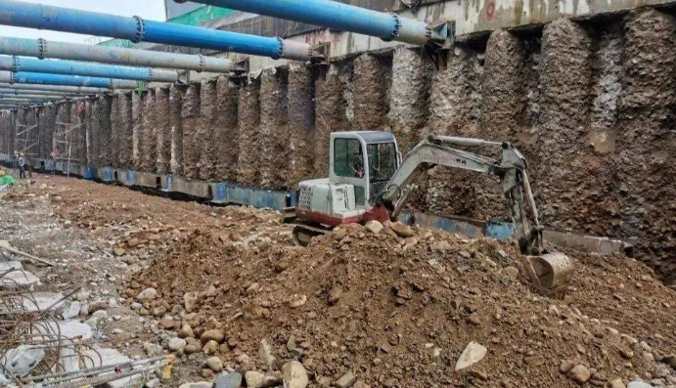
Deep Excavation - Overview
Definition and Applications​
Deep excavation involves soil removal beyond 4.5 meters (15ft).​
Engineering Challenges and Risks​
Risks include lateral earth pressures, wall deformation, groundwater inflow, and potential collapse if not properly managed.​
Multi-disciplinary Coordination​
Successful projects require collaboration among geotechnical, structural, construction, and monitoring teams for safety and stability.​
Importance of Planning and Monitoring​
Robust design, sequencing, and monitoring are critical to manage risks and ensure excavation stability throughout the project lifecycle.

Slide 3
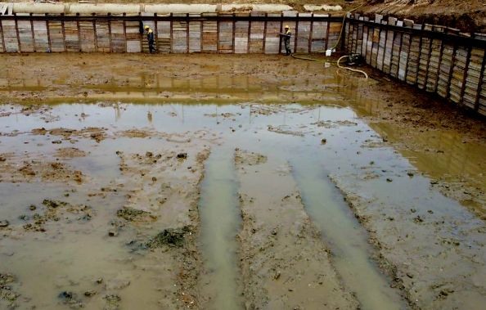
Deep Excavation – Considerations
Subsurface Investigation Importance​
Geotechnical investigations assess soil strength, stiffness, and stratigraphy to inform excavation design and prevent failures.​
Groundwater Impact​
Groundwater levels and permeability affect dewatering needs and risk of excavation base instability.​
Adjacent Structures Sensitivity​
Nearby buildings and utilities require strict deformation limits and stiffer support to prevent damage.​
Construction Sequencing​
Proper sequencing of excavation, braces, and dewatering ensures load management and safety.

Slide 4
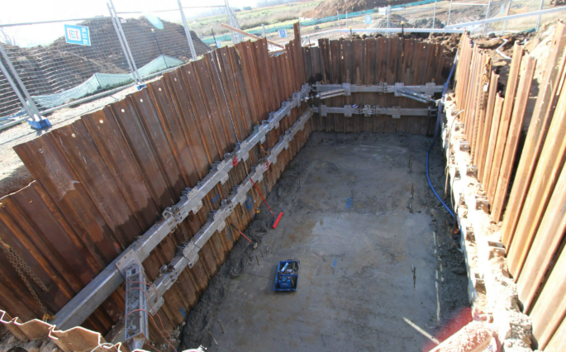
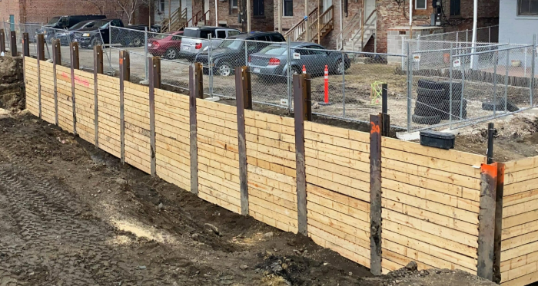
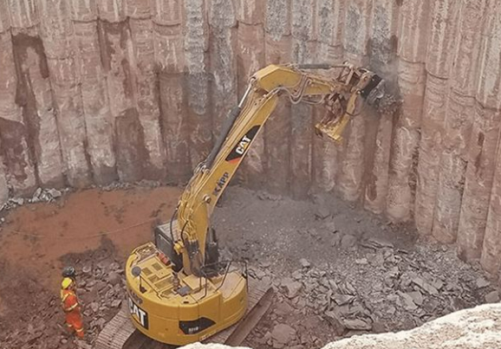
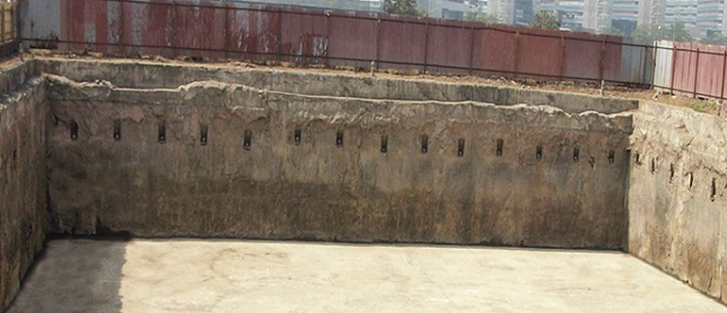
Deep Excavation – SUPPORT SYSTEMS
A
B
Sheet Piling System​ (A)
Sheet piling involves interlocking steel sheets forming a continuous wall, ideal for granular soils and quick installation.​
Soldier Pile and Lagging​ (B)
Soldier piles are vertical H-piles spaced with horizontal timber or concrete lagging, offering flexibility in varied soils.​
Secant Pile Walls​ (C)
Secant and tangent pile walls use overlapping drilled concrete piles to create rigid barriers and water cutoffs.​
Slurry (Diaphragm) Walls​ (D)
Slurry walls are robust supports made with trenching and bentonite slurry, effective in deep soft soil excavations.
C
D

Slide 5
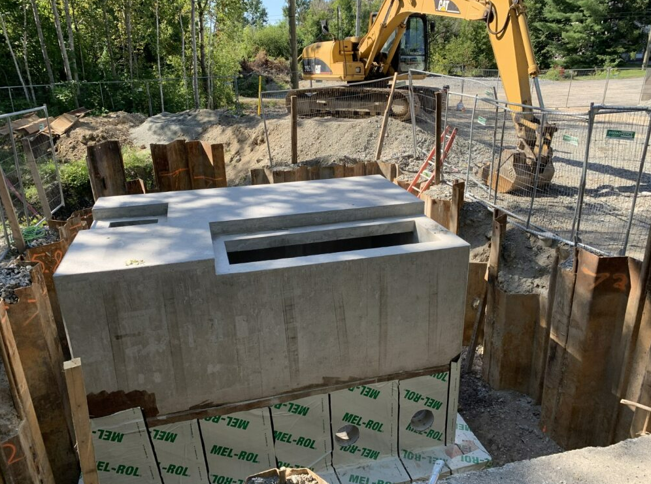
Deep Excavation – BEST PRACTIVES
Staged Excavation and Support​
Excavation proceeds in lifts with supports like struts installed at preset depths to limit wall height and ground movement.​
Coordination and Groundwater Control​
Effective coordination of excavation, support, and dewatering ensures groundwater is controlled to maintain site stability.​
Quality Control and Monitoring​
Verification of support installation depths and loads along with regular monitoring maintains alignment with design assumptions.​
Supervision and Communication​
Experienced supervision and clear communication among teams ensure disciplined sequencing and project safety.

Slide 6
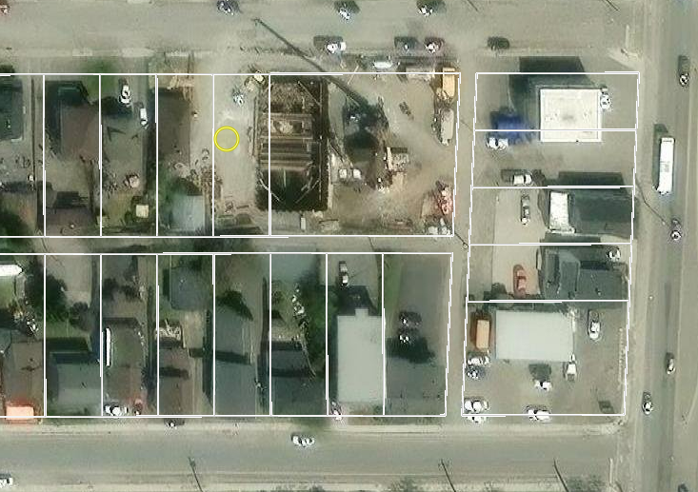
Deep Excavation – St Charles LS
New Existing
St Charles Lift Station Project
Existing lift station is 90+ years old and undersized for current flows
New lift station provides increased capacity, modern infrastructure, and improved reliability (330 L/s to 520 L/s)
Capacity increase requires increase effluent storage ie larger wet well
Construction requires deep excavation

Slide 7
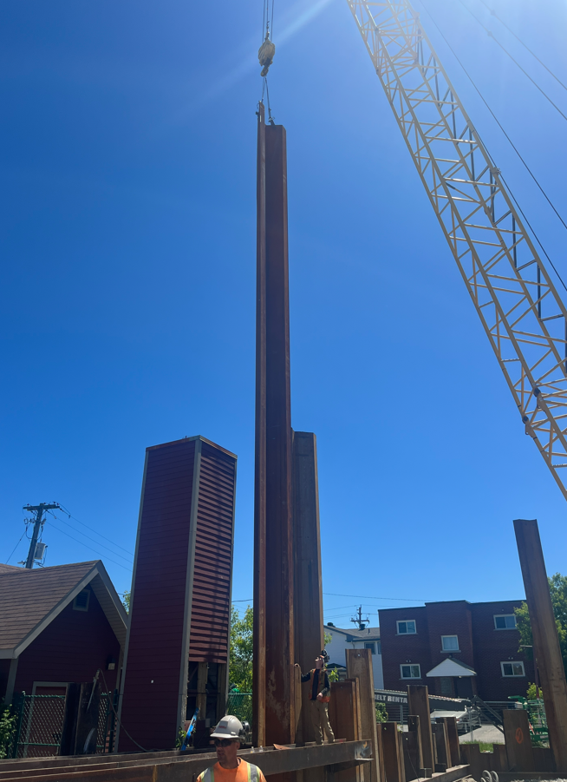
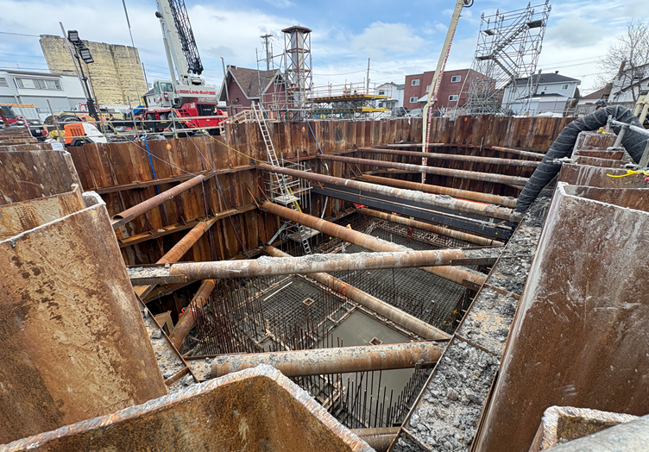
Deep Excavation – St Charles LS
St Charles LS - Excavation Requirements
Geotechnical work identified silty soils with limited bearing capacity
Geotech work showed no bedrock, leading to a sheet‑pile cofferdam design
Sheet piles installed to 30 m (98ft) depth using welded 60‑ft sections
Sheet pile installation done via crane mounted hydraulic hammer
Wet well excavation depth is 10 m (33ft)

Slide 8
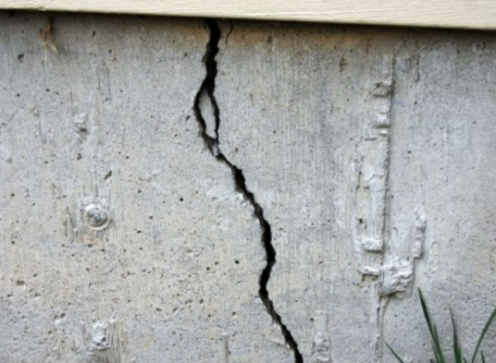
Deep Excavation – St Charles LS
St Charles LS – Settlement Issues
During sheet pile installation excessive settlement occurred on the North (street) and West sides of the property
Additional Geotech investigation hypothesized that liquefaction occurred
Liquefaction: loosely packed soils lose their strength and behave more closely to liquid.
237 St. Charles was purchased Nov 2024 was for sale and was acquired as a precaution
Vibration intensity and sheet pile installation speed was reduced for remainder of installation
Vibration monitoring was also increased (number of devices and readings)

Slide 9
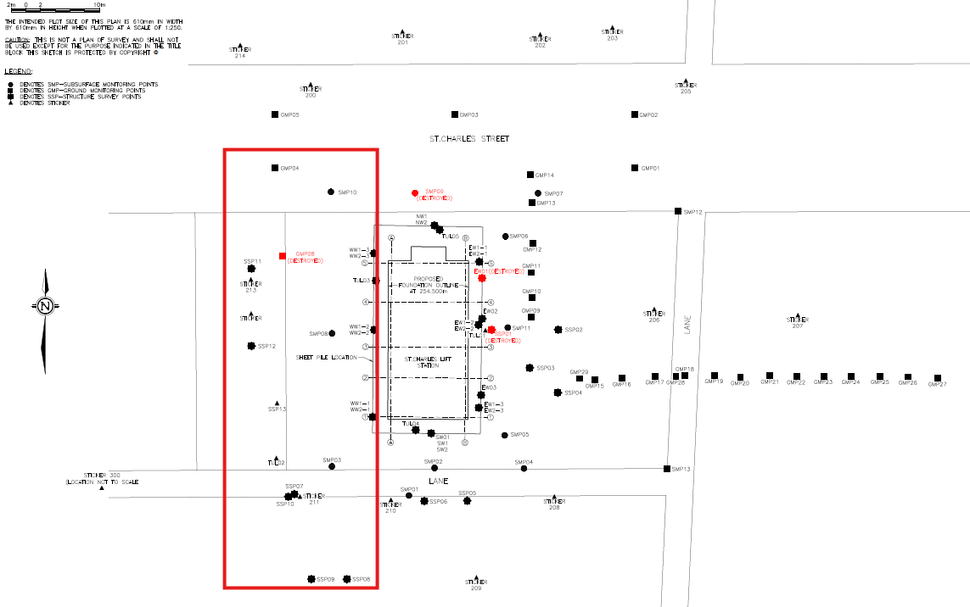
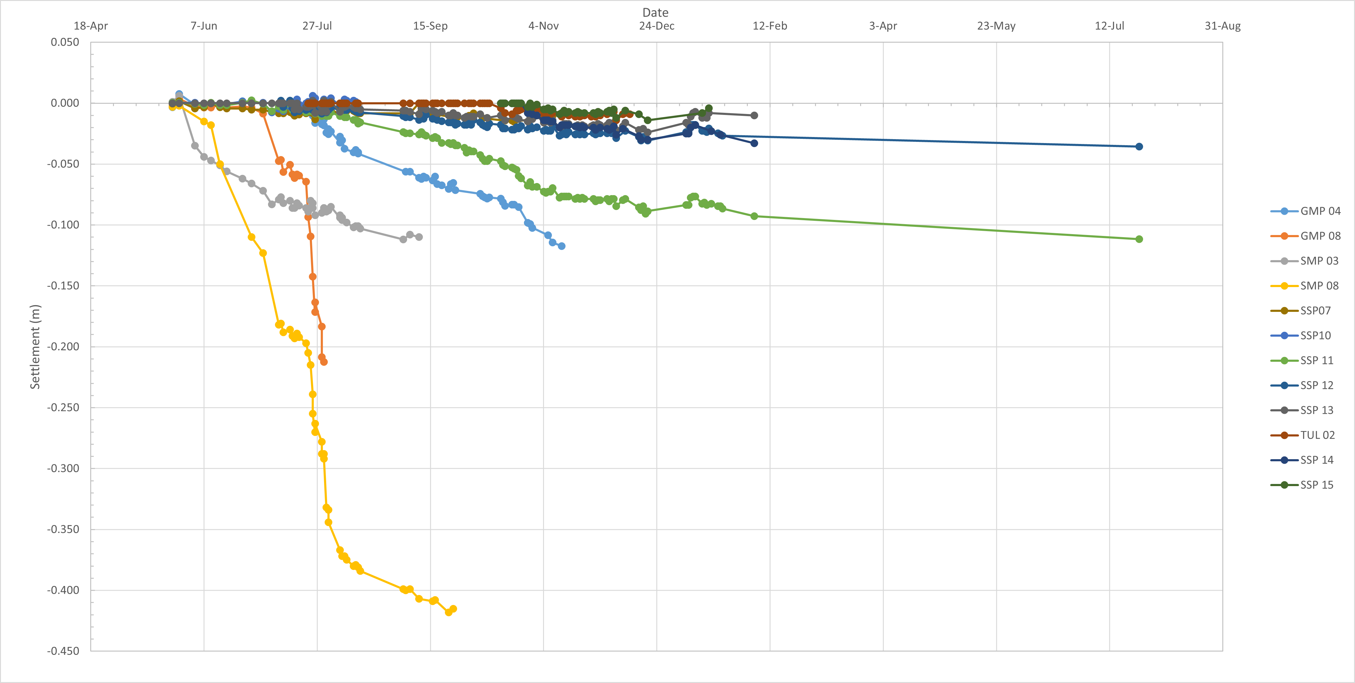
Deep Excavation – St Charles LS
Settlement monitoring on West Side illustrates areas of concern and severe settlement

Slide 10
Deep Excavation – SUMMARY/TAKEAWAYS
Understanding Subsurface Conditions​
Thorough geotechnical investigations are essential to identify soil, water, and risk factors before excavation begins.​
Support Systems Design​
Selecting appropriate support systems balances stiffness, constructability, and cost based on project conditions.​
Groundwater Management​
Effective groundwater control is critical for stability and for minimizing environmental impacts during excavation.​
Monitoring and Construction Sequencing​
Continuous monitoring and proper construction sequencing ensures safety and reduces the risk of settlement

