Slide 1

2026 Construction Season And Beyond
Rob Rocca, CET
Manager of Design Services

Slide 2
Annual capital spend
Notes:
In 2025, we spent $69 million on linear capital projects. We tendered 18 projects.

Slide 3
2025 Annual capital spend by program

Slide 4
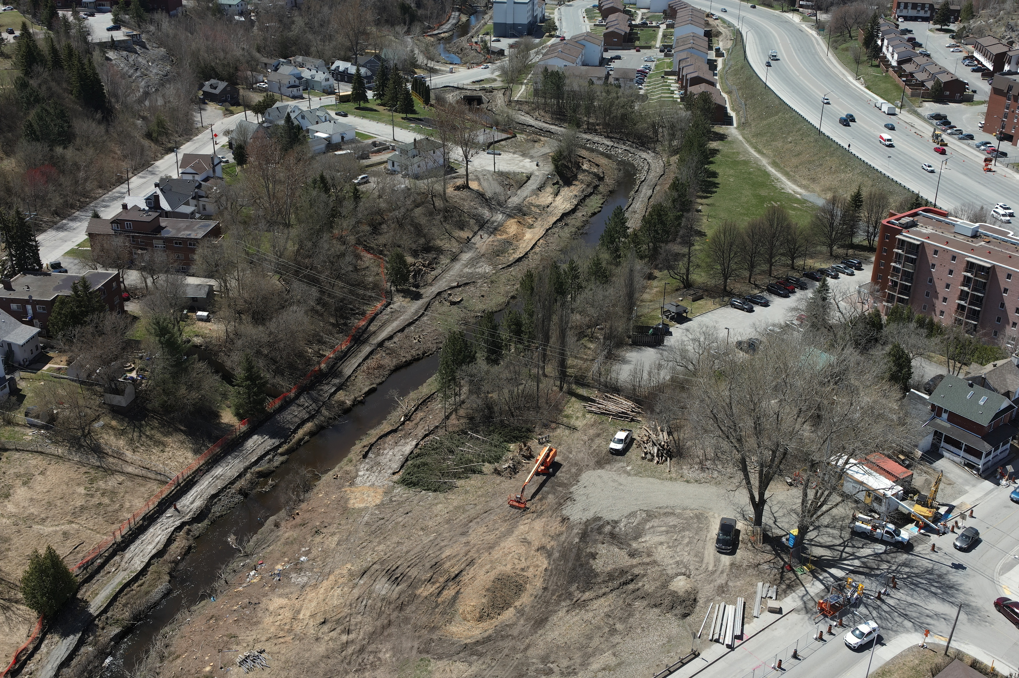
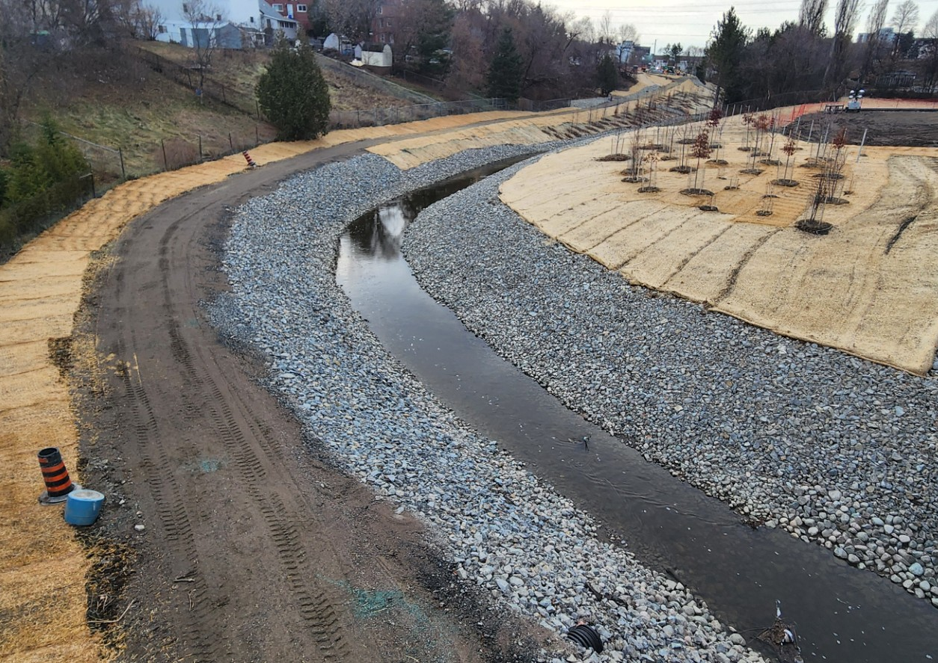
2025 Capital program highlights Junction Creek Rehabilitation and Reprofiling

Slide 5
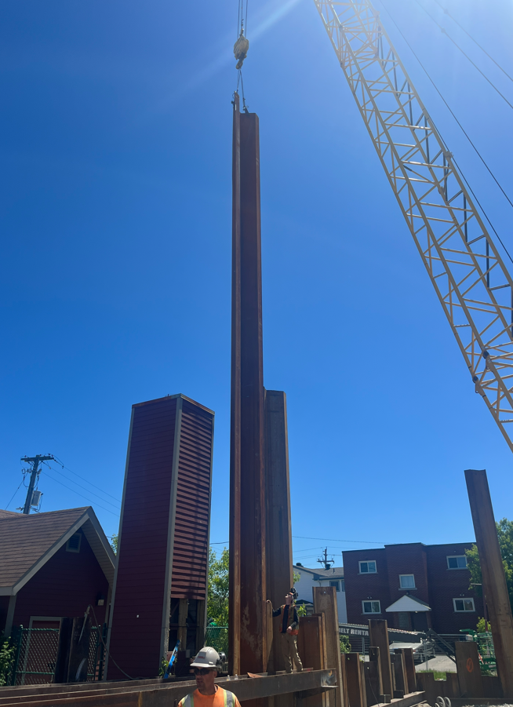
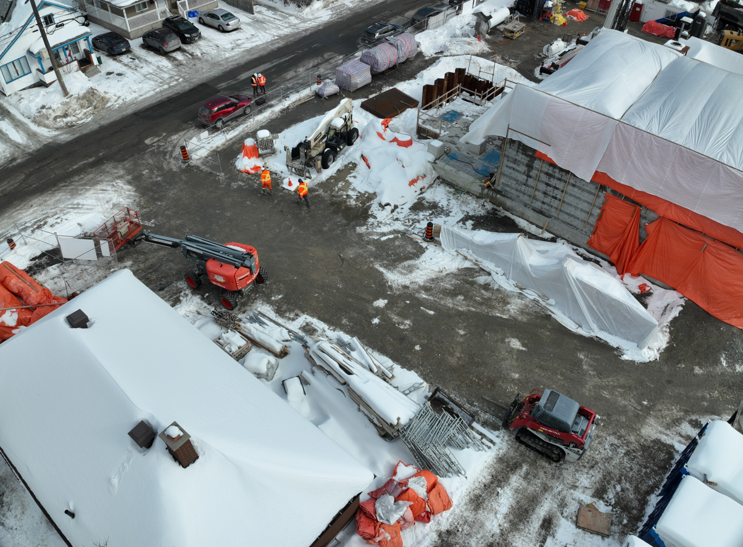
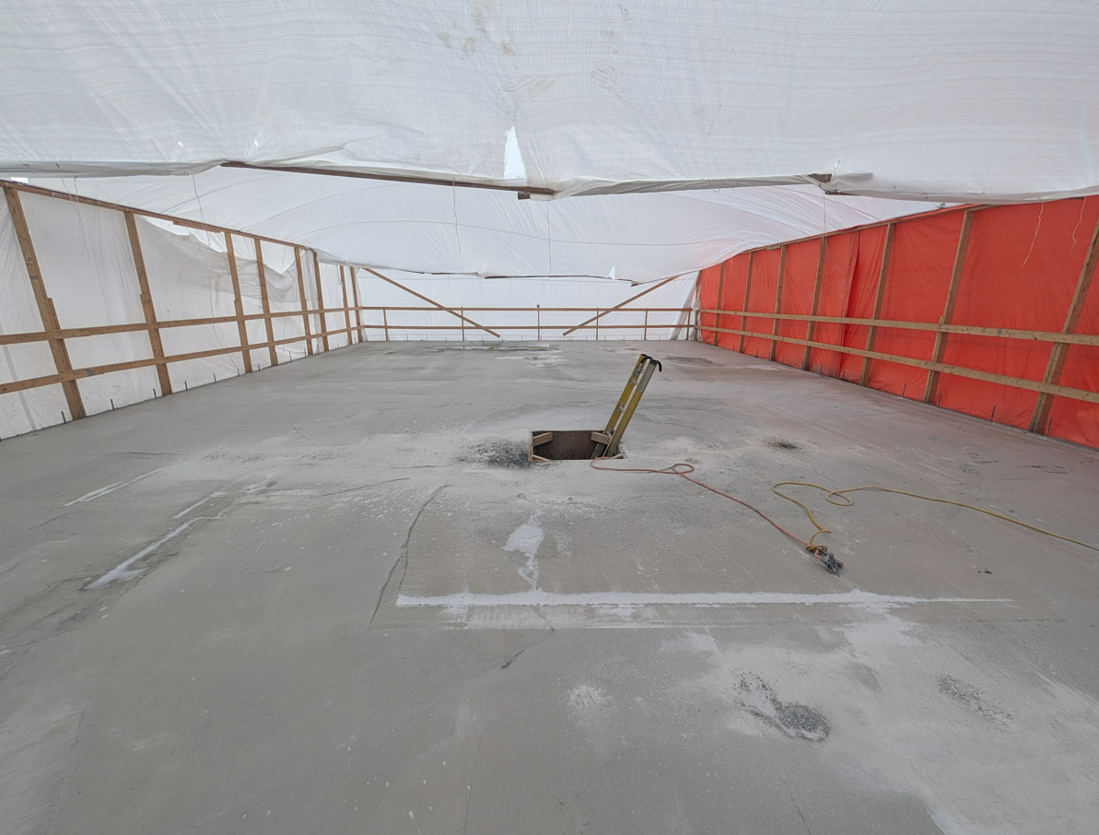
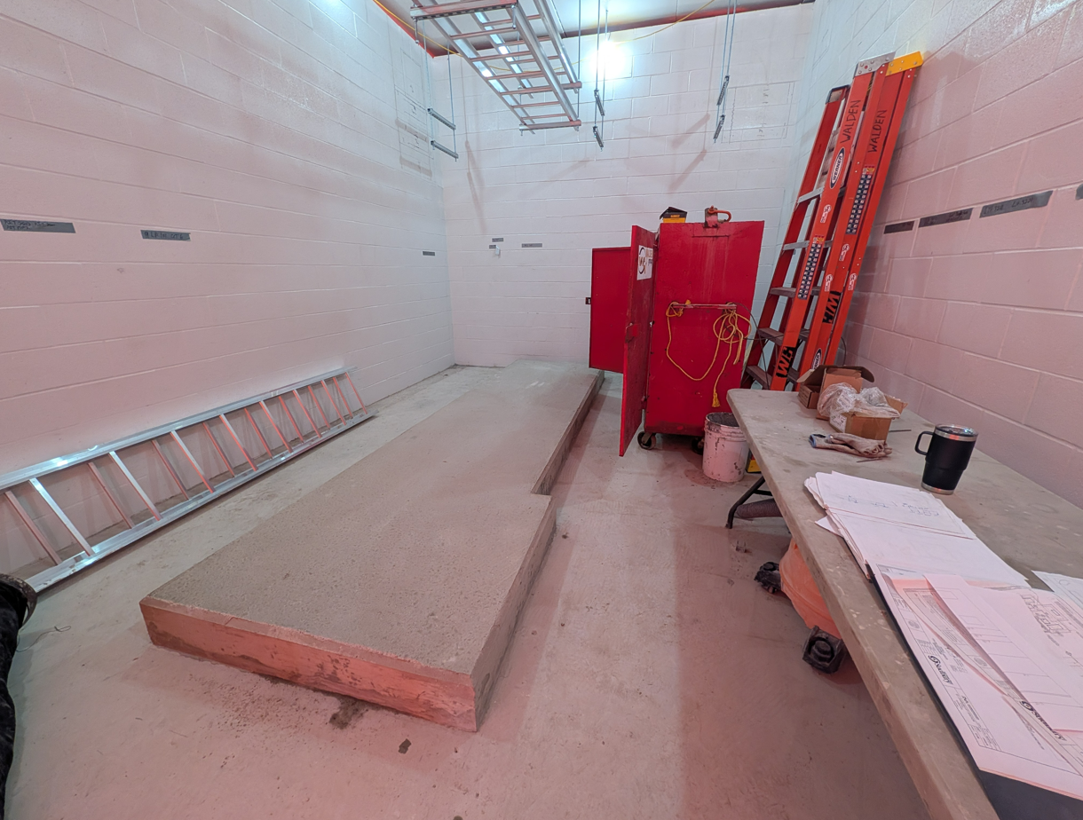
2025 Capital program highlights St. Charles lift station

Slide 6
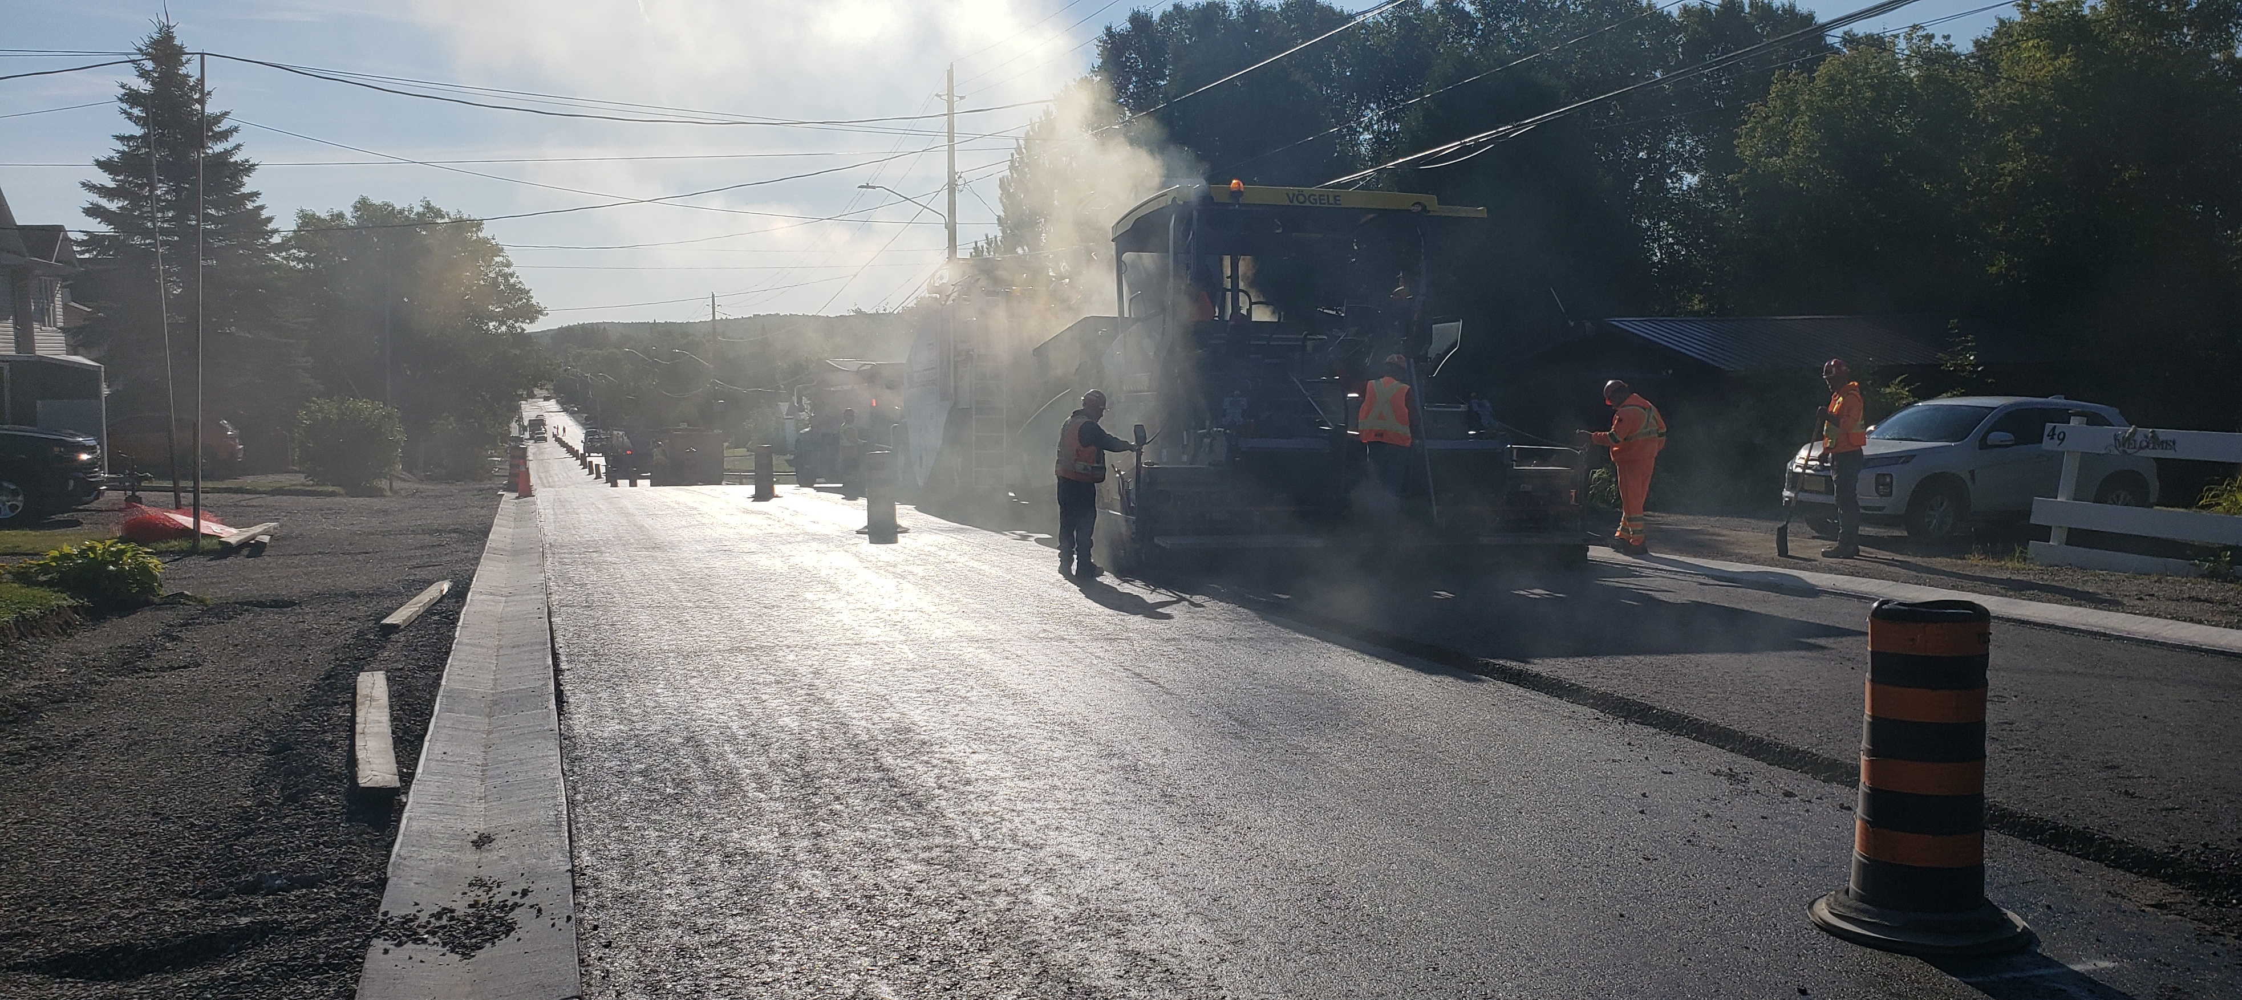
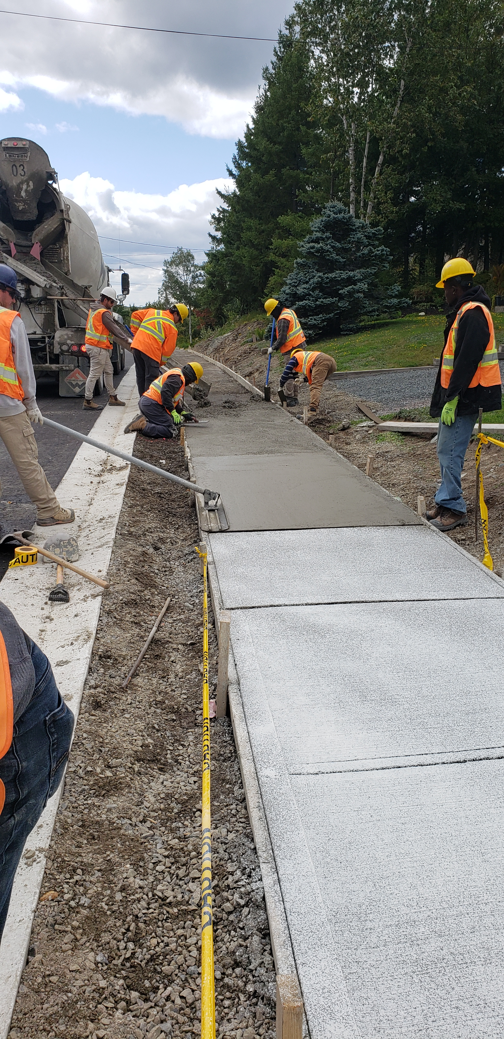
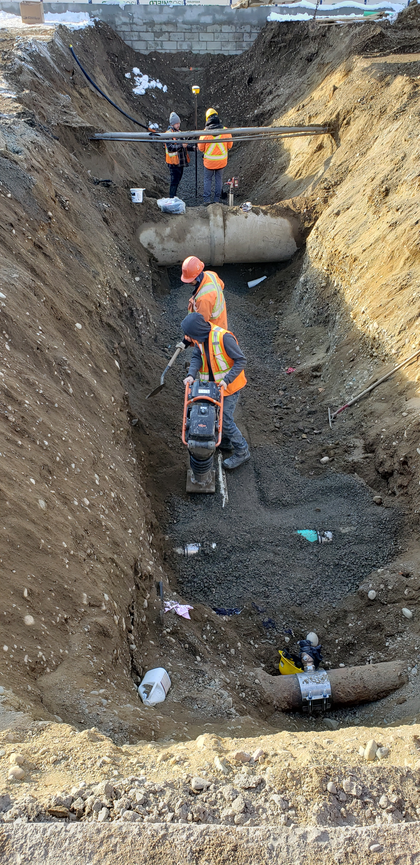
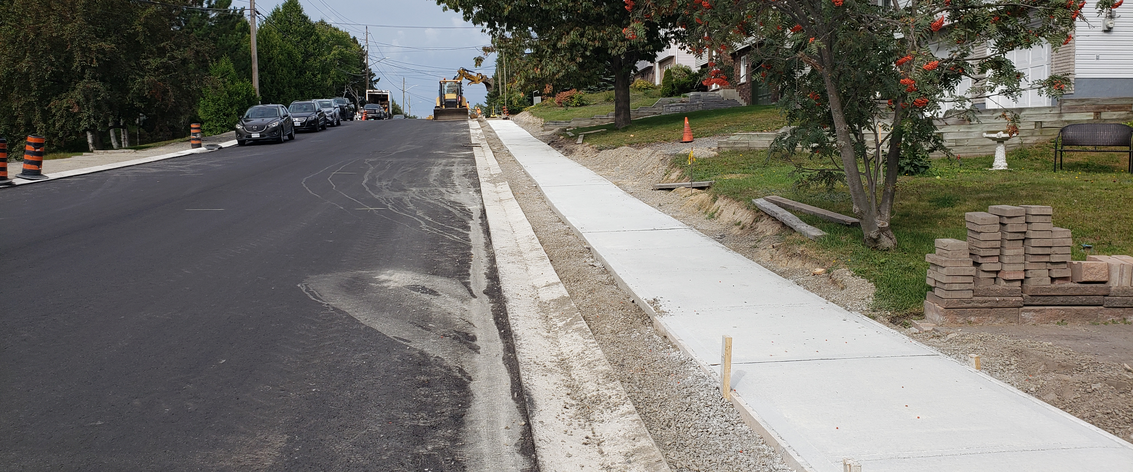
2025 Capital program highlights Hillcrest Drive reconstruction
2025 Annual Contractors Meeting

Slide 7
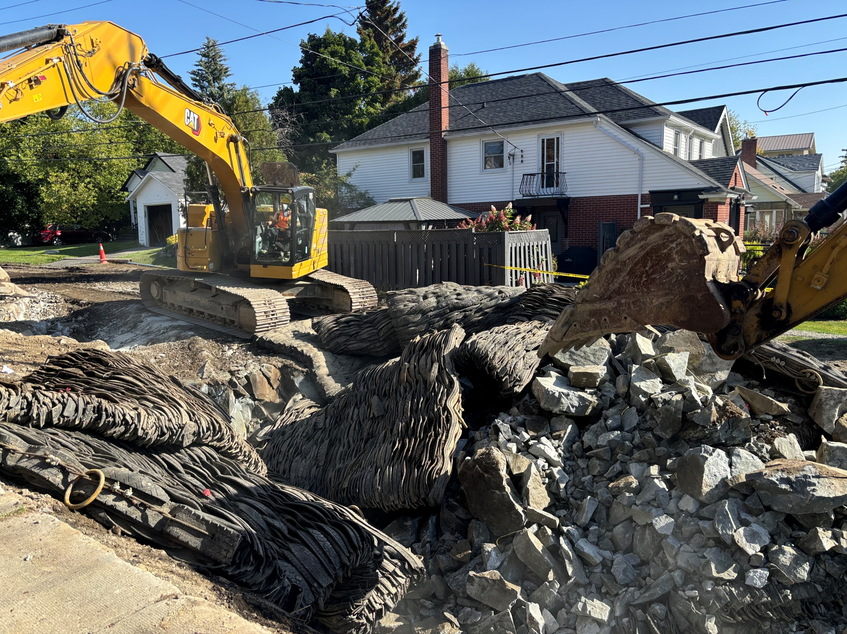
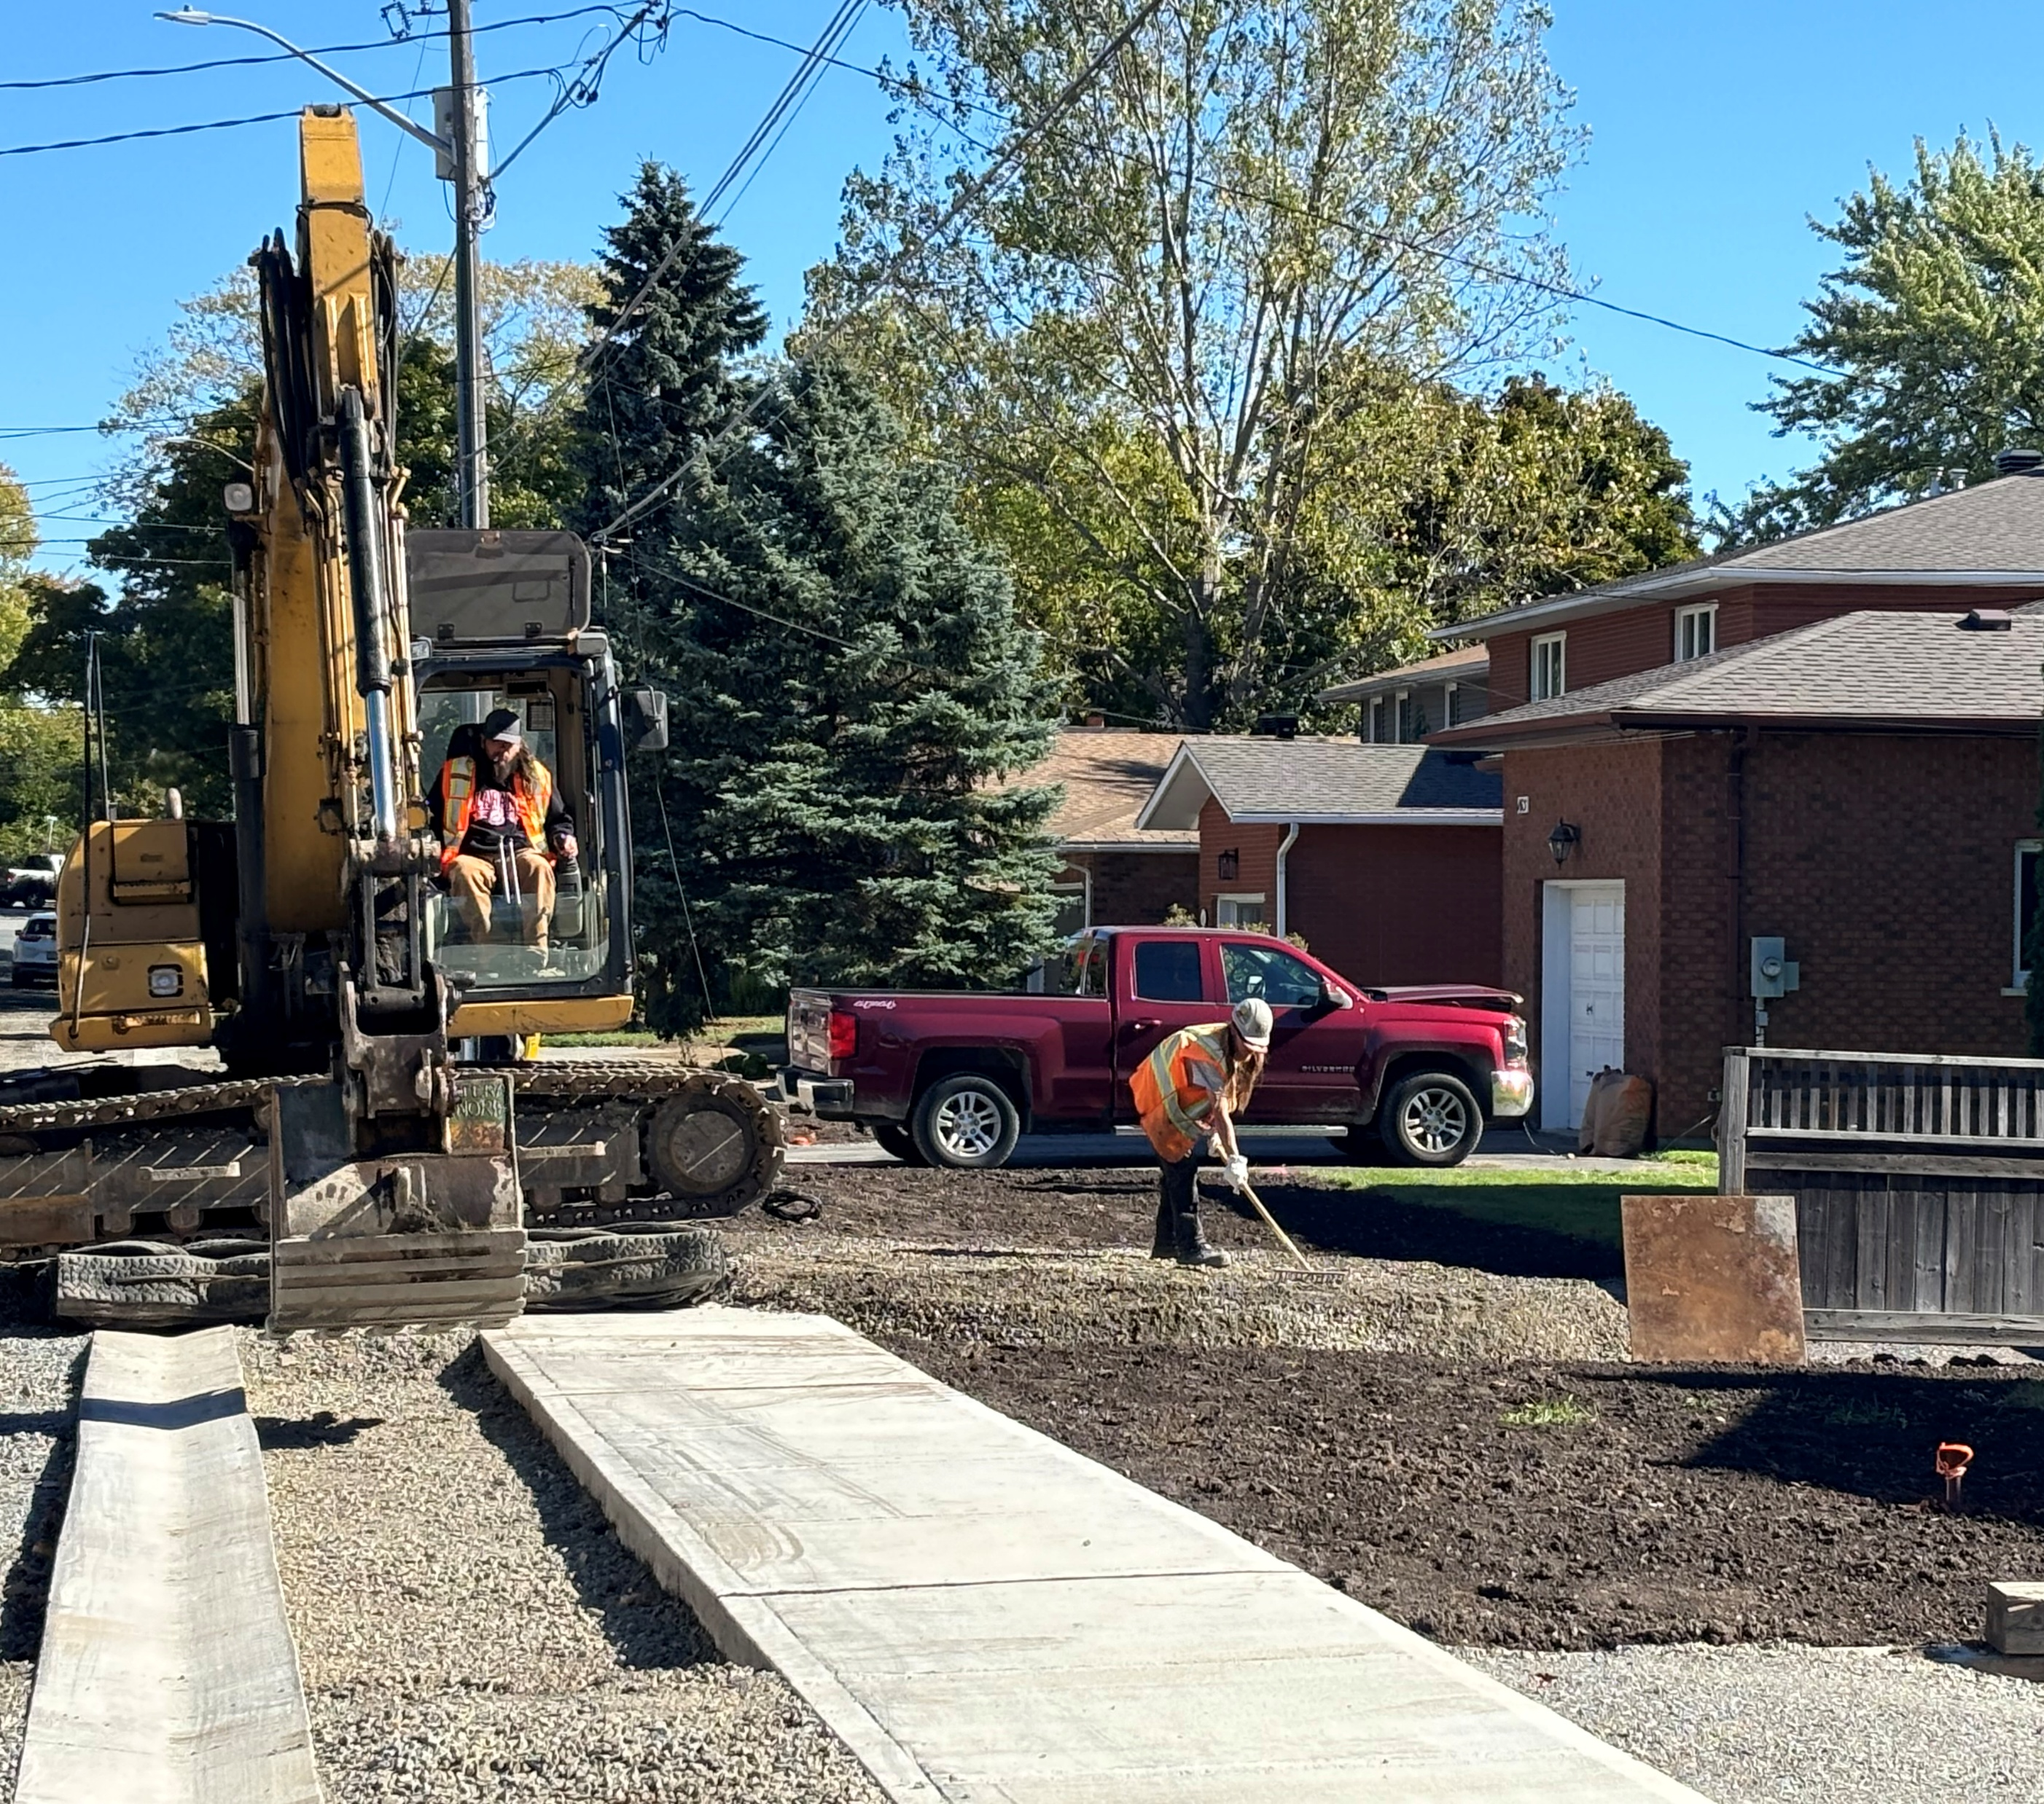
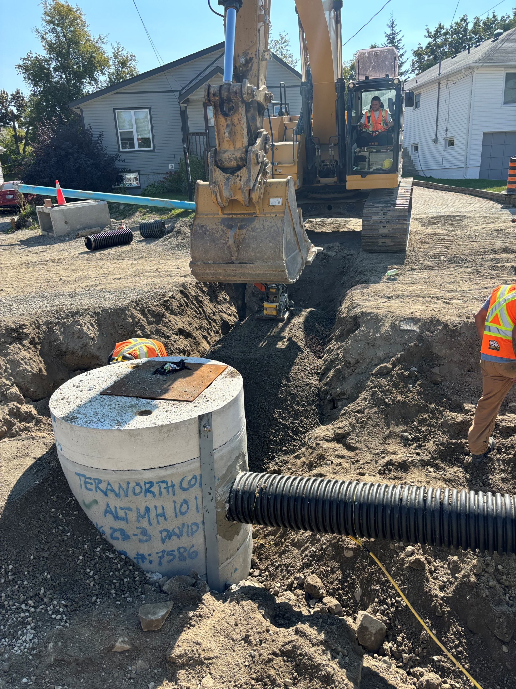
2025 Capital program highlights Marion / David / paris / facer

Slide 8
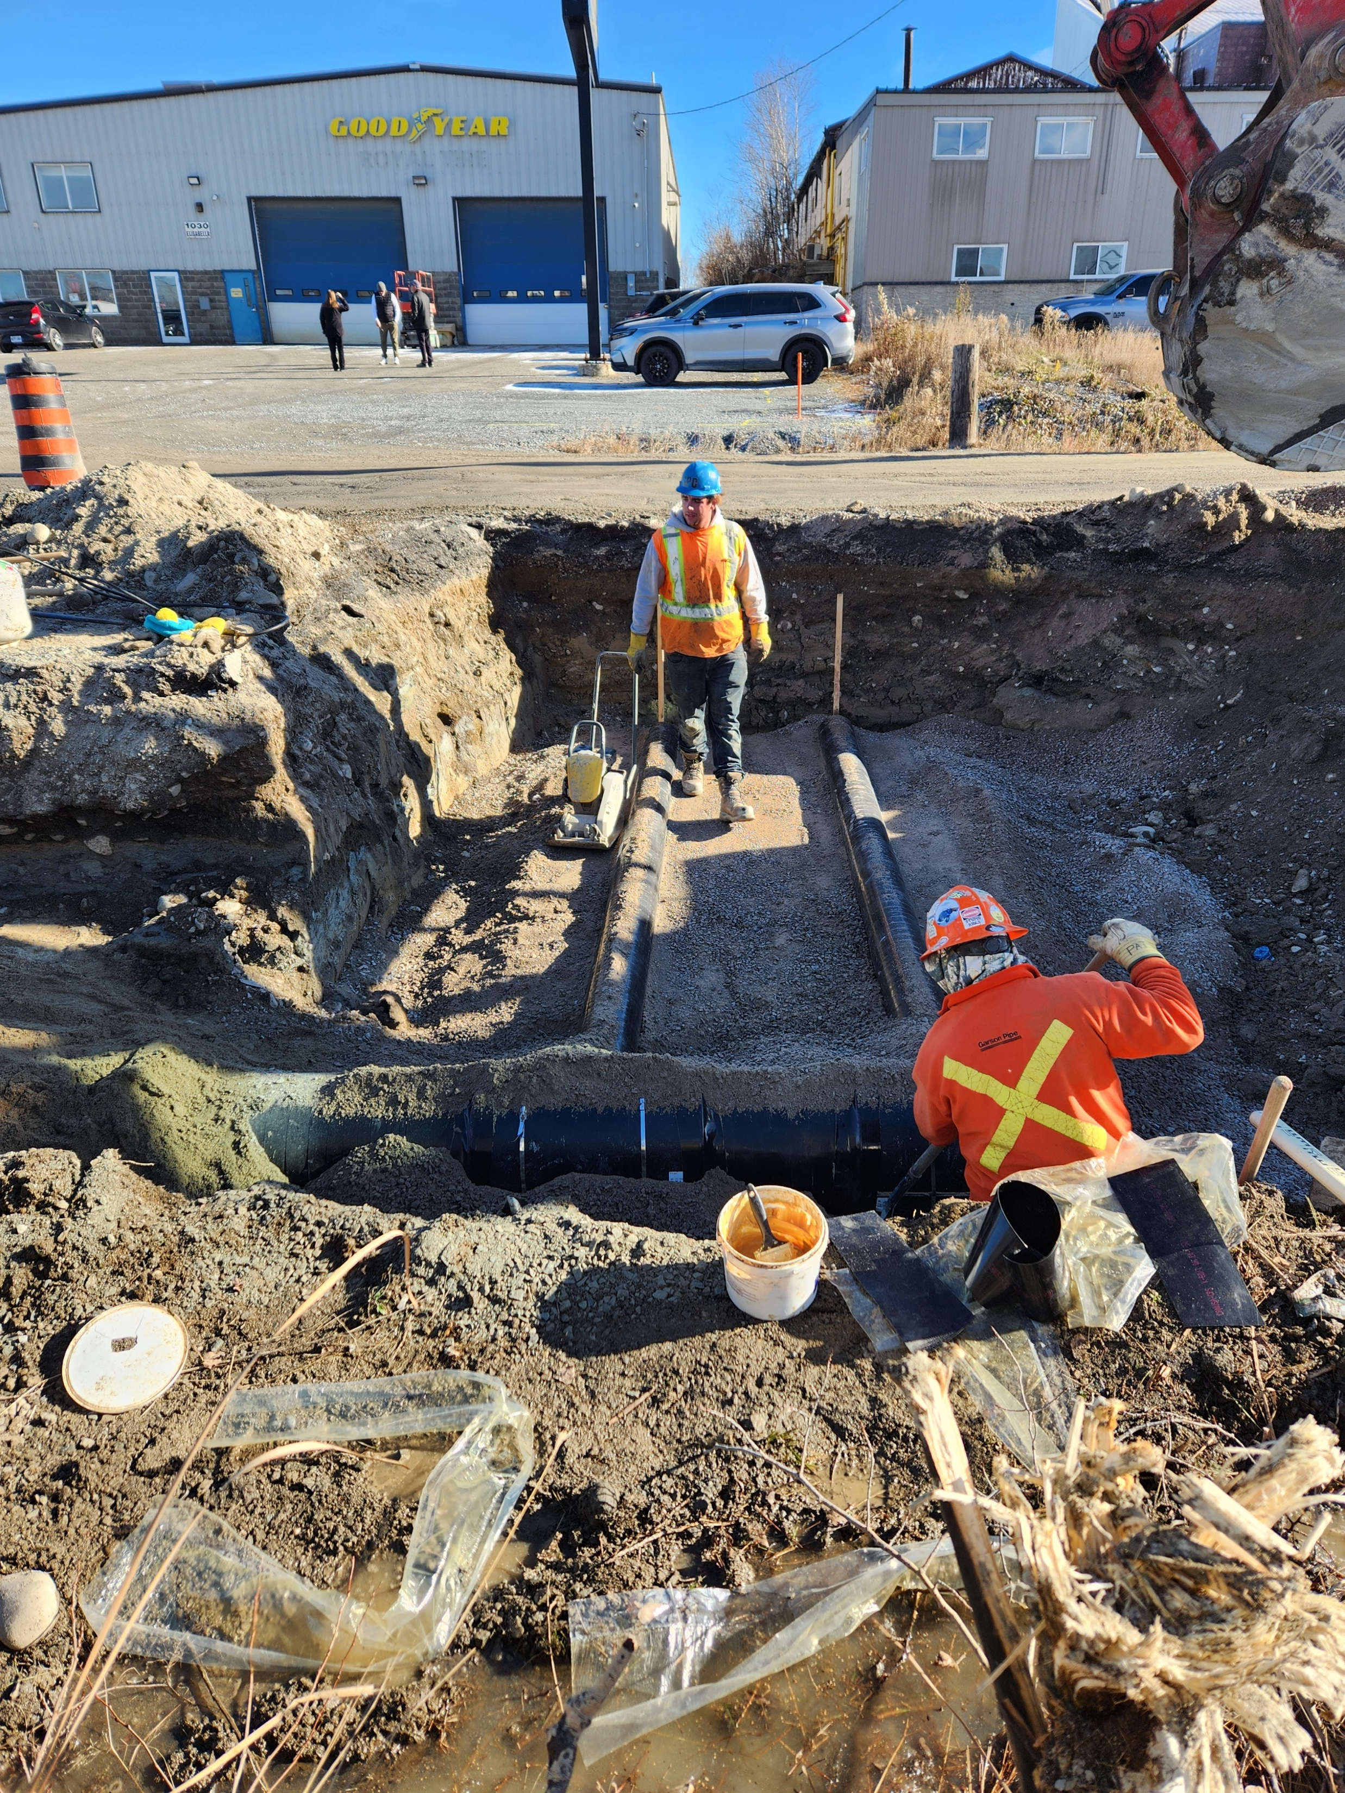
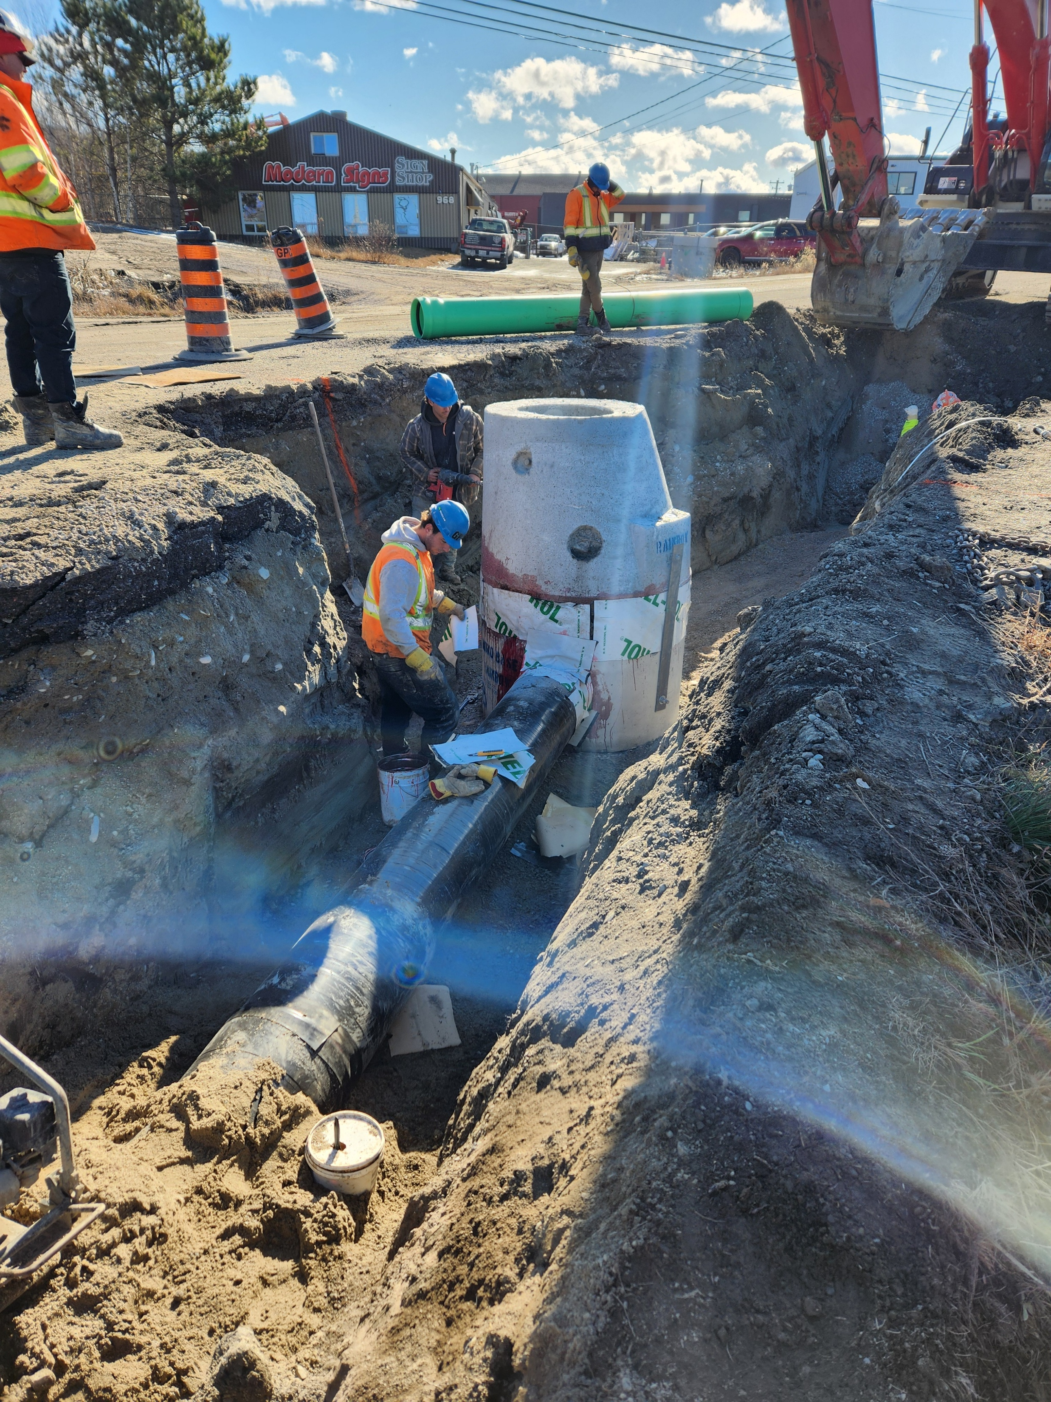
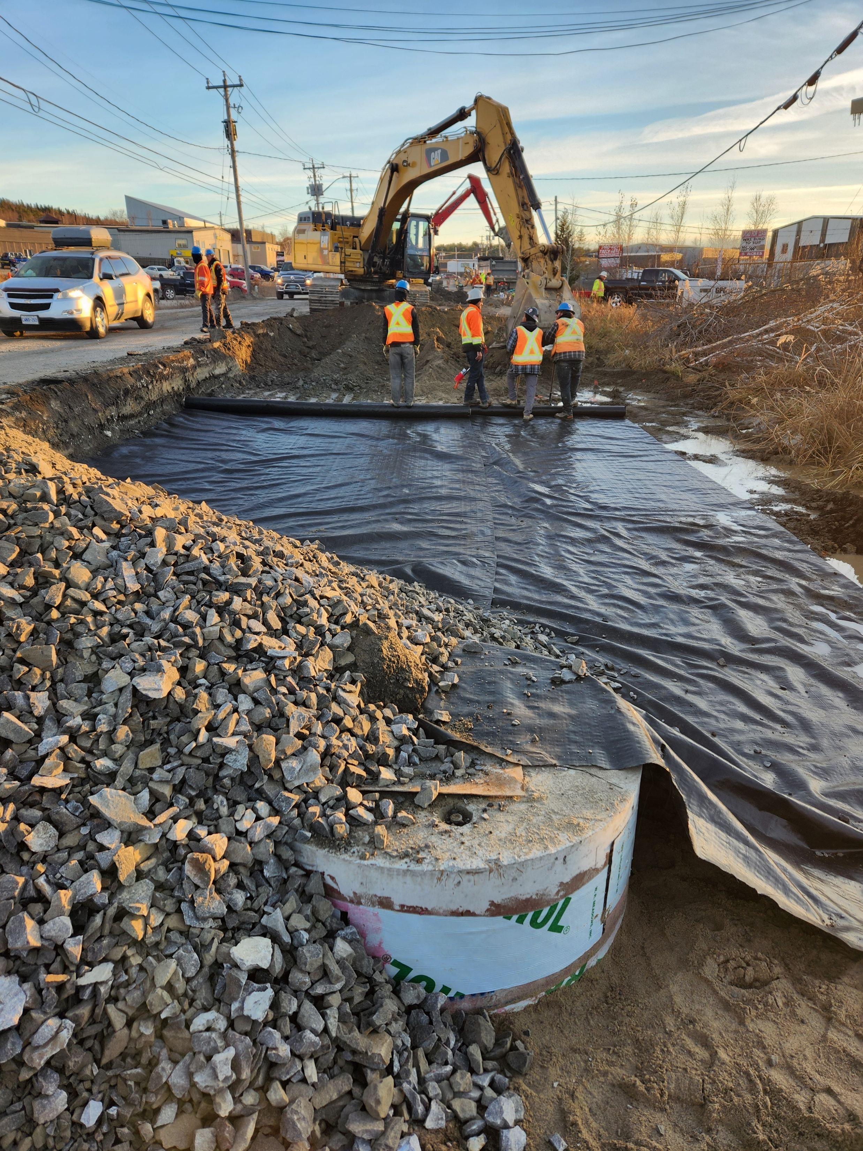
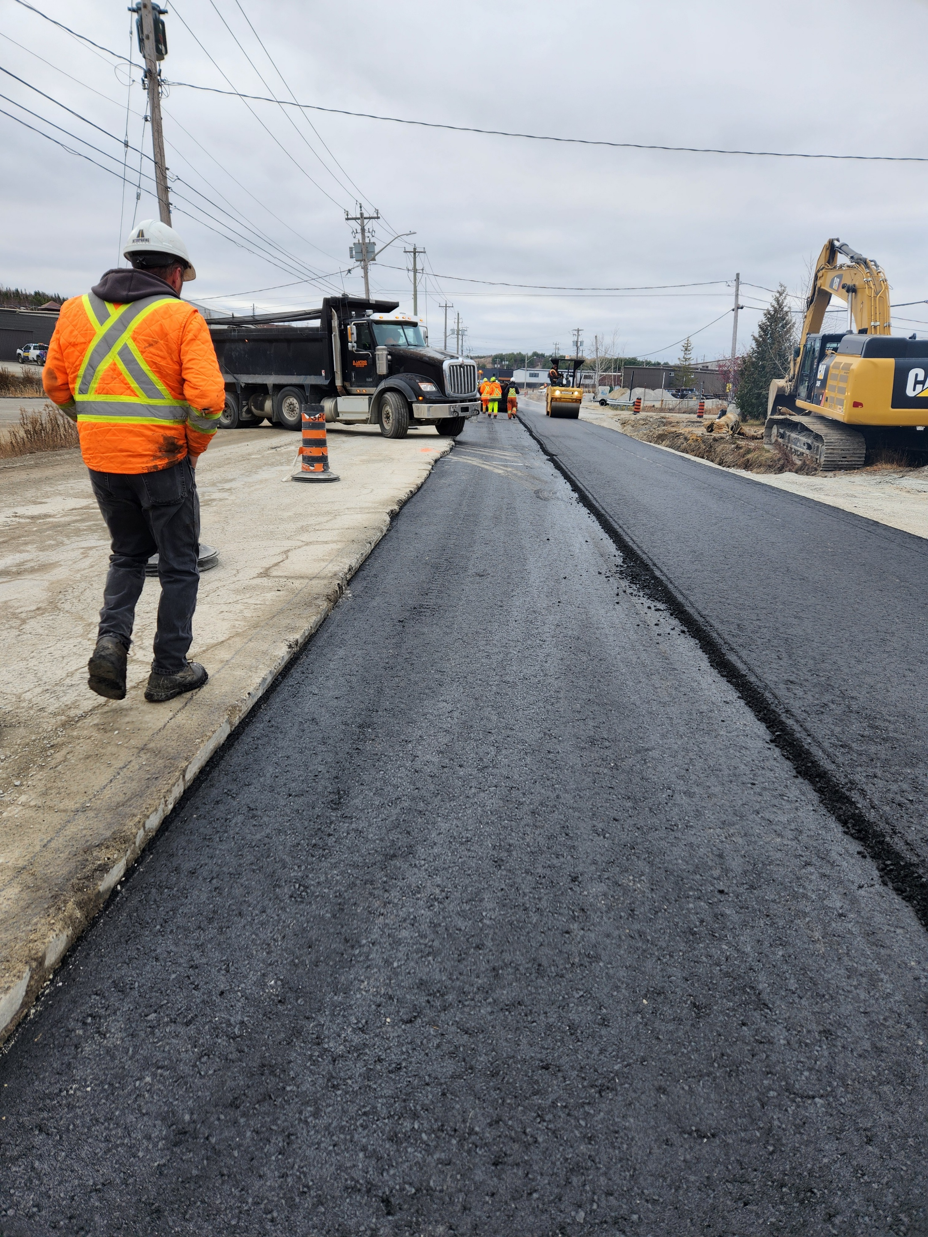
2025 Capital program highlights Phase 2 – Lasalle/elisabella ELS implementation

Slide 9
Capital program Delivery
Office of the CAO
Community Infrastructure
Engineering Services
Construction & Project Services
Design Services
Linear Infrastructure Services
Environmental Services
Water & Wastewater
Infrastructure Assets
Facility Design & Construction
Engineering Services delivers projects that maintain, rehabilitate, renew and expand infrastructure systems, including roads, stormwater collection systems, water distribution systems, sanitary collection systems and fixed infrastructure facilities
Notes:
Provide a brief overview of our service-delivery model…

Slide 10
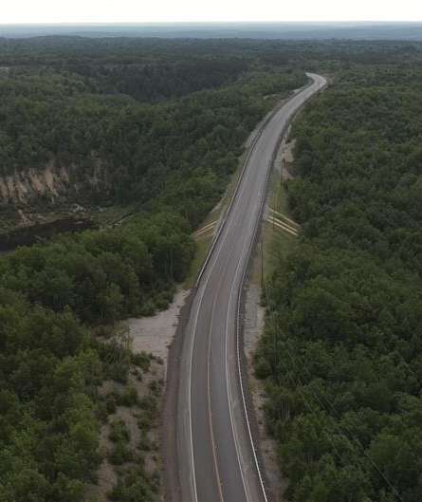
Looking ahead to 2026
2026 Approved Capital Budget: $150M, including more than $73M for linear infrastructure
MR35 Rehabilitation (Big Nickel Mine to Notre Dame in Azilda)
Two $5M Spread Laid Asphalt Patching Contracts
Montee Principale (MR15 to MR35) and MR15 Rehabilitation (W of St. Laurent to E of Belisle Dr)
College Street Underpass
Lively Infrastructure Upgrades
Long Lake Road Reconstruction (St. Charles Lake Rd to Gateway)
Notes:
We recently did a review of our Capital Program, including active projects to confirm expenditures to date, status and remaining funds. The focus was mainly around Road Projects.
Some projects that we’re originally planned for Construction in 2026, were deferred due to things such as property constraints or re-scoping, therefore those funds we’re added in the 2026 Road Rehab strategy plan that was approved by City Council on March 10 2026. The list includes Garson Coniston Road and Second Ave from Kenwood to Bancroft. New projects include the first two on this slide.. MR 35 and Two $5 Million Spreader Laid Asphalt Patching Contracts.

Slide 11
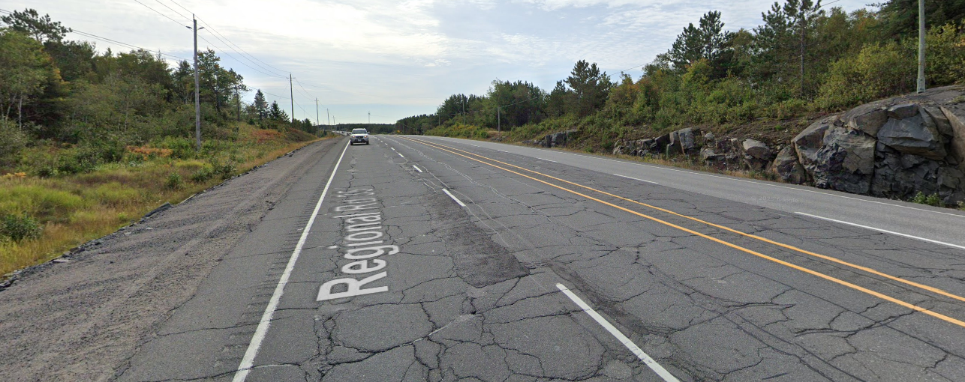
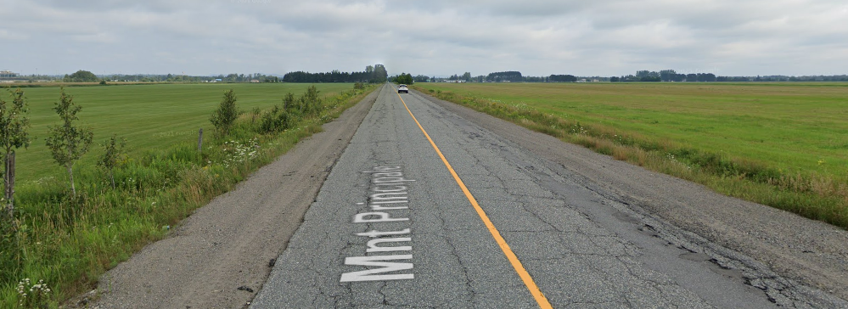
Looking ahead to 2026 MR35, Montee Principale and MR15 Rehabilitation
MR 35
Total of 8.2 km asphalt rehabilitation using a combination of pavement renewal treatments to address localized pavement conditions from Big Nickel Mine to Notre Dame in Azilda
Montee Principale and MR 15
Total of 6.7 km of pavement rehabilitation, shouldering, and culvert replacements which completes a rural link between the communities of Val Caron and Azilda
Notes:
Total project budget - $17M

Slide 12
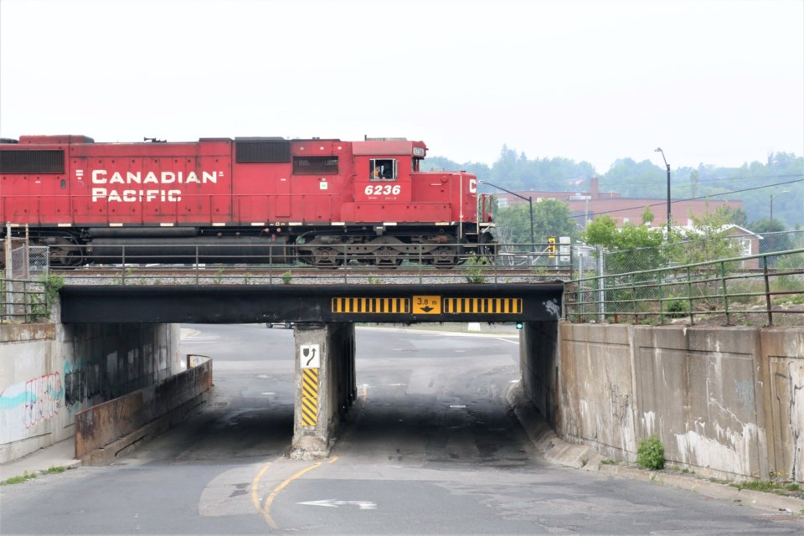
Looking ahead to 2026 College street underpass rehabilitation
Greater Sudbury’s oldest bridge (60+ years)
Budget constraints and competing priorities resulting in bridge rehabilitation-only work to be completed in 2026
Completed EA recommends ultimate solution of five-leg roundabout as preferred intersection design
Improves vertical clearance
Adds cycling and walking facilities
Enables connectivity with future Ste. Anne Rd Extension
Notes:
Total project budget for the approved scope is $8.7 Million. The remaining recommendations that we’re part of the EA will be reprioritized in future years.

Slide 13
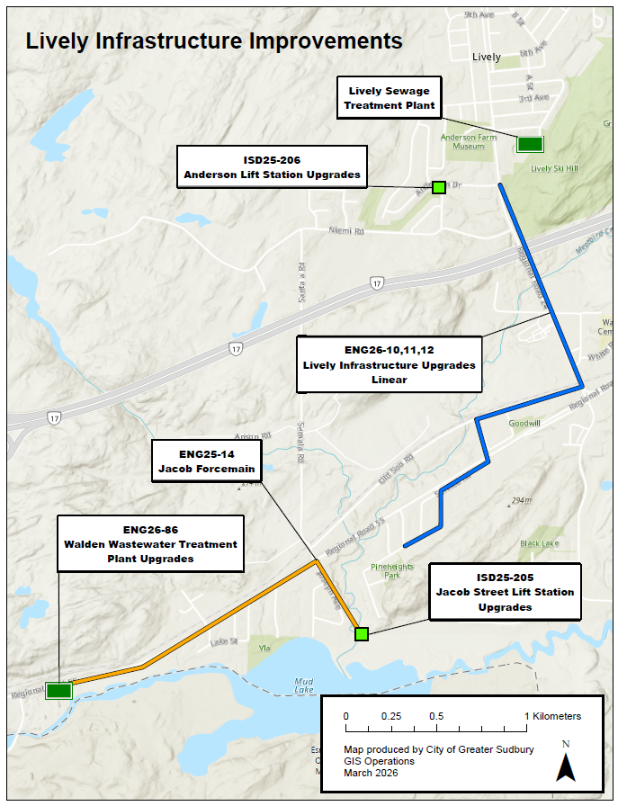
Looking ahead to 2026 Lively Infrastructure Upgrades
7 separate infrastructure projects (4 linear, 3 facilities) with the overall goal to increase sanitary sewer capacity in the community of Lively/Walden
Will unlock 3,300 new housing units (585 of which are shovel-read)
Detailed design and construction of lift station upgrades, linear collection system and WWTP upgrades
Total Project Budget: $70M
$35M from Provincial Housing Enabling Water Systems Fund (HEWSF)
$28M from Federal Government (CHIF)

Slide 14
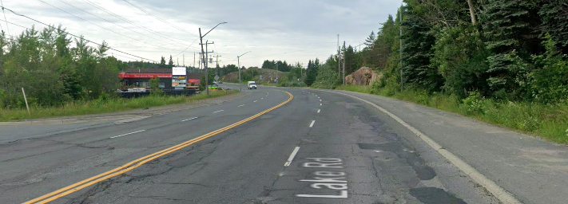
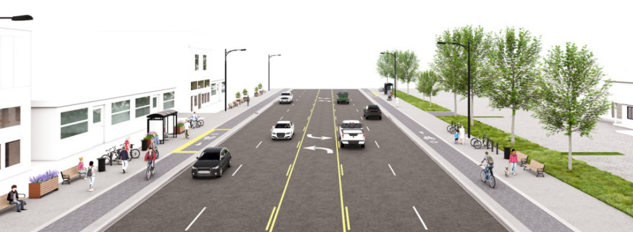
Looking ahead to 2026 Long Lake Road Reconstruction
Greater Sudbury adopted a Complete Streets Policy in 2018
Road reconstruction to align with Greater Sudbury Complete Streets Design Guidelines, adopted in 2025
Currently a 4-lane cross-section, with sidewalk on one side to be transformed into a 5-lane cross-section with the addition of a two-way centre-left turn lane, sidewalks and cycle tracks on both sides of the road

Slide 15
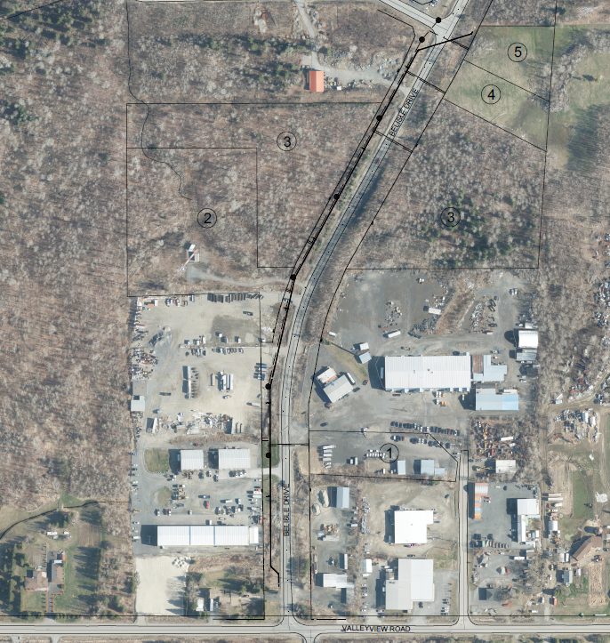
Looking ahead to 2026 Belisle Dr Servicing Upgrades
Employment Land Strategy approved by Council in 2023 identified four strategic employment areas
City is investing in upgrading municipal servicing in these areas to support job creation and investment in local ICI growth
Val Caron Industrial Park on Belisle Drive is on partial servicing
Water and sanitary servicing are being extended south of Lamondin Street
City-owned land will also be serviced to improve its marketability

Slide 16
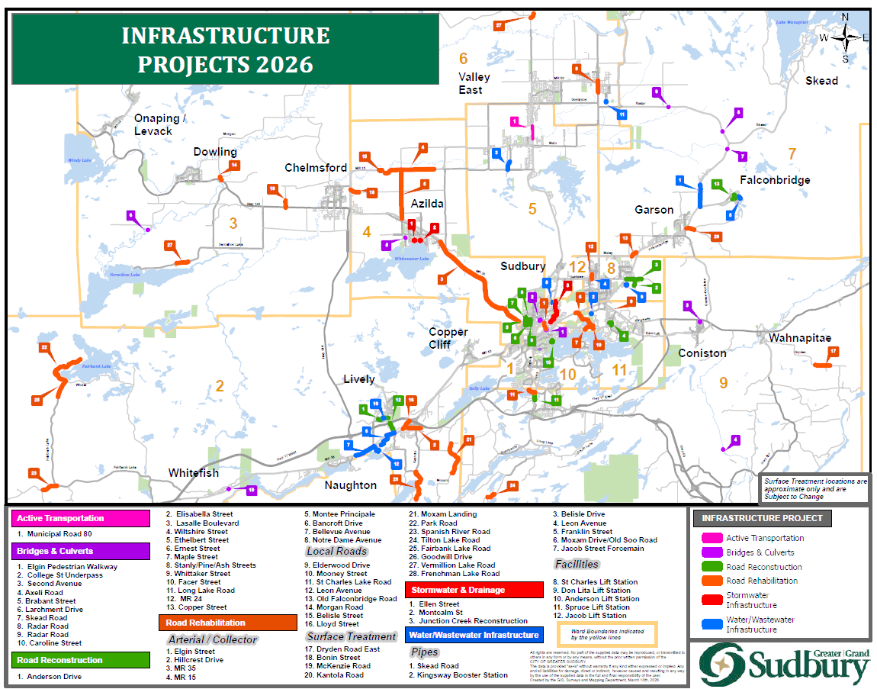
Notes:
Two $5M Spread Laid Asphalt Patching Contracts

Slide 17
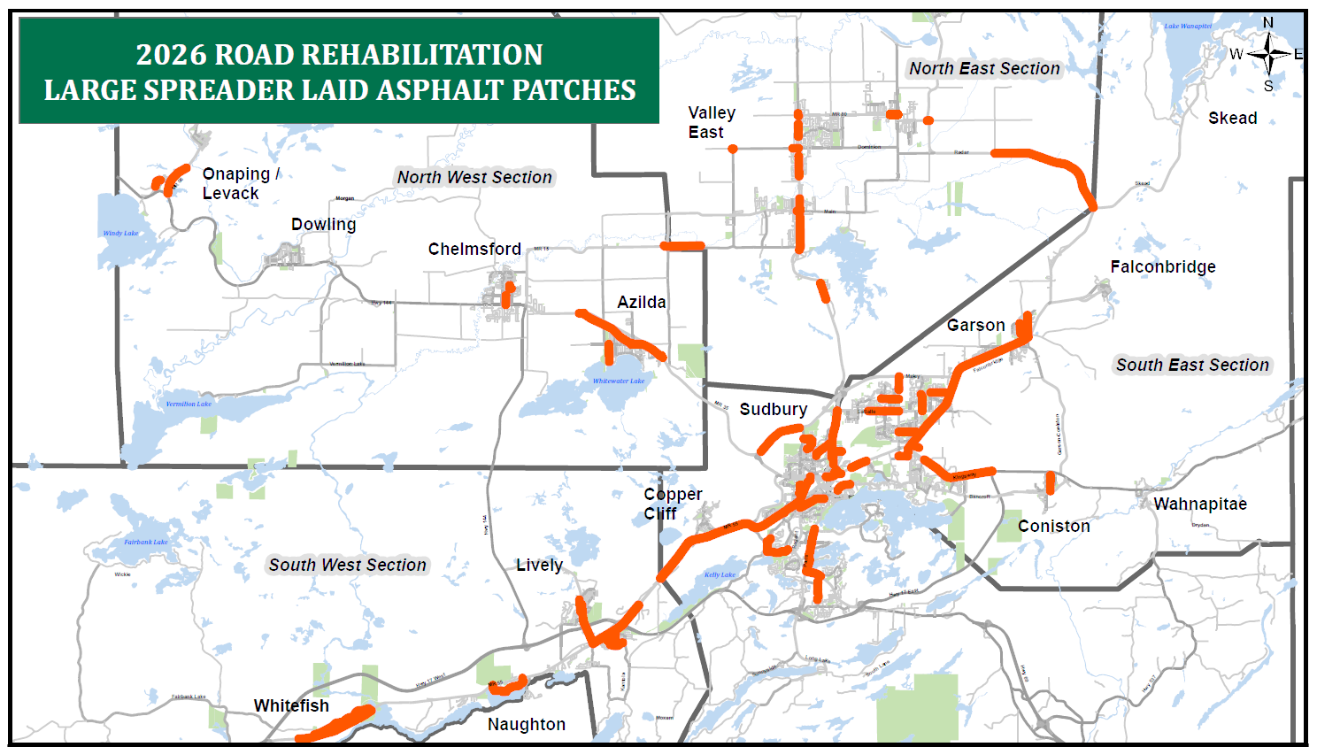
Looking ahead to 2026 Large spreader laid asphalt Patches
On March 10, City Council approved the creation of two (2), $5M large spread laid asphalt patching contracts to accelerate road rehabilitation across the community
Notes:
Two $5M Spread Laid Asphalt Patching Contracts

Slide 18
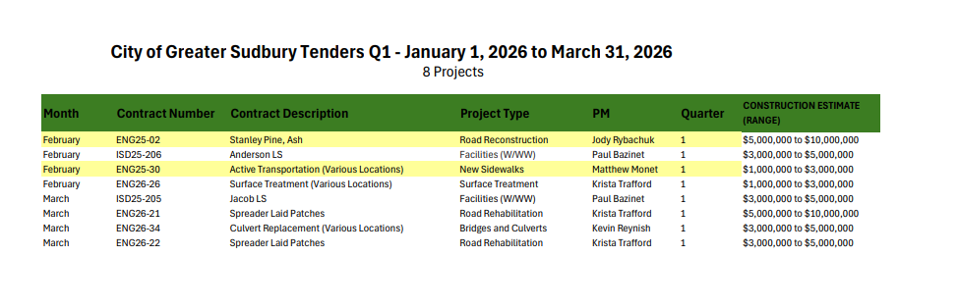
2026 TENDER SCHEDULE

Slide 19
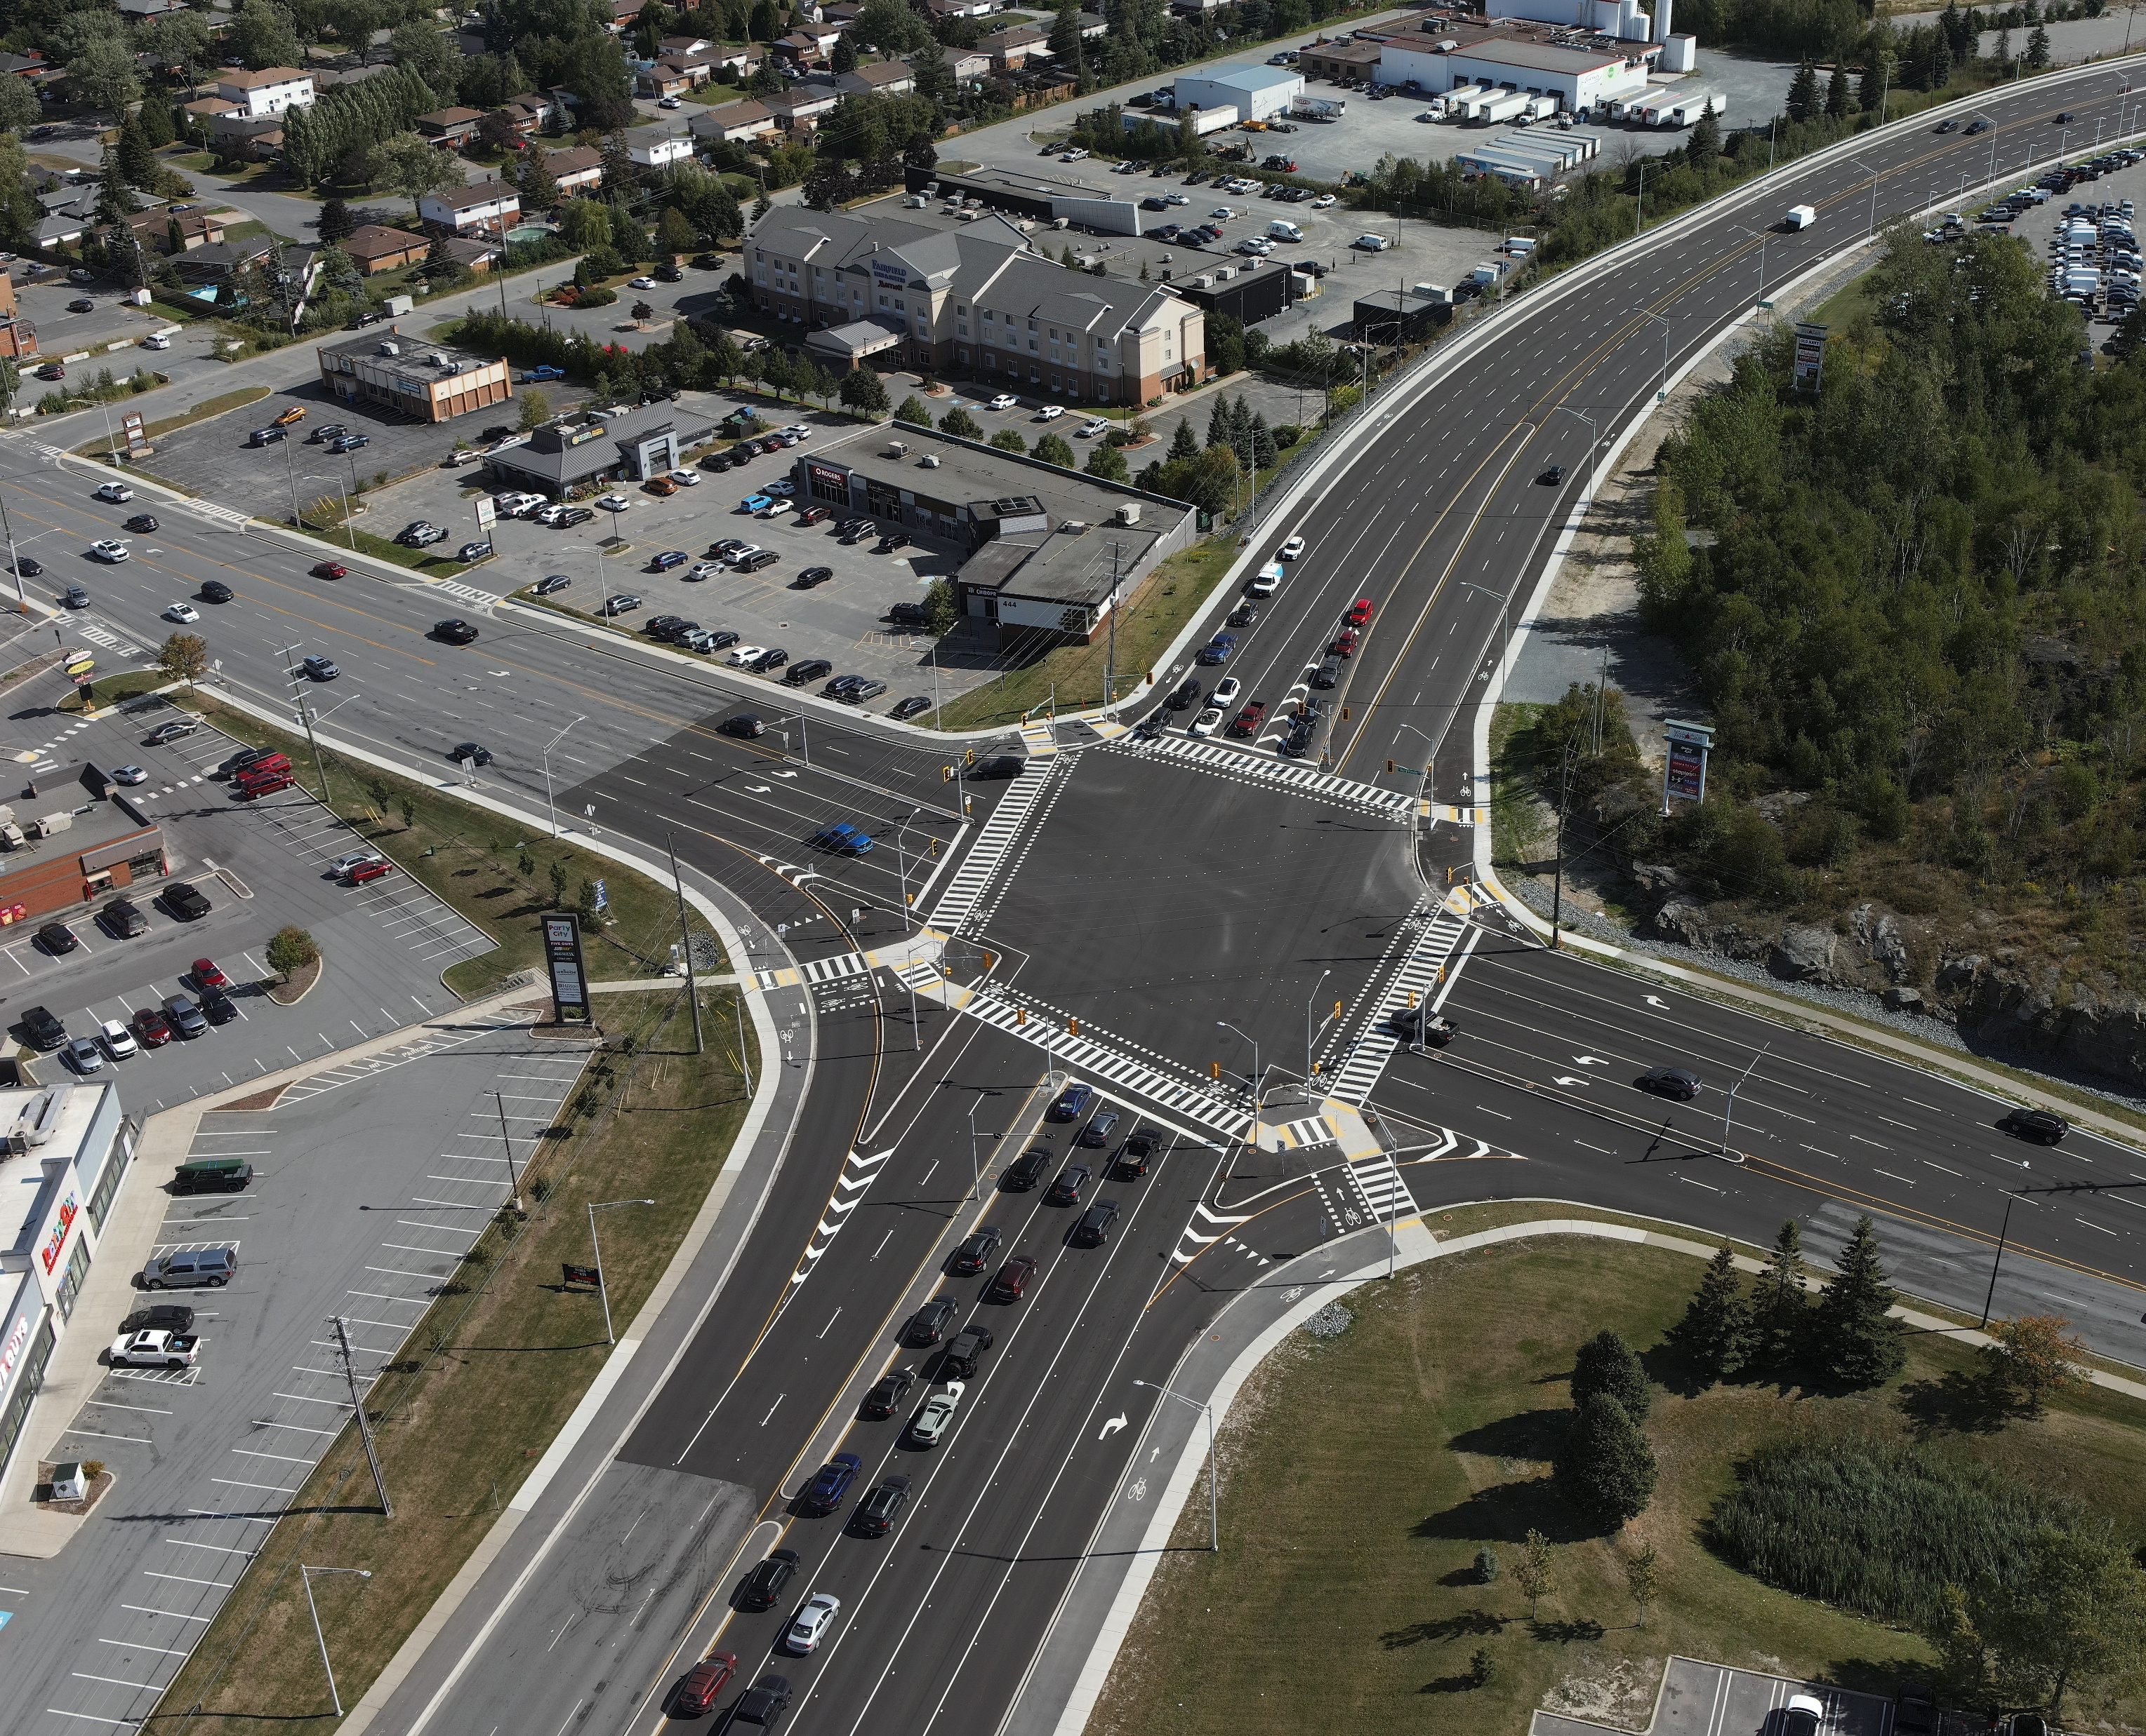
Multi-year Capital Budget
In 2024, Greater Sudbury moved to a 4-year capital plan and budget (2024-2027)
Based on success of this initial multi-year budget, the City is considering moving to a 10-year capital plan in 2028
Annual capital budget updates are still required to address any changes in municipal environment or funding opportunities
Notes:
Benefits of multi-year budgeting:
Improved project planning and execution over several years
Residents and businesses learn of forthcoming community improvements and impacts to services well in advance
Improved pricing and staffing efficiencies are possible, where similar purchases or projects can be combined within the same tender
Contractors can plan for longer-term capital or personnel investments

Slide 20
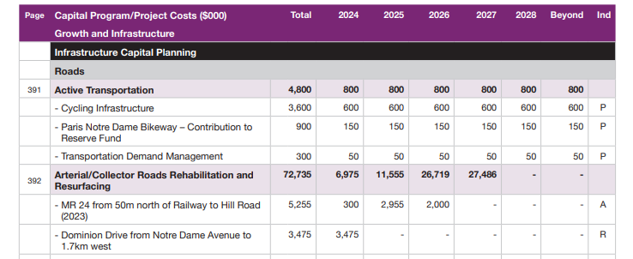
2027 Construction Outlook Highlights
Search “2024-2025 Proposed Budget” for 4-year outlook
Infrastructure Capital Budget Outlook pages 381-386 (of document)

Slide 21
2027 Construction Outlook Highlights
Arterial/Collector Roads Rehabilitation and Resurfacing:
Panache Lake Rd (St. Pothier to Island)
MR55 (Horizon to Simon Lake Dr West)
Lansing Ave (Madison to Maley)
Long Lake Rd (Sunvalley to Tilton Lake Rd)
MR24 (Hill to Anderson and First to Fifth)
Local Roads Rehabilitation and Resurfacing:
Lapointe St (Centennial Dr to MR80)
Mont Adam St (Lloyd St to Leslie St)
Greenwood Dr (Bayridge Crt to Fourth Ave)
Fourth Ave (Mildred St to Greenwood Dr)
Aurore St (West End to East End)
Michael St (Hwy 144 to Aurore St)

