Slide 1
SPECIFICATION UPDATES, ANNUAL PREQUALIFICATION & GNSS Network
JOEY CRISPO, C.E.T.
DESIGN SERVICES COORDINATOR

Slide 2
1) SUPPLEMENTAL SPECIFICATIONS (GSSS)
Notable updates include:
OPS 407 MUNI - MH, CB, DI and VC Installation
Language added for parging the inside and outside of pipes at structures
OPS 441 MUNI – Watermain Installation
PVC-O is now an approved material type for watermain pipe
OPS 180 MUNI – Management of Excess Soils
Revised reporting requirements and new forms contractors must use

Slide 3
2) SUPPLEMENTAL SPECIFICATIONS (GSSS) Cont
Some other specification updates:
OPS 304 MUNI – Surface Treatment
OPS 409 MUNI – CCTV
OPS 410 MUNI – Pipe Sewer Installation
OPS 511 MUNI – Rip-Rap, Rock Protection, and Granular Sheeting
OPS 1010 MUNI – Aggregates

Slide 4
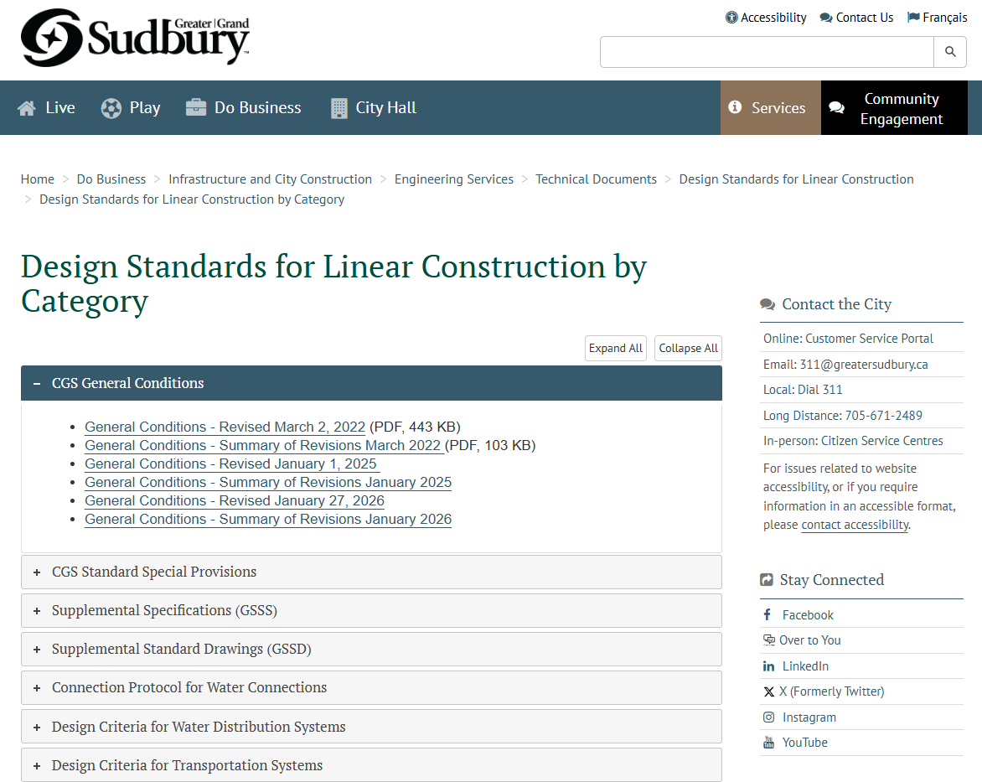
3) Summary of revisions & updates
Summary of Revisions and Update Specifications can be found on the City Engineering Services website:
https://www.greatersudbury.ca/do-business/infrastructure-and-city-construction/

Slide 5
4) Complete Streets
Original Complete Streets Policy was approved by City Council in June 2018​
  A Complete Street is designed to meet the needs of all users, including pedestrians, cyclists, transit riders, and drivers, while considering varying ages and abilities. ​
Complete Streets Design Guidelines was approved by City Council in June 2025​
  Guidelines represent the City’s official direction for planning, designing and implementing transportation infrastructure.
  The City is currently working on updates to standard drawings (GSSDs) which will be uploaded to the City’s website soon.

Slide 6

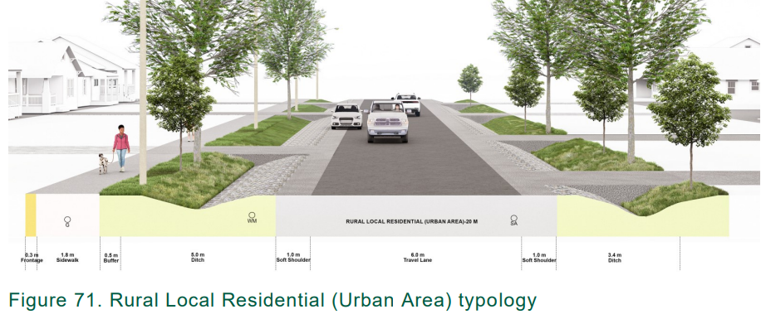
5) Complete Streets
Detailed information regarding Complete Streets including typologies for various road classes can be found on the City Transportation website:
https://www.greatersudbury.ca/live/transportation-parking-and-roads/complete-streets/

Slide 7
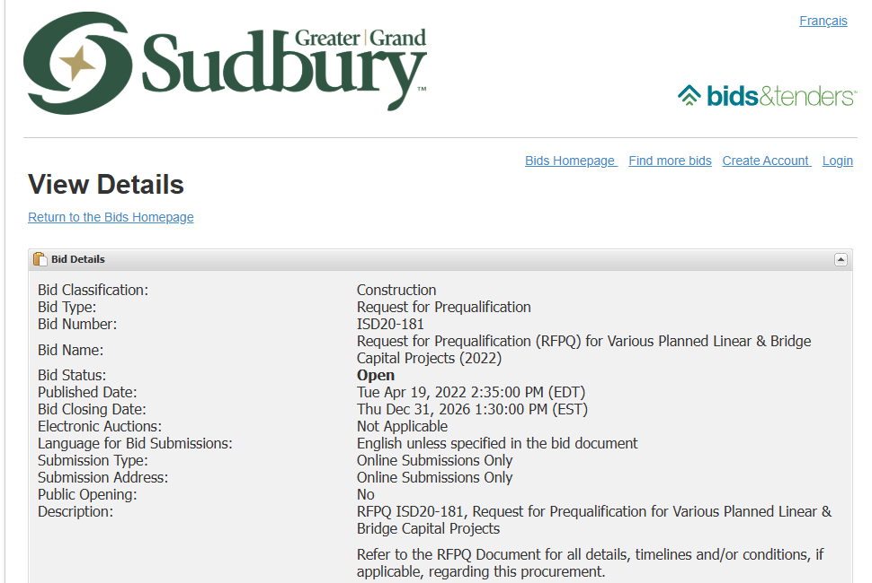
6) ISD20-181 - RFPQ ANNUAL PREQUALIFCATION
Addendum #3 issued in December 2025 to extend the closing date until December 2026 of this year.
City will be issuing a new annual prequalification (RFPQ) to replace existing ISD20-181 in Q4 of 2026.

Slide 8

7) CGS GNSS Network
The City has created its own GNSS network. This network will ensure all surveyors have the network tools they need for accurate data without the need to setup a base and localize on a job site. (SIM card or hotspot still needed, Bell towers recommended). This will be available free for all City capital project work.

Slide 9
8) CGS GNSS Network
We will ensure your data collectors have Zone 81 and have the right settings. The network will be an RTCM3.x MSM7 network (Same as Topnet RTK_MSM or Smartnet MSM_NEAR) mainly, with legacy support a consideration later if needed.
To get on the initial list please contact Zach at: zacharie.dubois-parent@greatersudbury.ca

