Slide 1
Watermain Connection Protocol
Brittany Hallam, P.Eng.
Director of Linear Infrastructure Services

Slide 2

Supervisor Contract Information
- Distribution & Collection
  Area: Onaping, Levack, Dowling, Chelmsford, Lively, Copper Cliff, the Valley, Capreol
          Kyle McLean x 5227
          Jesse Bertrand x 3659
  Area: Sudbury, Garson, Coniston, Wahnapitae, Falconbridge
          Don Pilon x 3639,
          Roger Joanisse x 3607,
          Larry Cormier x 3662

Slide 3
Role of an OIC and Distribution & Collection Staff
  Review bib plans ensuring operational feasibility and adequate supply of water for customers
  Operation of all valves and hydrants
  Review to ensure adherence to all testing procedures prior to connection.
  Witness all connections including connection of the bib system to the live water system.
  Attend watermain and bib breaks to determine next steps to allow for reinstatement of service
  All watermain tapping.

Slide 4

Booking Distribution & Collection Staff
Requires 48hrs notices for scheduling purposes
Specify what work will be completed
TI = Trouble Investigator
OIC = Operator-In-Charge

Slide 5
Temporary Water Supply Systems
  RPZ backflow preventers, supplied by the contractor and the installation certified on site.
  If a temporary water supply system shut down, it must be recommissioned and resampled.
  If there is a break, Distribution & Collection should be called immediately to witness the damage and repair.
  Note: It is at City staff’s sole discretion, what is required in order to safely place the bib back into service.

Slide 6
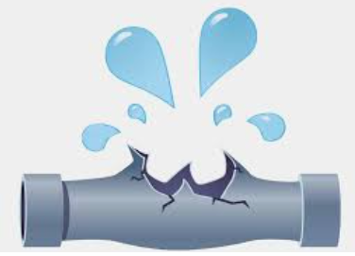
Watermain Break
  If there is a watermain break within the construction zone, D&C should be immediately called to attend site.
  City staff, under their operating licenses, have the sole discretion to determine what must occur to safely place the watermain back into service.

Slide 7
Thank You!

