Slide 1
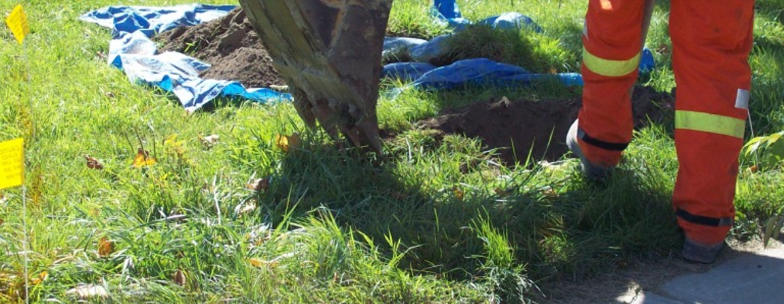
Plant Damage Prevention – A Shared Responsibility
Municipal Outreach Presentation 2022
Chris Van Daele

Slide 2
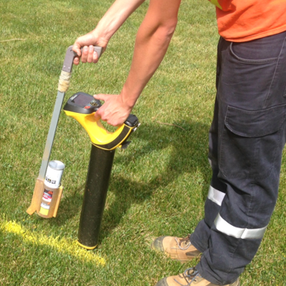
Agenda
Damage Prevention
Statistics Overview
Impacts of damages to gas infrastructure
Municipal strategies to consider
Duty of employer
Emergency line hit safety
Abandoned plant review
Sewer Cross Bore safety

Slide 3

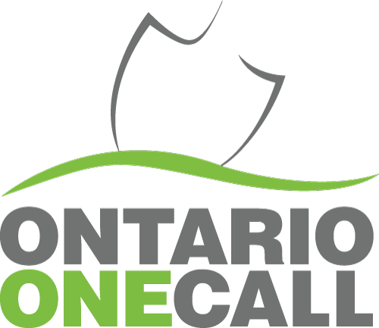
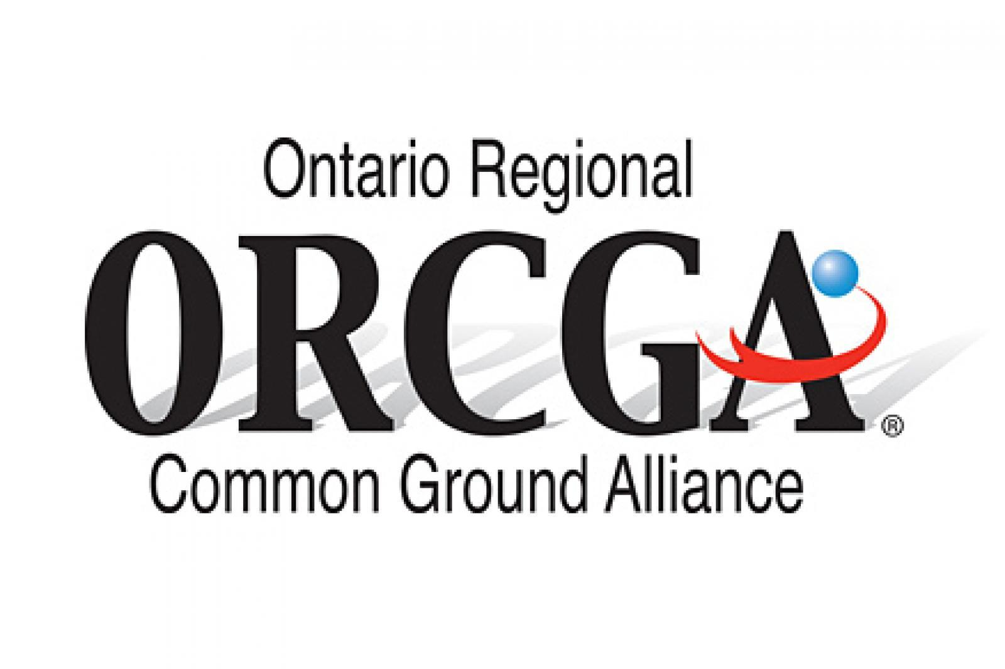
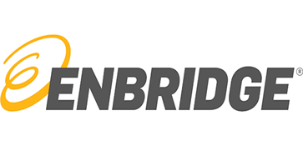
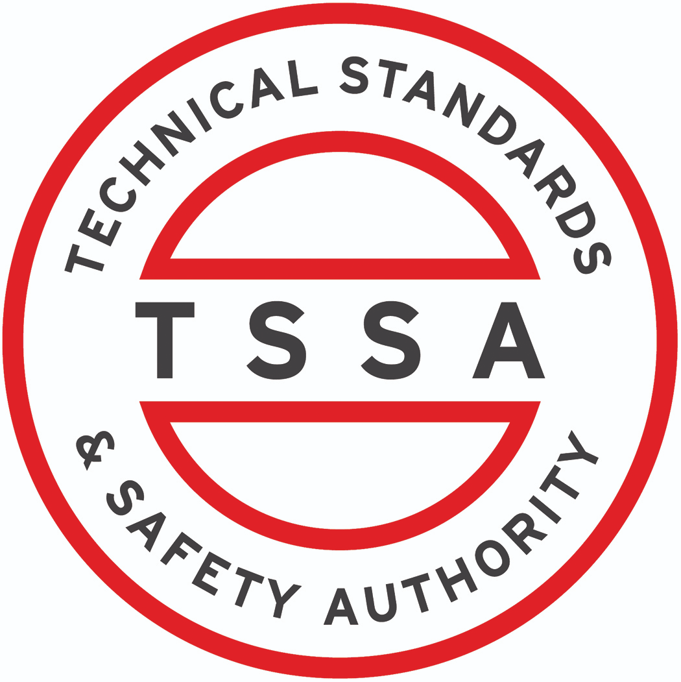
What is Damage Prevention?

Slide 4
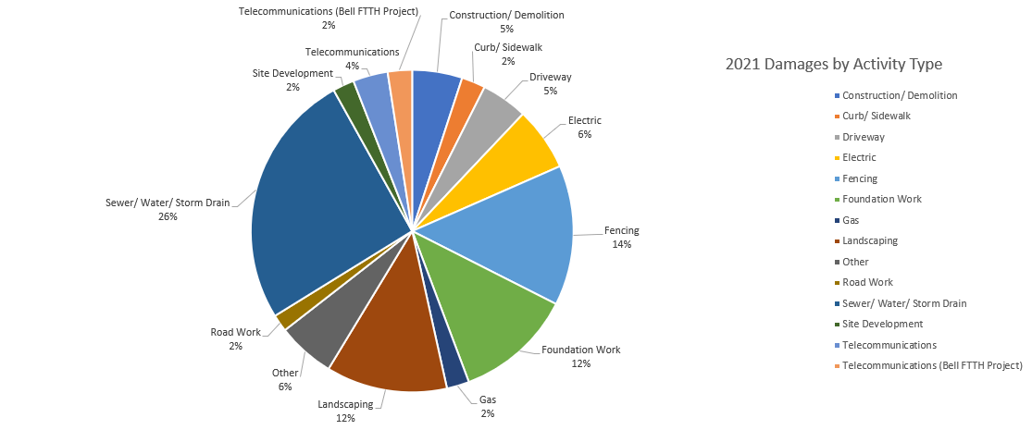
Stats

Slide 5
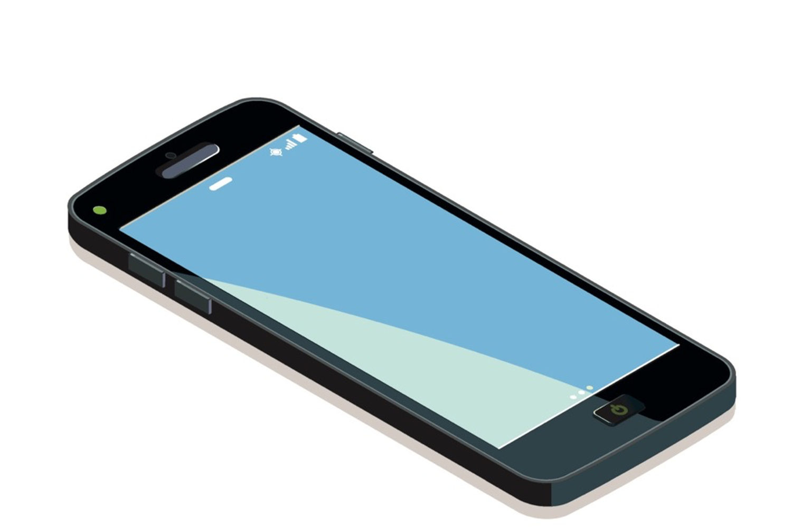



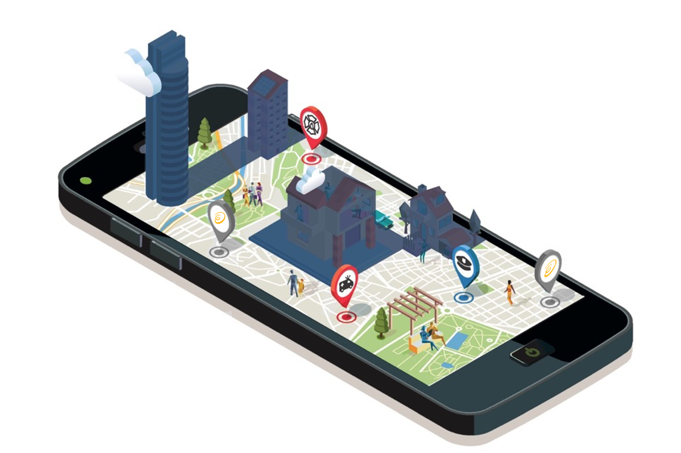
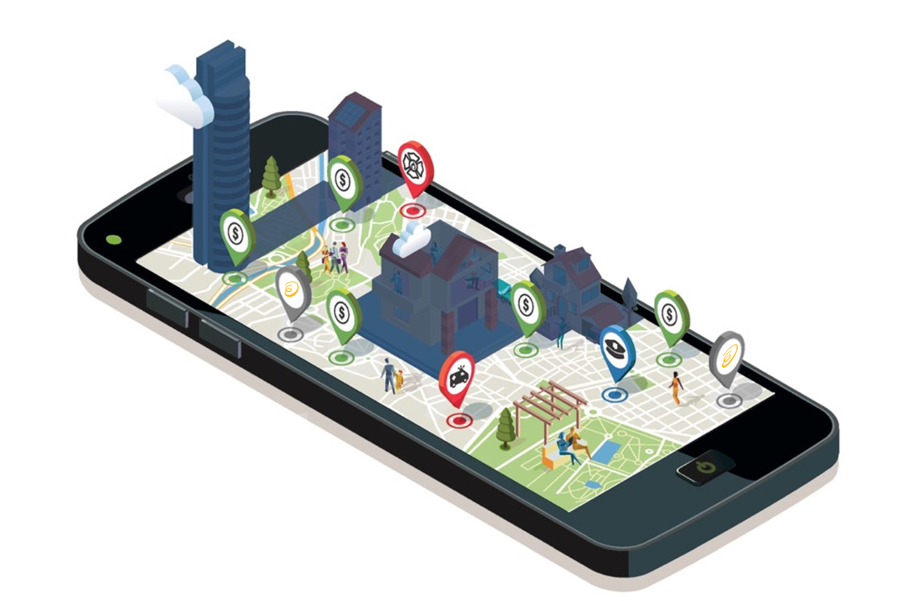
Why is damage prevention important?

Slide 6
Pipeline Damages
The consequences
Explosion
Fire
Injuries/fatalities
Natural gas spills and emissions (environmental impacts)
Interruptions of gas supply to customers
Potentially severe costs and legal penalties to individuals/organizations
Public perception

Slide 7

The importance of putting focus on hiring safe and prudent contractors
What is Bill C-45?
Bill C-45 is federal legislation that amended the Canadian Criminal Code and became law on March 31, 2004. The Bill established new legal duties for workplace health and safety, and enables serious penalties for violations that result in injuries or death. The Bill provided new rules for attributing criminal liability to organizations, including corporations, the representatives and those who direct the work of others.

Slide 8
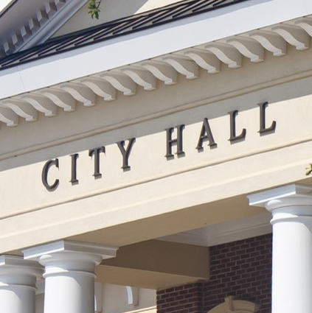
Municipal strategies to consider
Contractual consequences for utility damages
Mandatory utility damage reporting to municipality
Include utility damage history during project proponent bid evaluations.
Enbridge has started a program to award safe contractors with a certificate.
Mandatory training
Consequences for repeat damages on a project
Dedicated locator – continued on next slide

Slide 9

Any Questions?

