Slide 1
Customer Service
Presented by:
Miranda Edwards
Engineering Services, Project Manager

Slide 2
7 Guiding Principles
Customer Service Standards
Recruit, train, empower and recognize employees
Resolve issues on a first contact basis where possible
Knowledgeable staff with the right information to provide answers

Slide 3
7 Guiding Principles
Measure and improve customer service performance
Use technology to leverage opportunities and issues
Positive customer service culture is part of the City’s brand

Slide 4
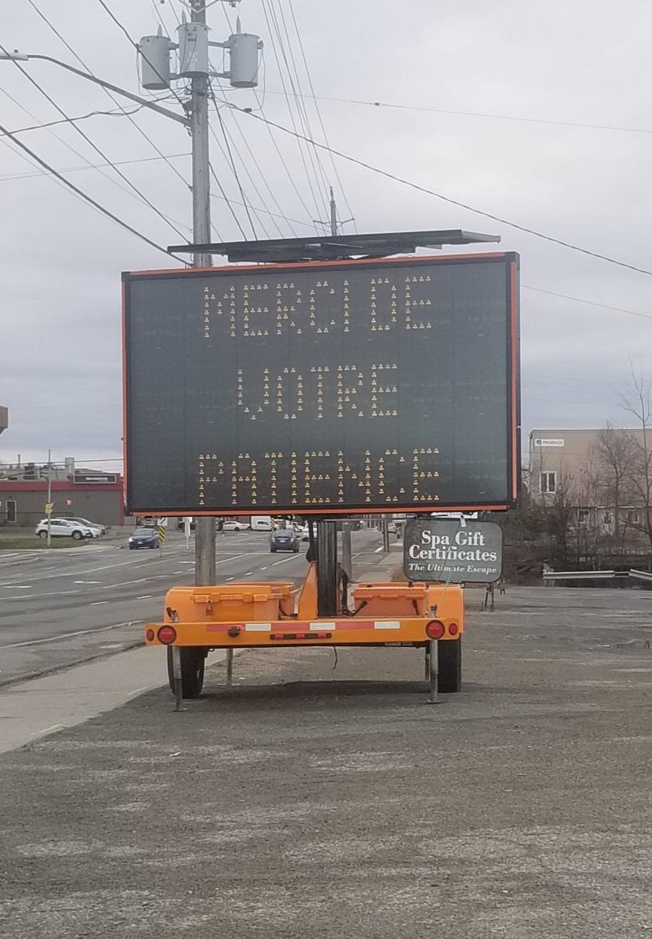
Contractor Expectations
Make the worksite accessible to all
Bilingual Notices and non-regulatory signs
Appropriate notification when affecting services or impacting traffic

Slide 5
Questions?

