Slide 1
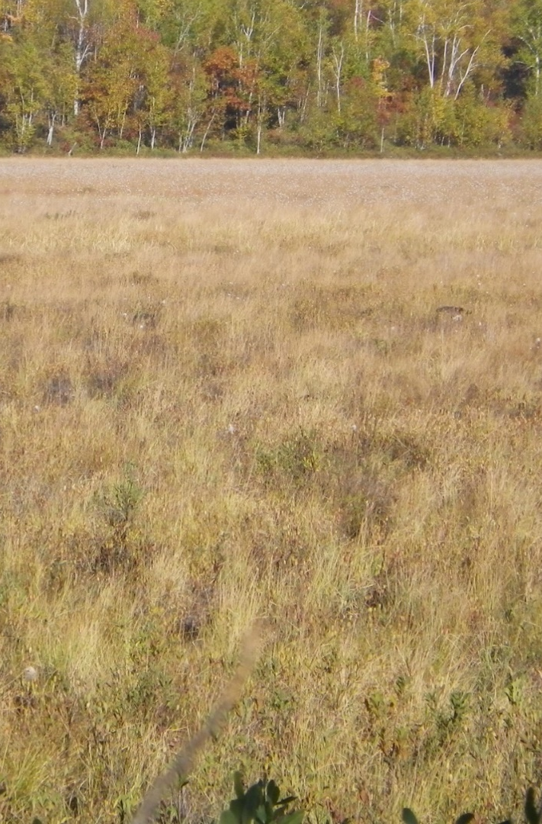
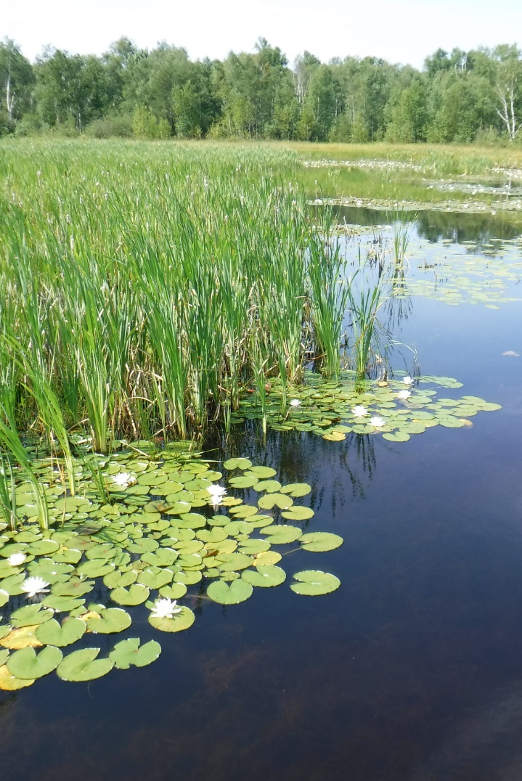
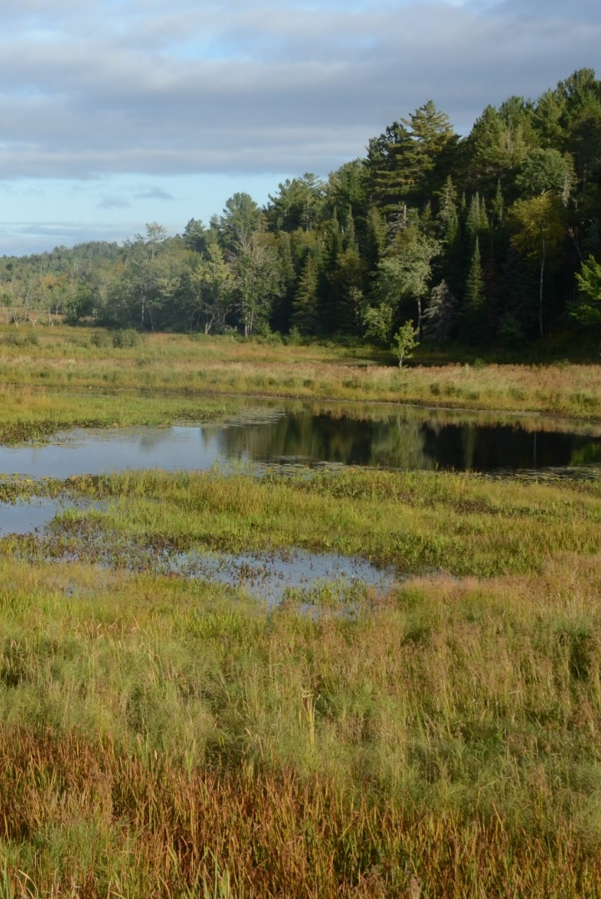
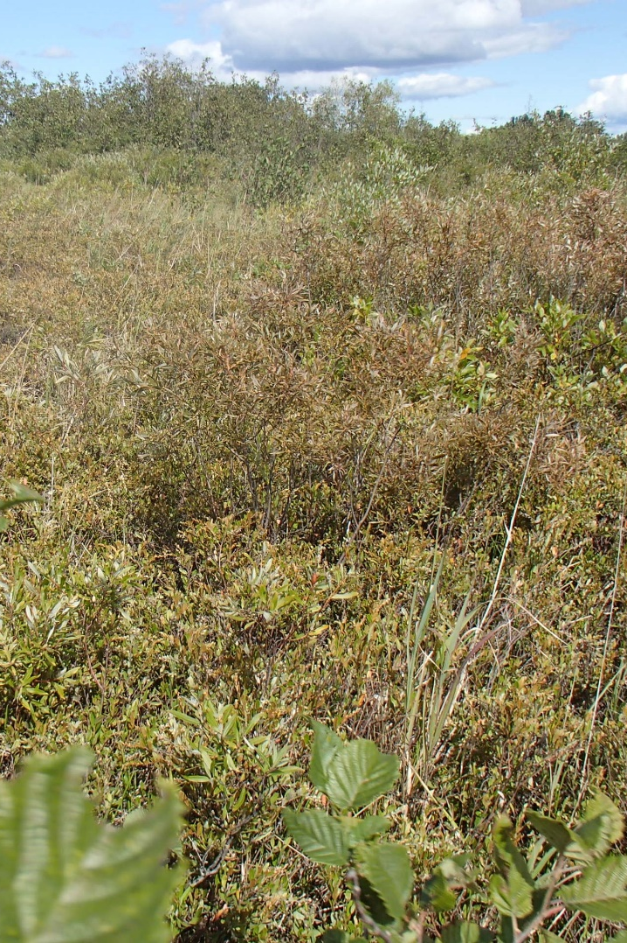
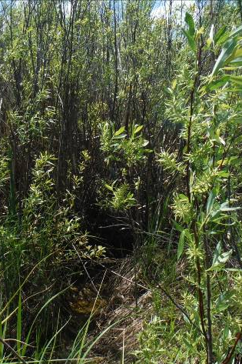
Wetlands Guidelines
March 2022 – CGS Contractors meeting

Slide 2
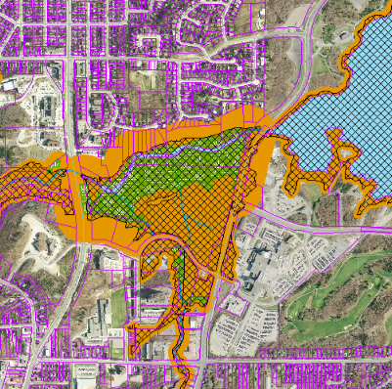
Ontario Regulation 156/06 – regulated features
Regulated features:
Lakes, watercourses (and their associated valleys), and wetlands
Associated hazards:
Flooding
Erosion (steep slopes, meander belts)
Unstable Soils (organic soils)
Lake Wanapitei: 267.95 m + 1.2 m
Dynamic Beaches (not common)
We regulate features as they are in the field!

Slide 3
Ontario Regulation 156/06 – regulated features
Regulated features:
Lakes, watercourses (and their associated valleys), and wetlands
Associated hazards:
Flooding
Erosion (steep slopes, meander belts)
Unstable Soils (organic soils)
Lake Wanapitei: 267.95 m + 1.2 m
Dynamic Beaches (not common)
We regulate features as they are in the field!

Slide 4
Wetland Guidelines
As of June, 2021
Restrict activities that can occur within and adjacent to wetlands

Slide 5
Regulated development
Development within and adjacent to wetlands requires permission from Conservation Sudbury
Placement, removal of fill, site grading
Temporary or permanent
Dump sites for excess fill material
Responsibility falls to landowner AND contractor
It’s illegal to undertake development or allow another person to undertake development
Landowners can assign contractor as an agent to apply on their behalf

Slide 6
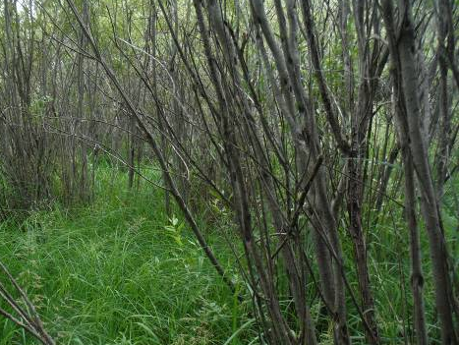
Identify wetlands early in project planning
Your responsibility to identify wetlands
Consultant may be required
Wetlands don’t always have standing water
Boots wet in spring = probably wetland
Identify potential dump sites early
CS application review can take 30 days+
Expect delays if wetlands aren’t properly identified
Confirm that the site conforms with wetland guidelines

Slide 7
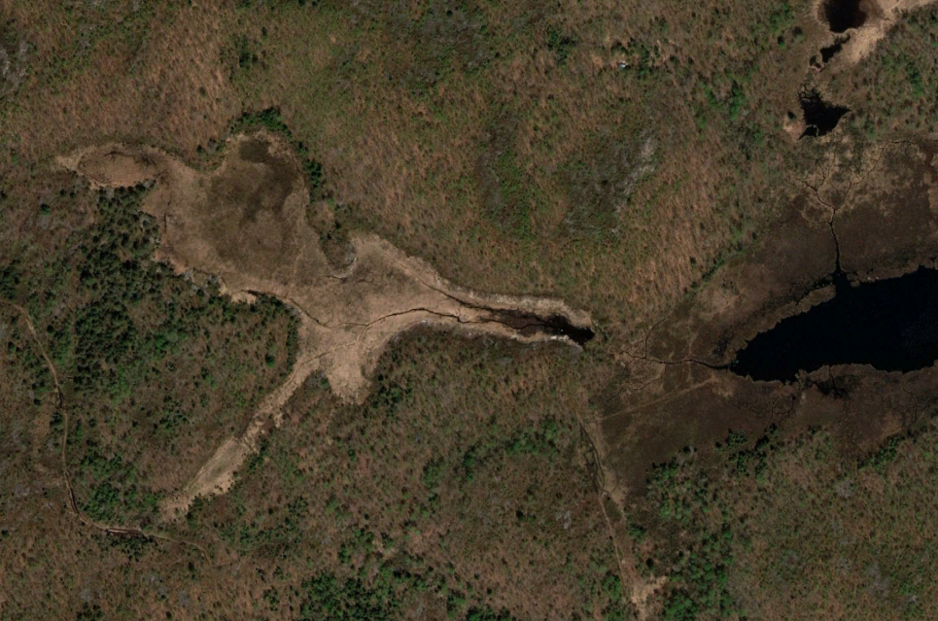
Map wetlands

Slide 8
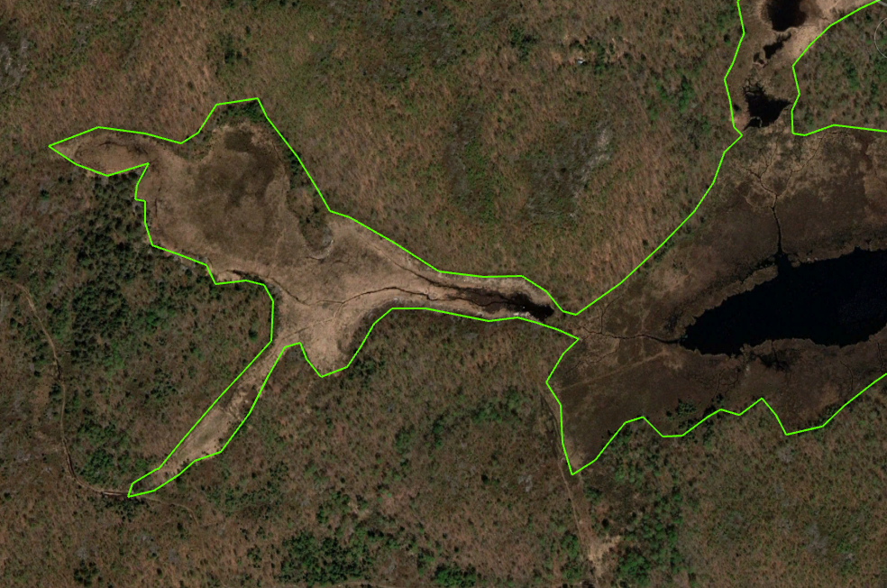
Map Wetlands

Slide 9
Map Wetlands

Slide 10
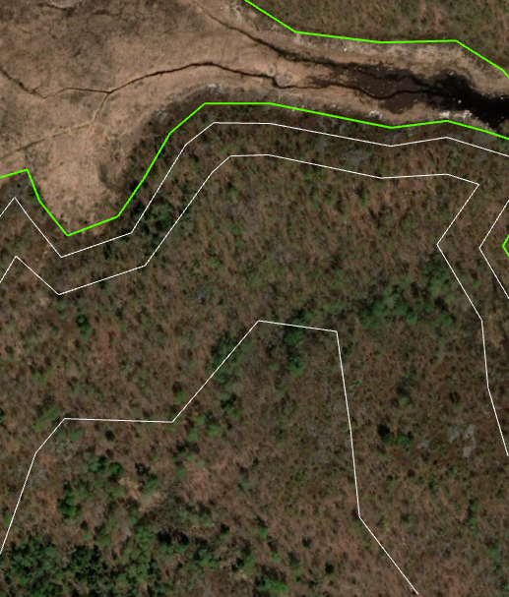
New Guidelines
Wetland
Within wetland
No development
Except under very limited circumstances
Not for the placement of fill if no other purpose

Slide 11
New Guidelines
12m
12 metre buffer
No development
Except under very limited circumstances
Not for the placement of fill if no other purpose

Slide 12
New guidelines
12 to 30 metres
Direct application required
Development may be permitted
Must conform to Wetland Guidelines
No other land available
No impact to hydrology of wetland
No pollution
30m

Slide 13
New Guidelines
30 to 120 metres
Direct application required
Development may be permitted
Must conform to Wetland Guidelines
No impact to hydrology of wetland
No pollution
120m

Slide 14

Questions and discussion
Can’t think of anything right now? Contact me later:

