Slide 1
2022 Construction Season
David Shelsted P.Eng.
Director of Engineering Services

Slide 2

New Book 7 Release
MTO has indicated they will update Book 7 for the start of the 2022 construction season
Result of industry consultation that began in 2018
Will include additional information on Automated Flagger Assistance Devices (AFAD)

Slide 3
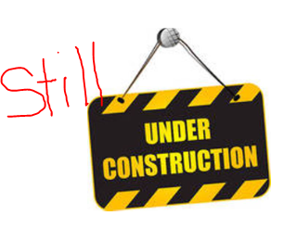
2021 Carry-Overs
ENG21-2 Hyland Drive and Wellington Heights Reconstruction,
ENG21-3 Dell Street Reconstruction
ENG21-4 Roy Street Reconstruction
ENG21-10 Lively Sewer Upgrades,
ENG20-24 MR35 Road Widening,
ENG21-30 Barry Downe Road Widening

Slide 4
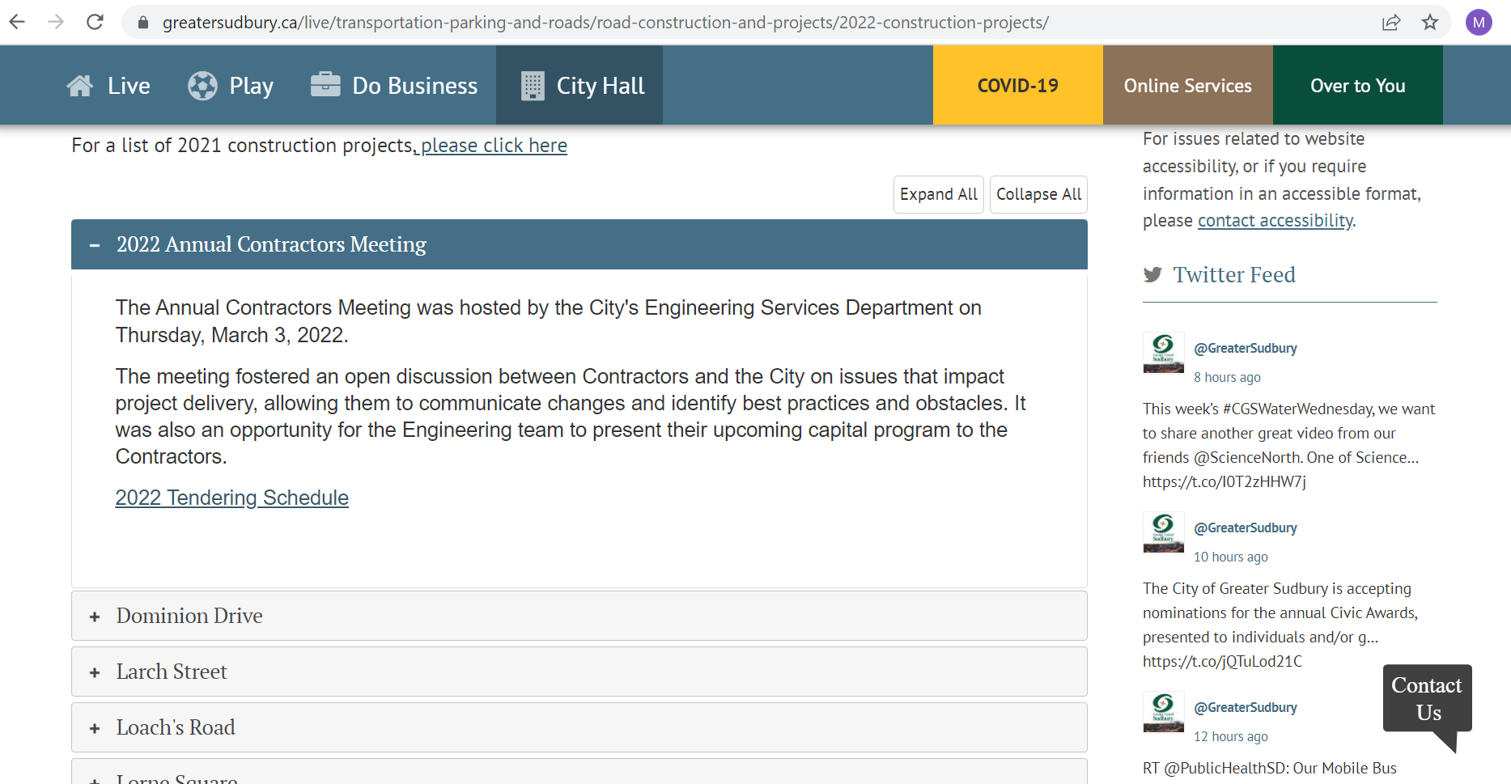
www.greatersudbury.ca/2022construction

Slide 5
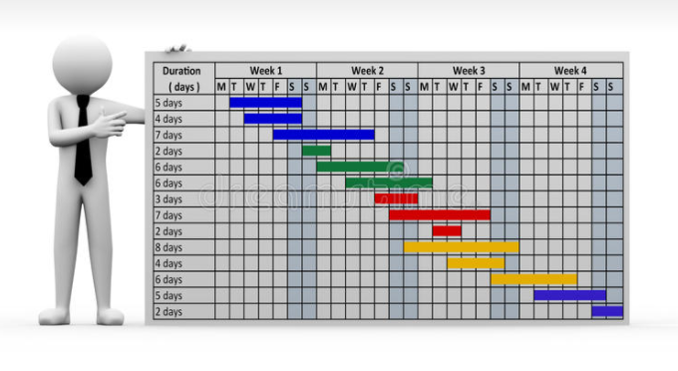
2022 Tender Schedule Highlights
Longyear Drive at Edison Rd - Roundabout
Lorne Square - Storm Replacement
Walter St and Kalmo Rd - Bridge Replacement
Kingsway - Roadway Reconstruction and Rehabilitation

Slide 6
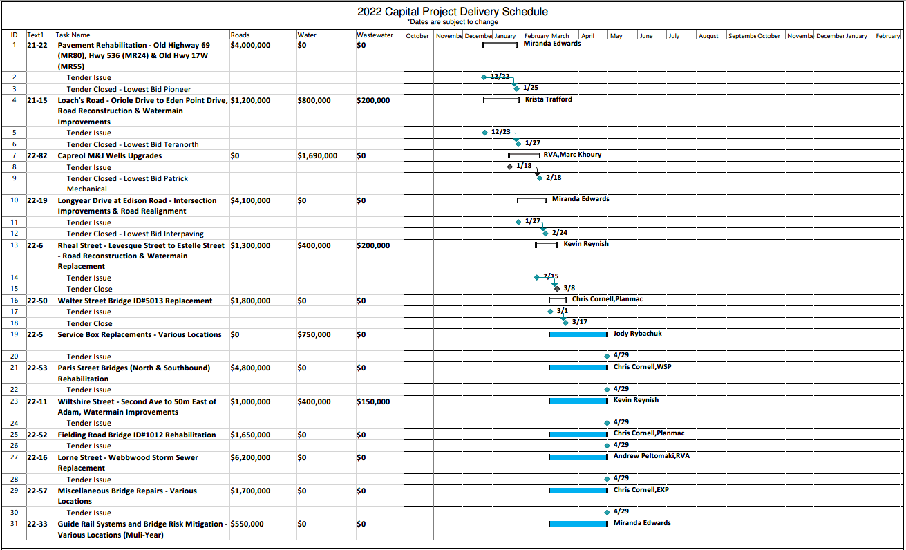

Slide 7
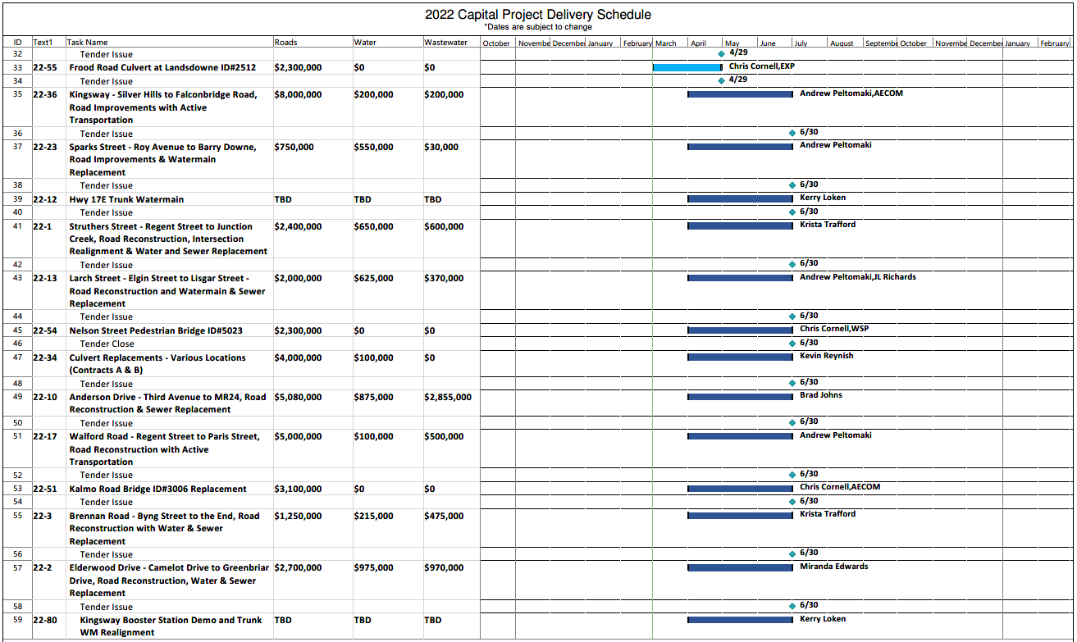

Slide 8
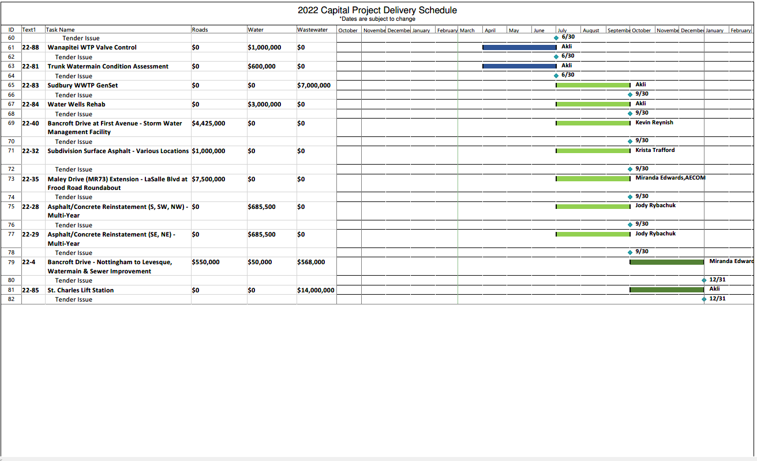

Slide 9
Questions?

