Slide 1
2021 Accomplishments
David Shelsted, P.Eng.
Director of Engineering Services

Slide 2
Employee Years of Service Recognition - 2021
5 Years of Service
Kerry Battistoni
Marisa Jarus (Talarico)
David Knutson
Tammy Mathieu
Gilles Villeneuve
Donald MacLean
10 Years of Service
Andrew Peltomaki
Notes:
Start the presentation off by recognizing important employee milestones reached in 2021

Slide 3
Employee Years of Service Recognition - 2021
15 Years of Service
Raymond Chevrette
Stephen Holmes
Kelly VanEmbden
40 Years of Service
Michael Scarpellini

Slide 4
2020/2021 Retires
2020
Darrell Stefankow
Soutsay Boualavong
Suzanne Charlebois
Special Mention
Randy Halverson (2020)
Viv Gibbons (2021)
Dave Kivi (2021)

Slide 5
Contractor Employee Milestone Recognition
Retirees
Steve McCool (Garson Pipe Contractors)
Dale Duxbury (Pioneer Construction)
Chris Etmanki (Pioneer Construction)

Slide 6

2021 Program – By The Numbers
32 contracts tendered, $79.9M spent
Rehabilitated 45.0 lane km’s of roadway at 21 locations.
Installed 7,650 m of active transportation including sidewalk and trails at 10 locations
Installed 7,685m of concrete curb and gutter at 9 locations
Preformed 6,850 m of sanitary lining at 41 locations

Slide 7
2021 Program – By The Numbers
Preformed 1,675 m of watermain lining at 6 locations
Replaced 6,760 m of watermain at 8 locations
Replaced 4,745 m of sanitary and storm sewer at 7 locations
Rehabilitated 3 bridges
Replaced 7 bridges

Slide 8
2021 Program – By The Numbers
Added 1 new pedestrian cross overs and 1 pedestrian traffic signal
Upgraded 1 intersection traffic signals
Installed 1,850 m of guiderail at 3 locations
Installed 8,410 m of rumble strip at 5 locations
Added 11,100 m of paved shoulders at 5 locations

Slide 9
2021 Program – By The Numbers
Completed 16,355 sq.m of large asphalt patches
Added 33 new streetlights
Rehabilitated 1 lagoon
Upgraded 1 Aeration System
Installed 890 m of culverts at 15 locations
Upgraded 1 booster station

Slide 10
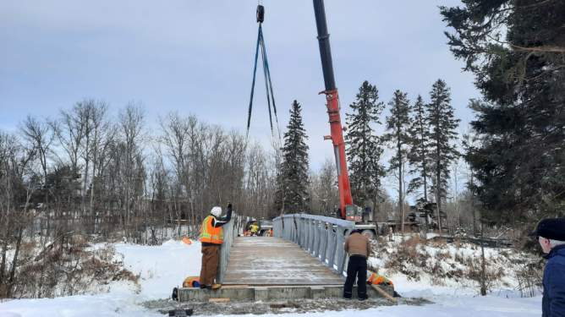
Whitson River Trail
Constructed 4.5 km of trails along Whitson River

Slide 11
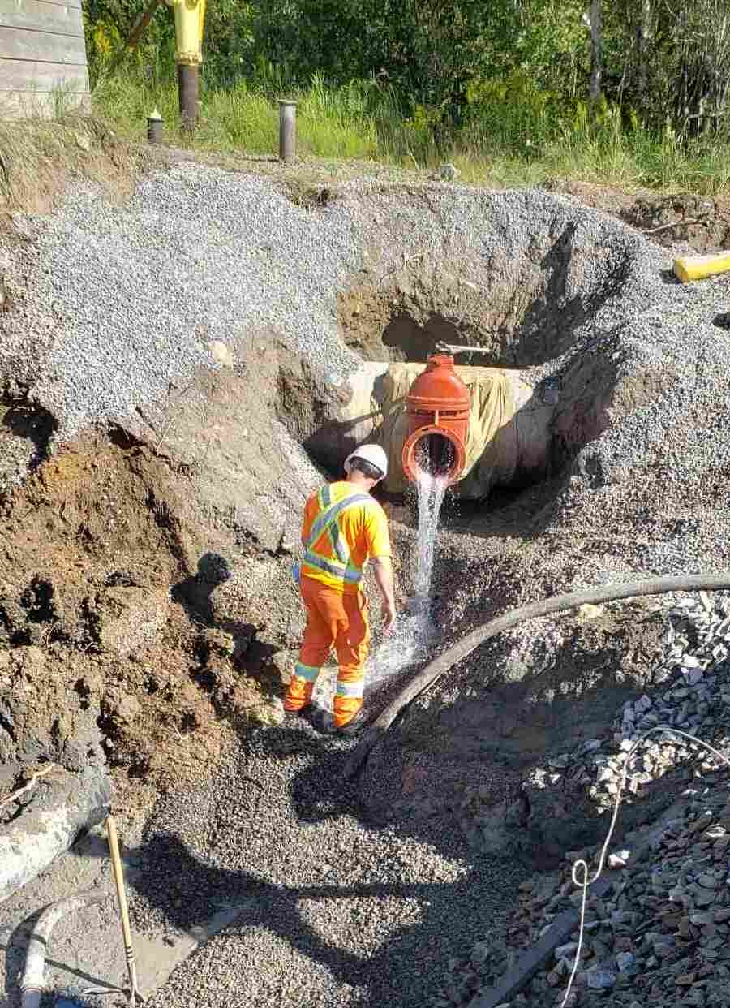
MR24 Watermain
Replaced 2 Concrete Box Culverts
Replaced approximately 700m of 300mm watermain,
Live-tap connection to Vale’s 750mm (30”) CPP Trunk Watermain repair of the existing connection point.

Slide 12
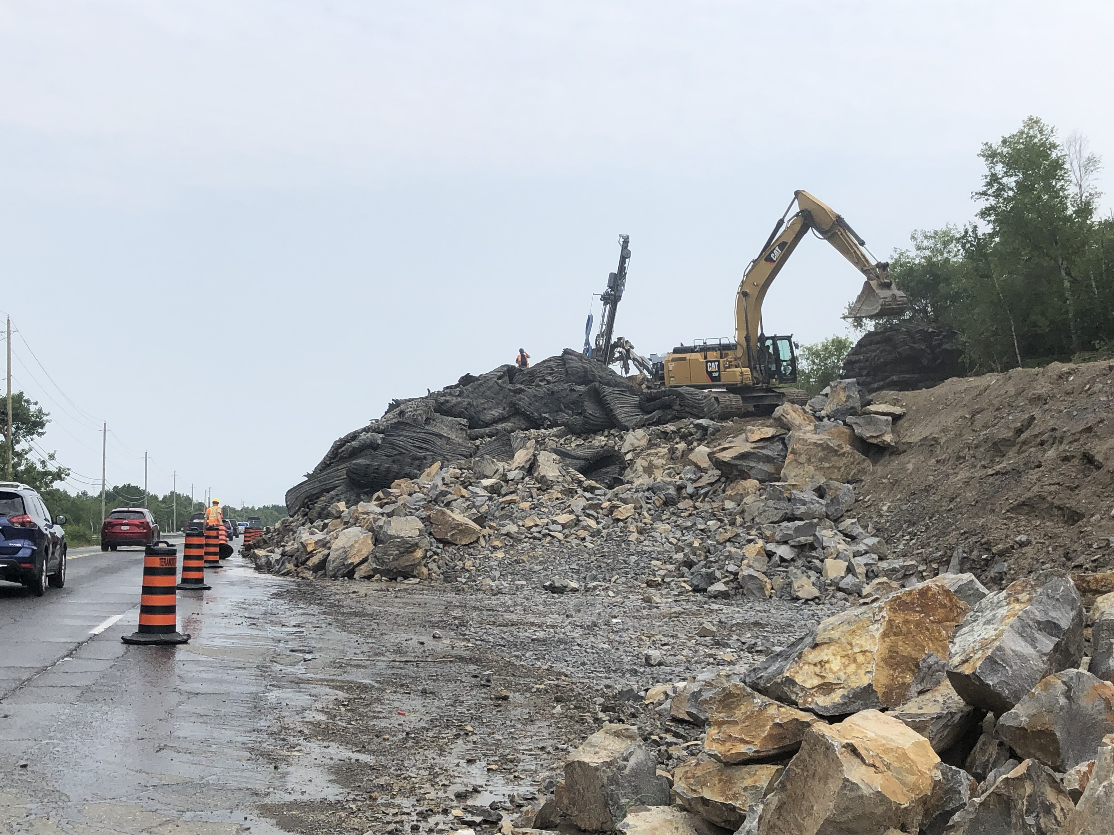
Long Lake Rd
Removed 10,500 cu.m. of rock to improve clear zone

Slide 13
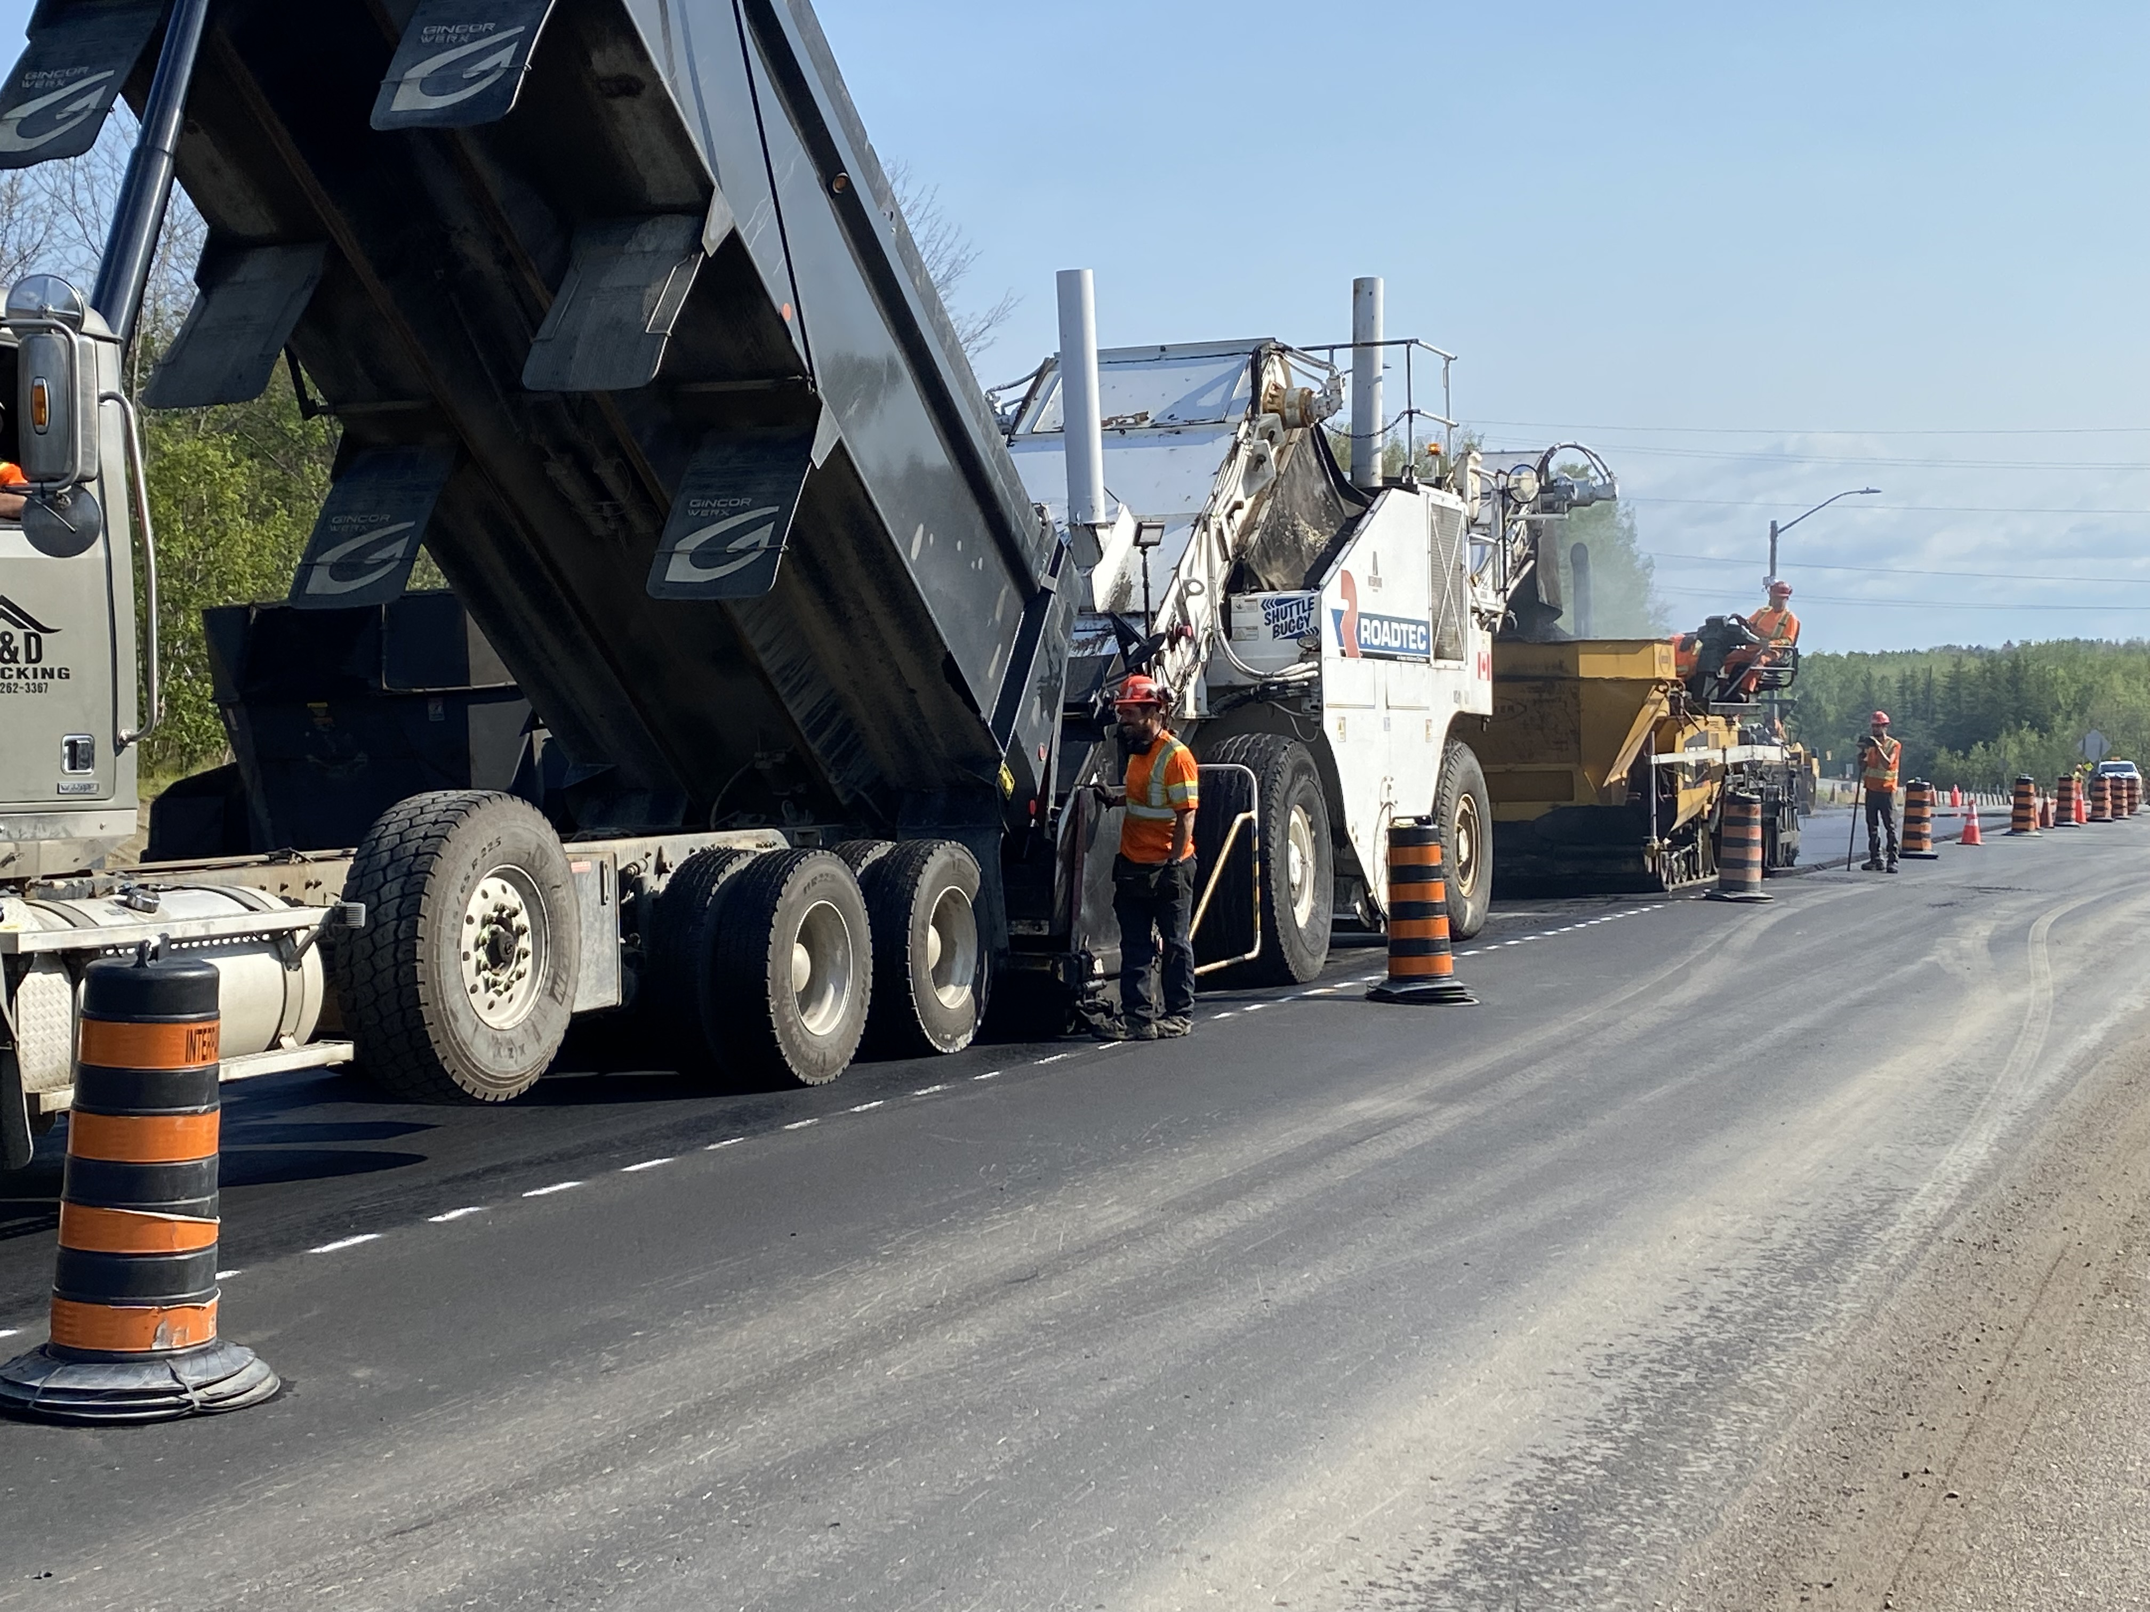
Skead Rd
Widened lane widths and extended the truck climbing lane

Slide 15
Questions?

