Slide 1
Road Occupancy/Closures, Asphalt Degradation and Associated Fees
Presented by:
Robert James

Slide 2
Discussion:
Road Occupancy Permit
Road Closure Permit
Pronto – Create your own account
Asphalt Degradation
Fees
www.greatersudbury.ca/live/transportation-parking-and-roads/traffic-interruptions-or-road-closures/

Slide 3
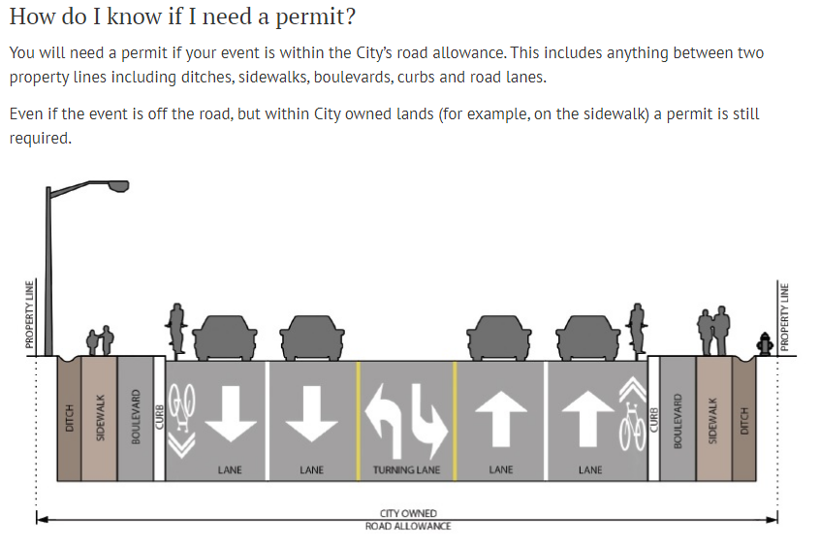

Slide 4
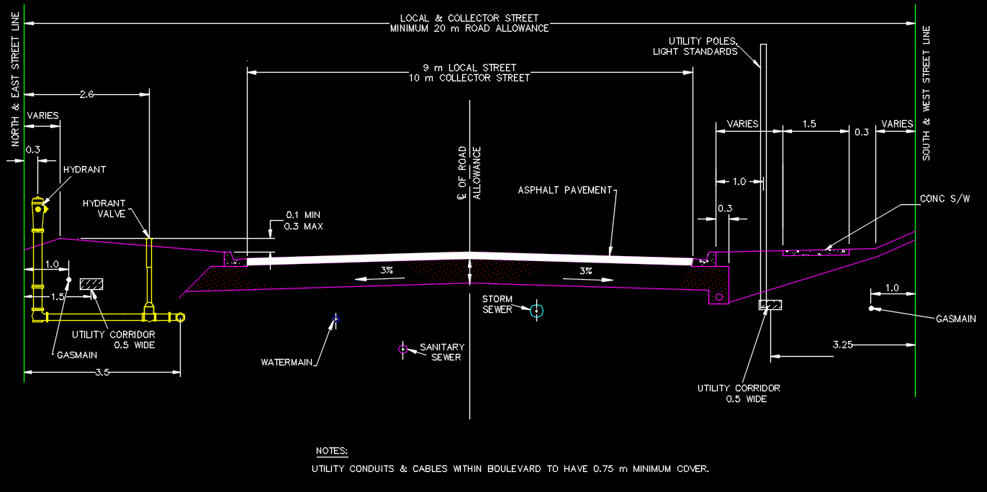

Slide 5
Road Occupancy Permit (ROP)
Physical changes to the 2024 ROP Form
Cost: $57.00 per calendar day. Payment by cash, cheque, debit, credit at TDS or Clerk can call and take C.C. payment by phone or monthly invoicing.
Timeline: 5 business days for processing.
Requirements:
  Traffic Control Plan (OTM Book 7)
  Certificate of Insurance for $5 million
  Application – signed/initialed. (No longer required)

Slide 6
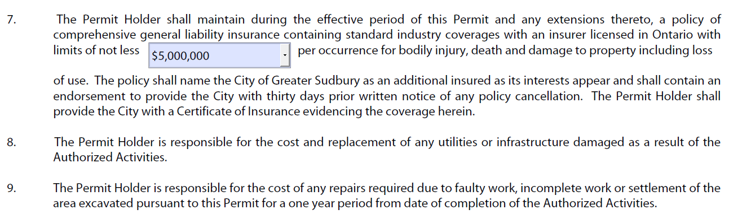
ROP – Certificate of Insurance

Slide 7

Road Closure Permit
Physical changes to the 2024 Permit form.
Cost: $116 flat rate, cash, debit, credit or cheque. Clerks can call for C.C. payment over the phone or monthly invoice.
Timeline: Minimum 3 weeks for processing.
Requirements: Signage notifying public one week in advance of the closure.

Slide 8

Requirements
Traffic Control Plan/Detour (OTM Book 7).
Certificate of Insurance for $5 million, naming the City of Greater Sudbury as an additional insurer.
The application, signed and initialed. (No longer required)
Notification letters to area residents.

Slide 9
Notification Letter
This includes the company or application name and contact
information, location of closure, purpose of closure, timeline and
any other pertinent information. The Notification Letter should be
submitted to the City of Greater Sudbury as well as any residents
and businesses in the area.

Slide 10
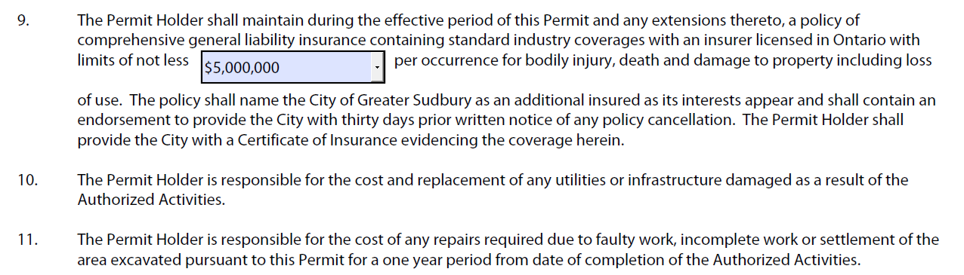
Road Closure - Certificate of Insurance

Slide 11
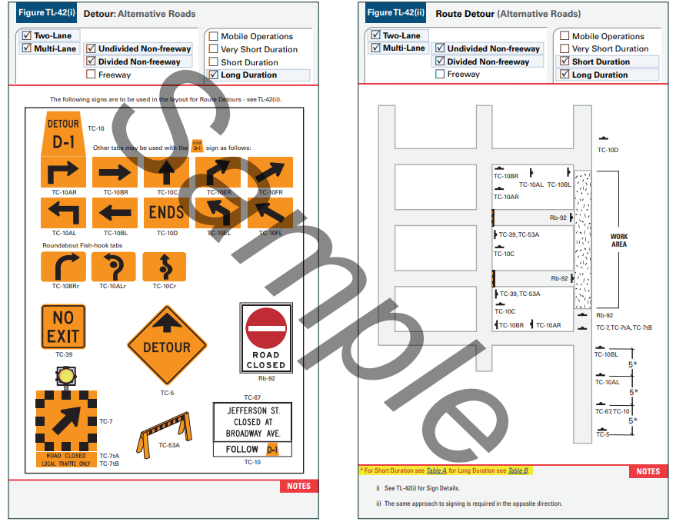

Slide 12
Traffic Control Plans
Anytime you are diverting vehicle or pedestrian traffic you will need to create a traffic control plan.
Traffic management plans need to be drafted based on the Ontario Traffic Manual’s Book 7 (Temporary Conditions).
The City does not provide assistance for the creation of traffic control plans. If you are unable to make your own traffic plan, you should hire a third party to create a plan.
Pedestrian and vehicle traffic must be addressed on the traffic control plan.

Slide 13
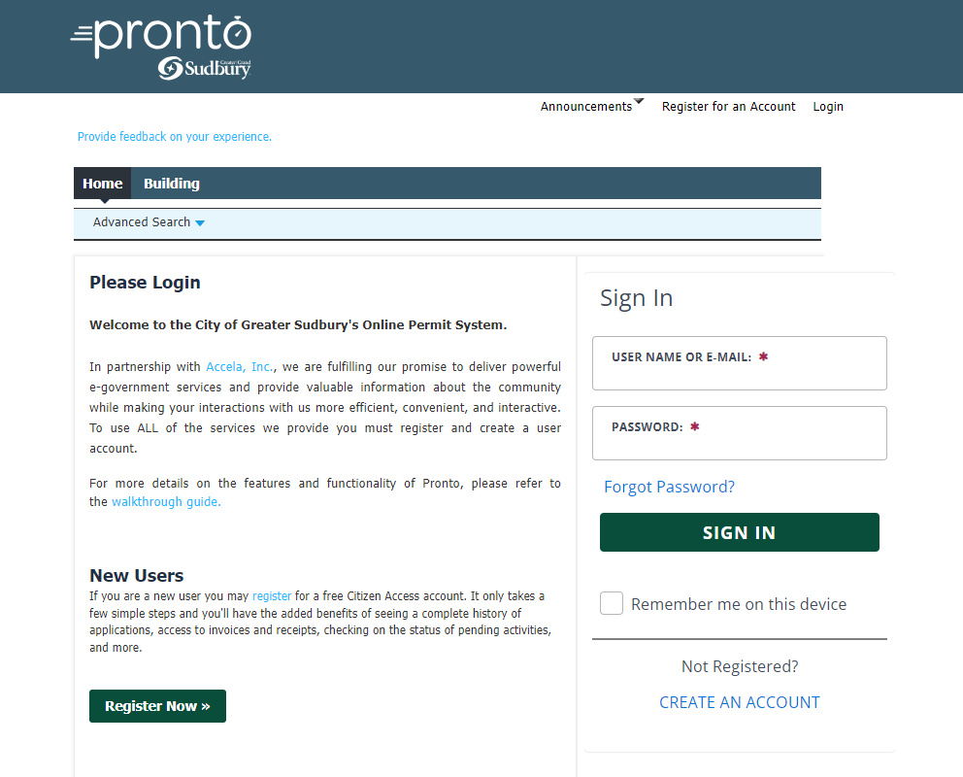
Pronto – Create an Account
You can now enter your own application. The city began the use of this software with Technical Services in October 2023.
Go to the city web site: www.greatersudbury.ca/live/transportation-parking-and-roads/traffic-interruptions-or-road-closures
Create an Account in Pronto.
Once you have an account, you may create your own application and submit it. You can watch the status of the application.
You will receive an email notification when your permit has been approved.

Slide 14
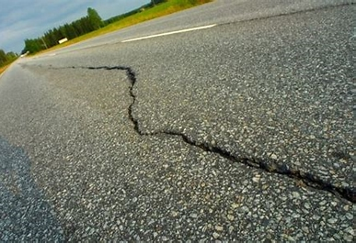
Asphalt Degradation
The City maintains a 3 year no-cut policy.
If there was a specific circumstance approved for the cut, there would be a $53 per sq.m. fee.
Greater than 3 and less than 5 yrs. = $44 per sq.m.
Greater than 5 and less than 7 yrs. = $36 per sq.m.
Greater than 7 and less than 10 yrs. = $22 per sq.m.
Greater than 10 yrs. = $9.50 per sq.m.

Slide 15
Questions?

