Slide 1
Enbridge 2024 Proposed Projects
City of Greater Sudbury: Annual Utilities Co-ordination Meeting
Notes:
Only use title case for the title of your deck. Use sentence case everywhere else.

Slide 2
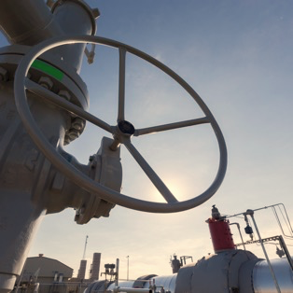
Overview of Planned Work in CGS 2024
Medina Lane
Coniston PCS, DRS
Martindale Road
Integrity work on the Sudbury lateral transmission line, not within CGS city limits
Joint Trench, Conversions and New Business
City of Greater Sudbury: Annual Utilities Co-ordination Meeting

Slide 3
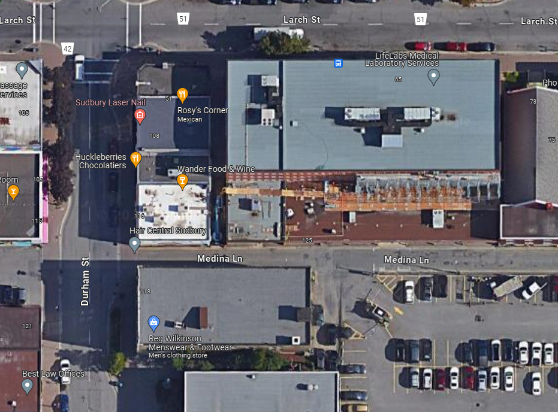
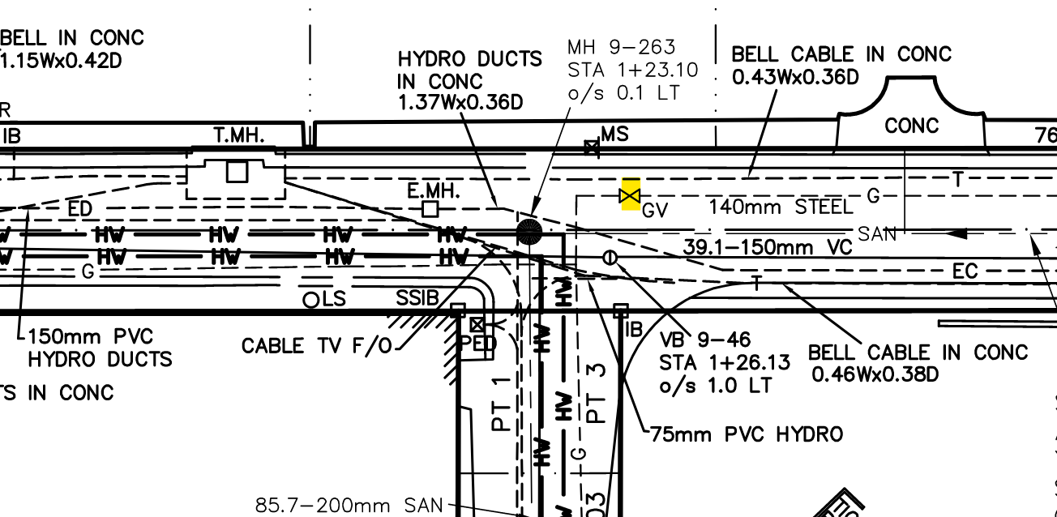
Medina Lane 4” Valve Replacement
4-5 Days Work Duration
Summer 2024
City of Greater Sudbury: Annual Utilities Co-ordination Meeting

Slide 4
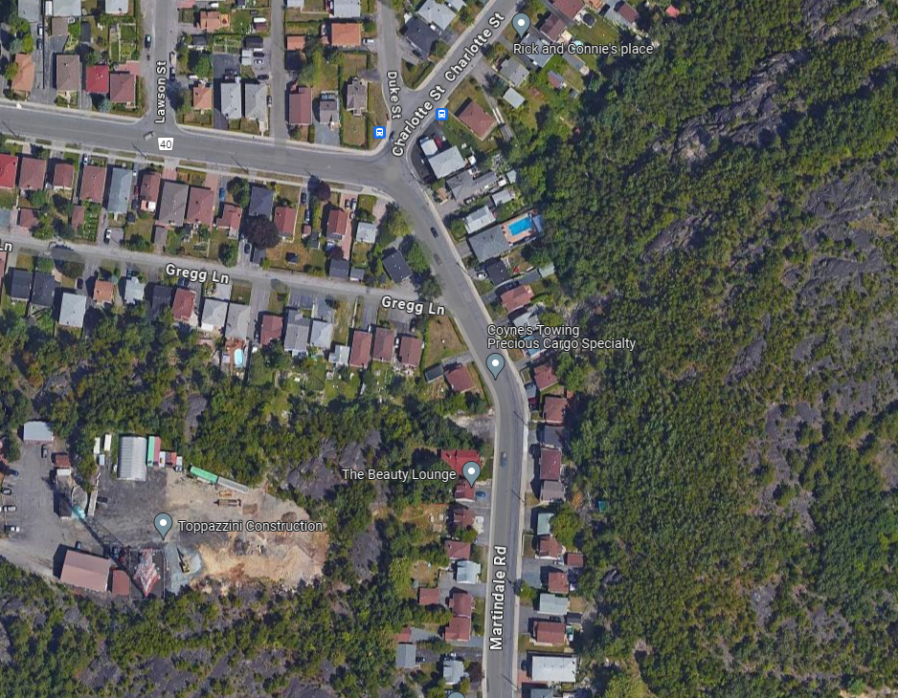
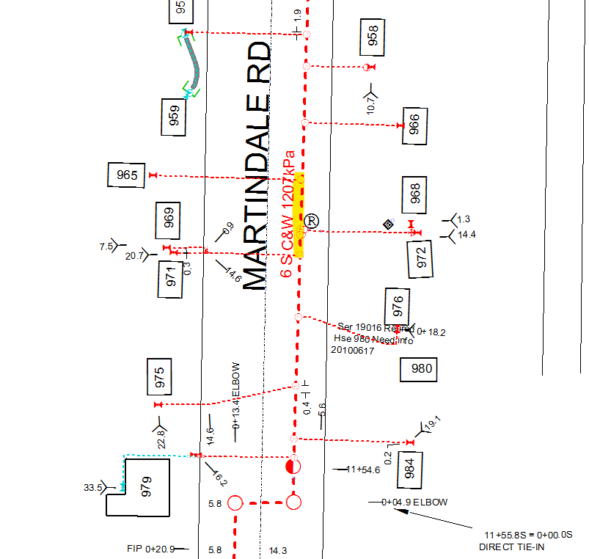
Martindale Rd 6” Main Cutout and Replace
4-5 Days Work Duration
Summer 2024
City of Greater Sudbury: Annual Utilities Co-ordination Meeting

Slide 5
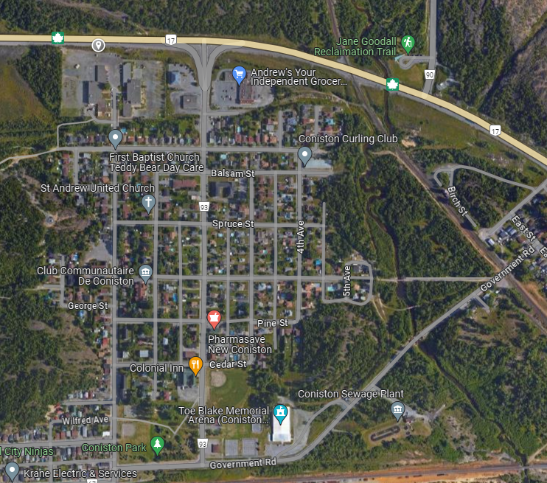
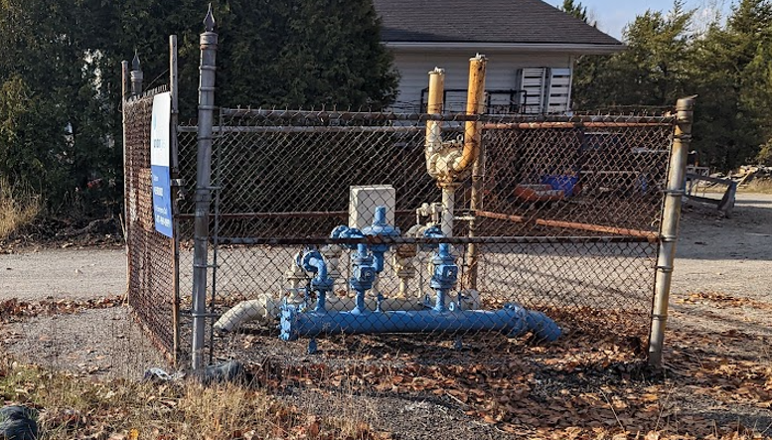
Coniston District Reg. Station Abandonment
5-10 Days Work Duration
Summer 2024
City of Greater Sudbury: Annual Utilities Co-ordination Meeting

Slide 6
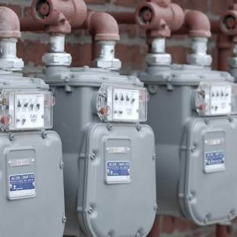
Sudbury 2024
Conversion
Pineridge Estates – Lively
4385 Highway 69 – Hanmer
Cam St. - 35m main extension from Luisa Dr.
235 Caswell - Sudbury
Joint Trench
Oscar St – Hanmer
Hazelton Phase 6 - Sudbury
Foxborough 5A,5B – Garson
Moonglow Phase 8B – Sudbury
Dominion Park Phase 13 – Val Caron
Remington Rd- Sudbury
Billiards Green – Sudbury
Customer work
CRA building
Rainbow Concrete
3161 Herold
1333 Highway 69
5864 Highway 69
935 Cambrian Heights
City of Greater Sudbury: Annual Utilities Co-ordination Meeting
Notes:
Gold accent bars can be used across the left side of boxes or images.
Minimum icon size is 0.25-inch diameter (0.635 cm)
Only use icons on a white or light grey (#EAEBEB) background

Slide 7
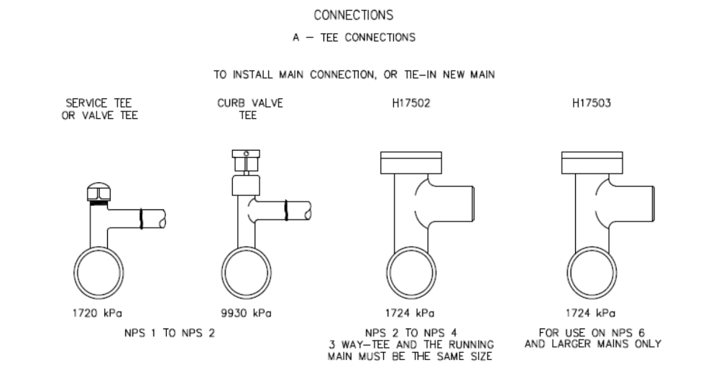
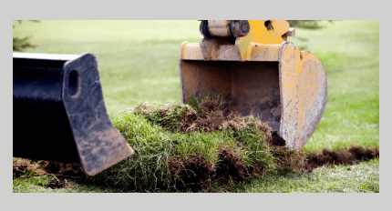
Third Party Guidelines
Third-Party Requirements in the Vicinity of Natural Gas Facilities Standard (enbridgegas.com)
Safe excavation and observation requirements.
Boundary clearances for mains.
Blasting and pile driving requirements.
Equipment crossing guidelines.
Excavation should assume there are branch connections and valves higher than the main, requiring more space
Working near vital pipelines?
Locate service providers may identify that a vital natural gas pipeline is within 30m of the proposed work area. Legally, work cannot begin until clearance is obtained.
City of Greater Sudbury: Annual Utilities Co-ordination Meeting

