Slide 1
BELL CANADA
2024 Proposed Projects
Presented by:
ADAM LAFOND [I.M.]
AND
MIKE BUTLER [CAG]

Slide 2
BELL CANADA
ENGINEERING SERVICES CONTACT INFO
ADAM LAFOND
CP2 MANAGER [I.M.]
NETWORK ENGINEERING AND TECHNOLOGY SERVICES
OFFICE: 705 673-3426
MOBILE: 705 690-3099
EMAIL: adam.Lafond@bell.ca
MIKE BUTLER
CP2 MANAGER [CAG]
NETWORK ENGINEERING AND TECHNOLOGY SERVICES
OFFICE: 705 673-6391
MOBILE: 705 920-0591
EMAIL: michael.butler@bell.ca
JASON BARIL
CP3 MANAGER
NETWORK ENGINEERING AND TECHNOLOGY SERVICES
OFFICE: 705 673-3218
MOBILE: 705 690-5763
EMAIL: jason.baril@bell.ca

Slide 3
BELL CANADA
FIELD OPERATIONS CONTACT INFO
WES EDMONDS
CP2 MANAGER
FIELD OPERATIONS
OFFICE: 705 674-3710
MOBILE: 705 690-0172
EMAIL: wesley.edmonds@bell.ca

Slide 4
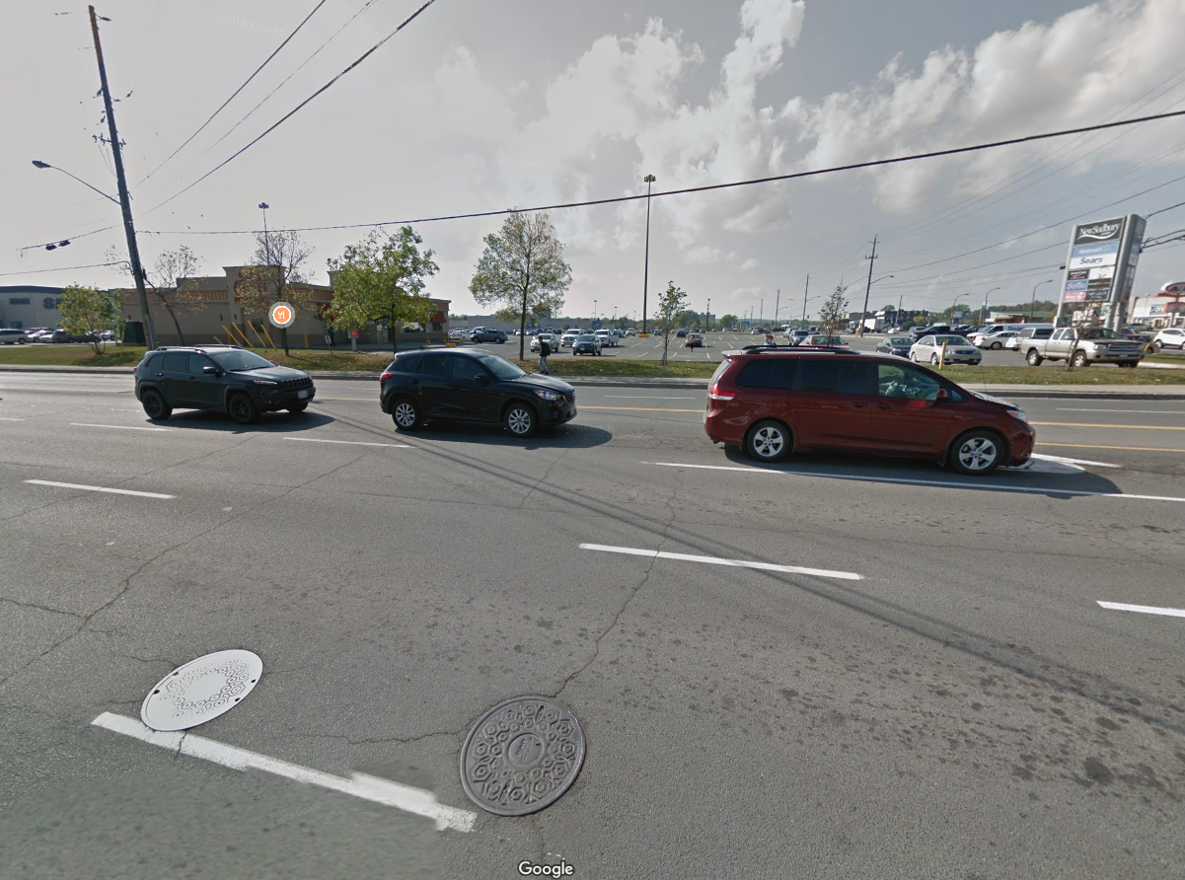
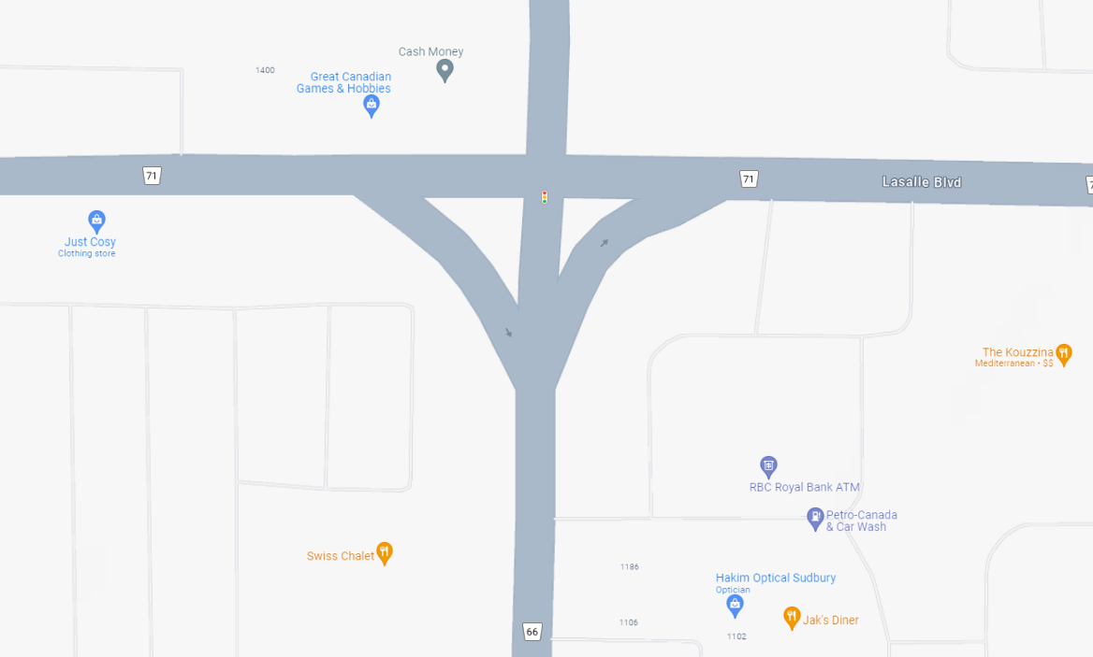
BELL CANADA
2024 Proposed Projects
46.521603, -80.944017
Location
  Limits of Construction: Lasalle and Barry Downe
  Scope of Work: DOUBLE LID FULL MANHOLE REBUILD [PLANNED FOR SUMMER 2024]

Slide 5
BELL CANADA
2024 Proposed Projects
Location
  Limits of Construction: SUDBURY AND SURROUNDING AREA
  Scope of Work: DAY TO DAY WORK AND SERVICE REQUEST > COMMONLY DRIVEN BY GSU AND THE GREATER CITY OF SUDBURY PROJECTS.

Slide 6
Bell Damage Repair Desk
Purpose - Bell Damage Repair Desk handles all damages to Bell poles, communication lines and structures. The purpose of this contact number is to establish a single point of contact for the Police and Contractors reporting a Cut Cable, Damaged Pedestal, JWI or OPI, downed cables, Buried Service Wires, and to move or bury a temporary line.
Call/ Report Handling Procedure – When the Police, Hydro Company, or a contractor calls reporting a Cut Cable, Damaged Pedestal, Broken Pole, JWI, BSW, OPI or Downed Lines, a report is created.
Bell Emergency Contact Number = 1-800-400-2255 and follow prompts to report damage.
Standard Bell Damage Repair Desk Questions Asked
Are you calling to report to damage?
(The type of damage is determined, Broken Pole, Down Lines etc.)
What are the address / location of the damage?
Civic address and street name.
May I have your name? The company name?
May I have the onsite name and phone number?
If there is nobody onsite, a contact name and number may be used.
What is the exact location of the damage? Do you have a cross street available?
(Front of property at property line or at the n/e corner of the intersection)
Recap all info – Note: Bell will provide a reference number to the caller – “Your reference number for this report is xxxxxxxx. This number is required to obtain any information regarding this claim.”
Storm Damage All Hours
Bell personnel will be responding within 2 hours to assess the damage on site and take the appropriate action. Hydro One will be contacted by the duty manager within 30 minutes to advise them that they are working on the issue and that they will call back once they have an ETA for a technician to arrive on site.

Slide 7
