Slide 1

2024 Construction Season and Outlook for 2025 to 2027
Stephen Holmes, P.Eng.
Manager of Project Services

Slide 2
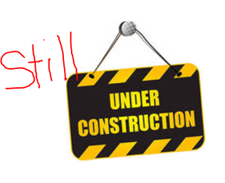
2023 Carry-Overs
Anderson Dr (Lively)
Loach’s/Armstrong (South End)
Bridge of Nations
Paris Notre Dame Bikeway
Kingsway, BD to Falconbridge
Agnes St (Flour Mill)
Nelson Street Pedestrian Bridge

Slide 3
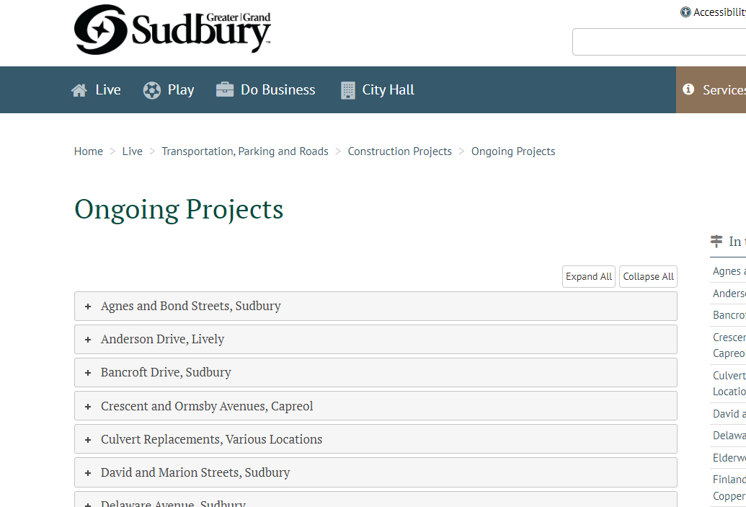

greatersudbury.ca/ongoingprojects

Slide 4
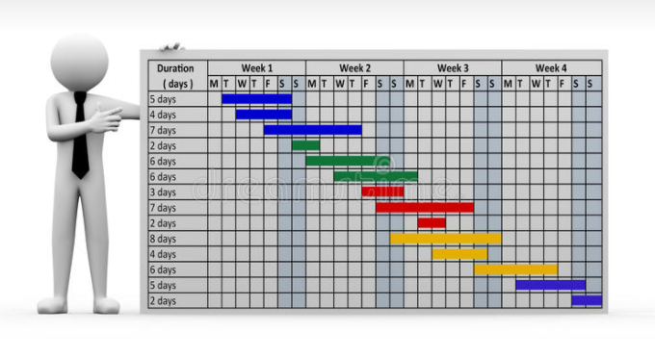
2024 Tender Schedule Highlights
David/Marion at Paris
Junction Creek Reprofiling
Lasalle – Falconbridge to Elisabella
Hillcrest (Lively)
Wiltshire – Adams to Randolph
Ethelbert/Ernest/Maple
Lily Creek Culvert at Regent
Skead Road Watermain
CPR Overpass (MR35)

Slide 5
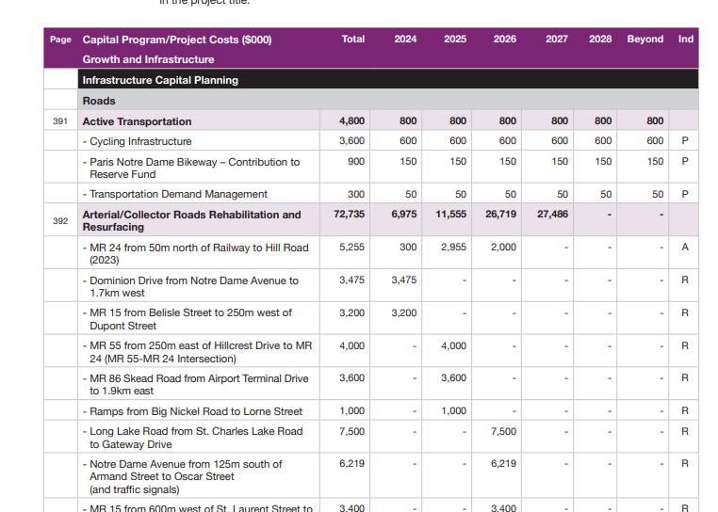
2024 – 2027 Proposed Budget Document
Infrastructure Capital Budget Outlook
Pages 381 to 386
(search 2024-2025 Proposed Budget)
greatersudbury.ca/proposedbudget

Slide 6

2025 Construction Outlook Highlights
MR55 - Hillcrest to MR24
Skead Road - Airport to 1.9km East
Ramps – Big Nickel to Lorne
College Street CPKC Rail Underpass
Second Av – Bancroft to Kenwood (2025 to 2027)

Slide 7
2026 Construction Outlook Highlights
Lasalle – Elisabella to 400m East
Elisabella – Lasalle to Lapointe
Notre Dame – Armand to Oscar (Hanmer)
MR15 – St. Laurent to Montee Principal
Barry Downe – Lillian to Maley
Long Lake Road – St. Charles Lake Rd to Gateway
Garson Coniston Road – Hwy 17 to 5.8km N
Highland/Oakwood (Capreol)
Bancroft – Kingsway to Bellevue
Bellevue – Howey to Bancroft

Slide 8
2027 Construction Outlook Highlights
Montee Principal – MR15 to MR35
MR55 – Horizon to Simon Lake Drive West
Lansing – Madison to Maley
Long Lake Road – Sunvalley to Tilton Lake Road
Frood Road – Shevchenko to Lasalle
Panache Lake Rd – St. Pothier to Island Road
MR24 – Hill to Anderson & First to Fifth

Slide 9

Questions?

