Slide 1

2024 Annual Utilities Coordination Meeting

Slide 2
Welcome!
Notes:
good

Slide 3



Housekeeping
Respectful and Engaged Conversations
Cell Phones
Washrooms/Emergency Exits

Slide 4
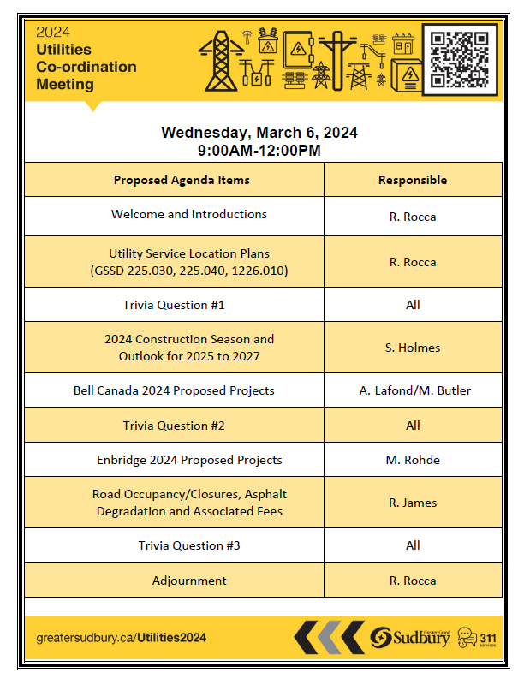
Agenda
www.greatersudbury.ca/Utilities2024

Slide 5
Utility Service Location Plans
(GSSD 225.030, 225.040, 1226.010)
Presented by: Rob Rocca

Slide 6
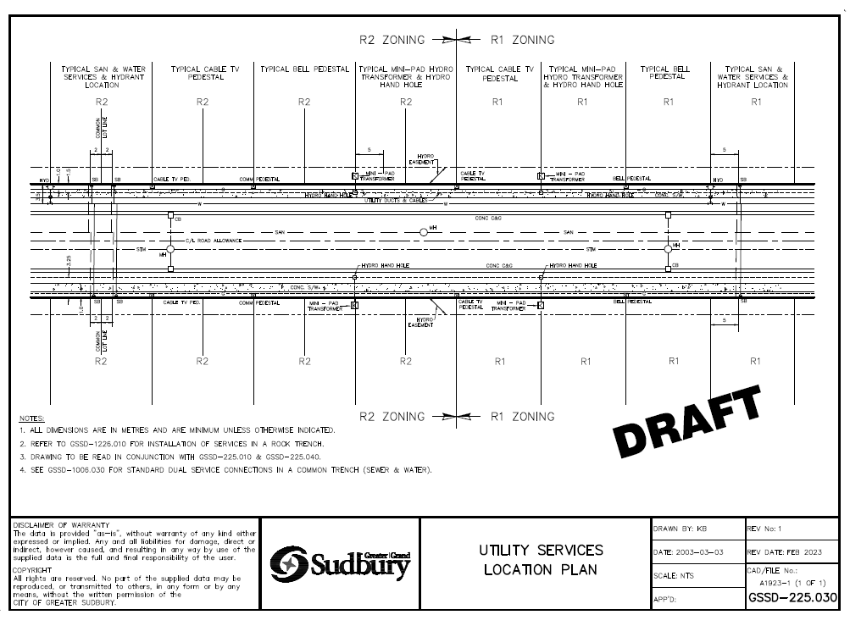
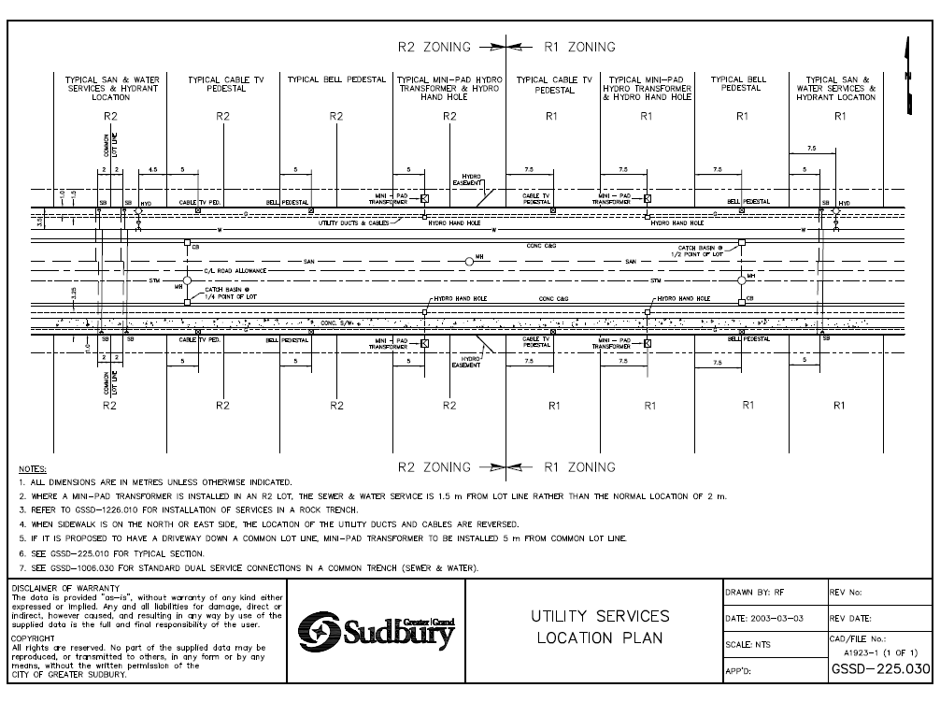

Slide 7
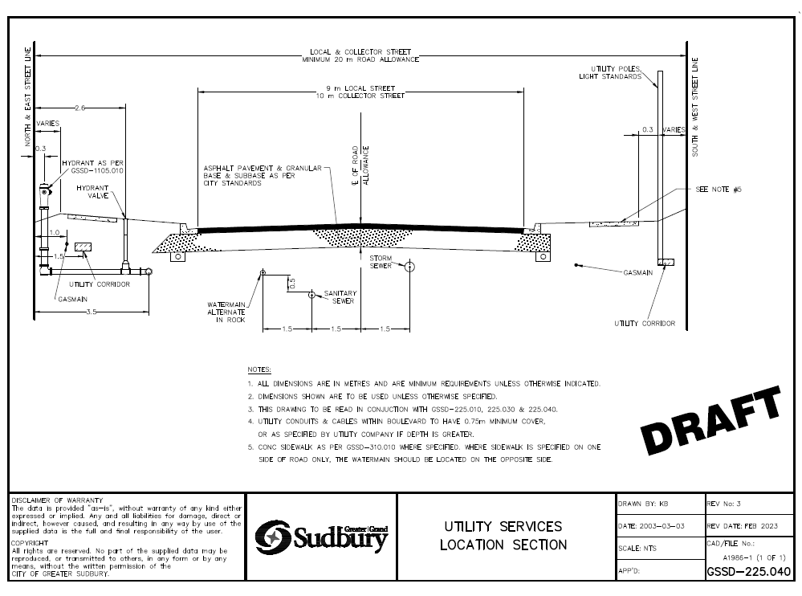
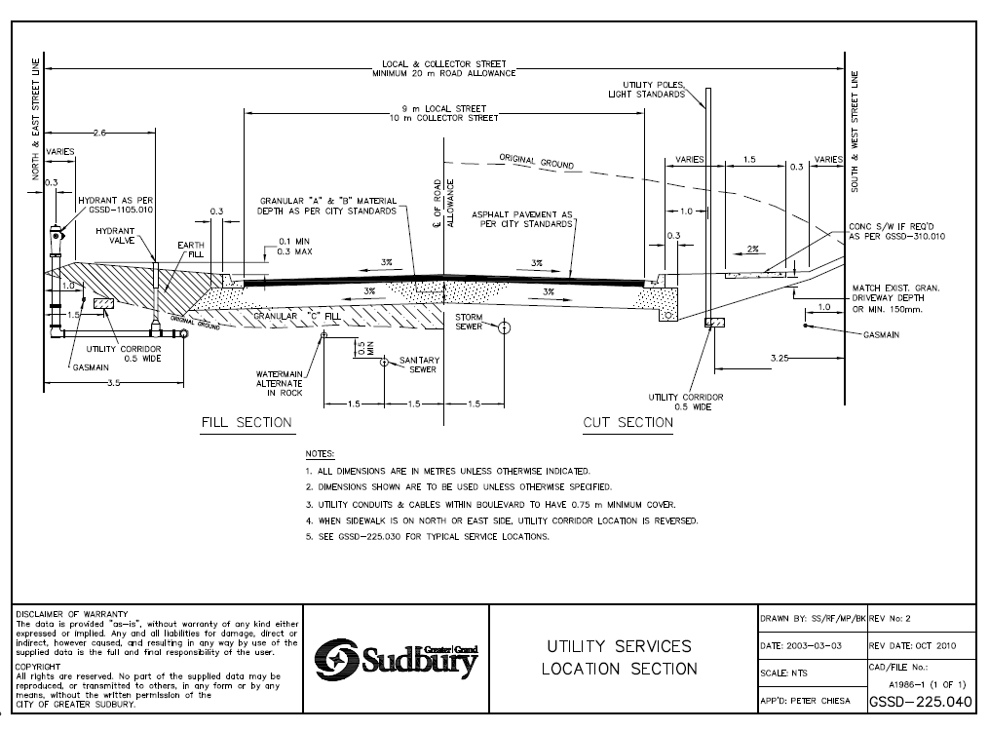

Slide 8
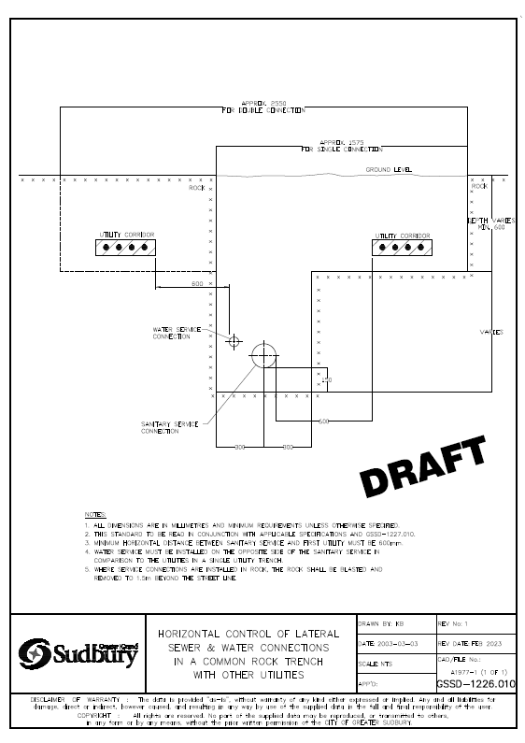
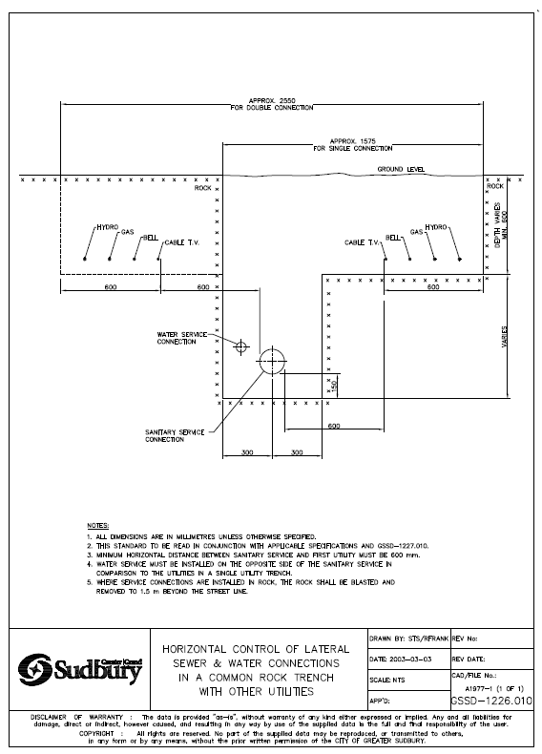

Slide 9

Thank you!

