Slide 1
Road Occupancy/Closures, Asphalt Degradation and Associated Fees

Slide 2
Discussion:
Road Occupancy Permit
Road Closure Permit
Degradation
Fees
www.greatersudbury.ca/live/transportation-parking-and-roads/traffic-interruptions-or-road-closures/

Slide 3
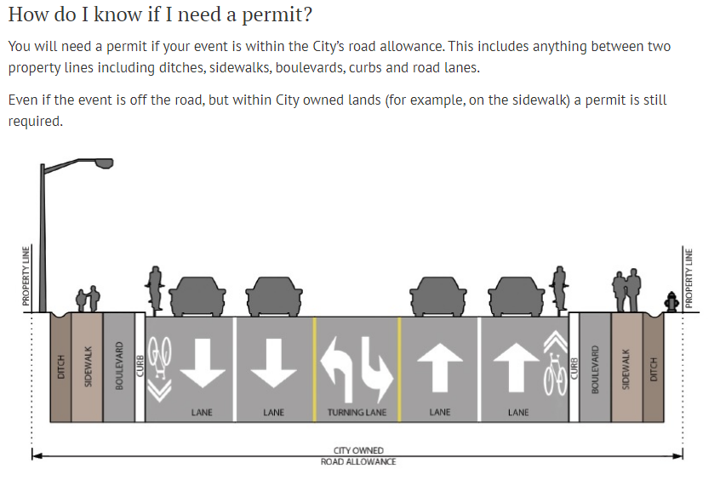

Slide 4
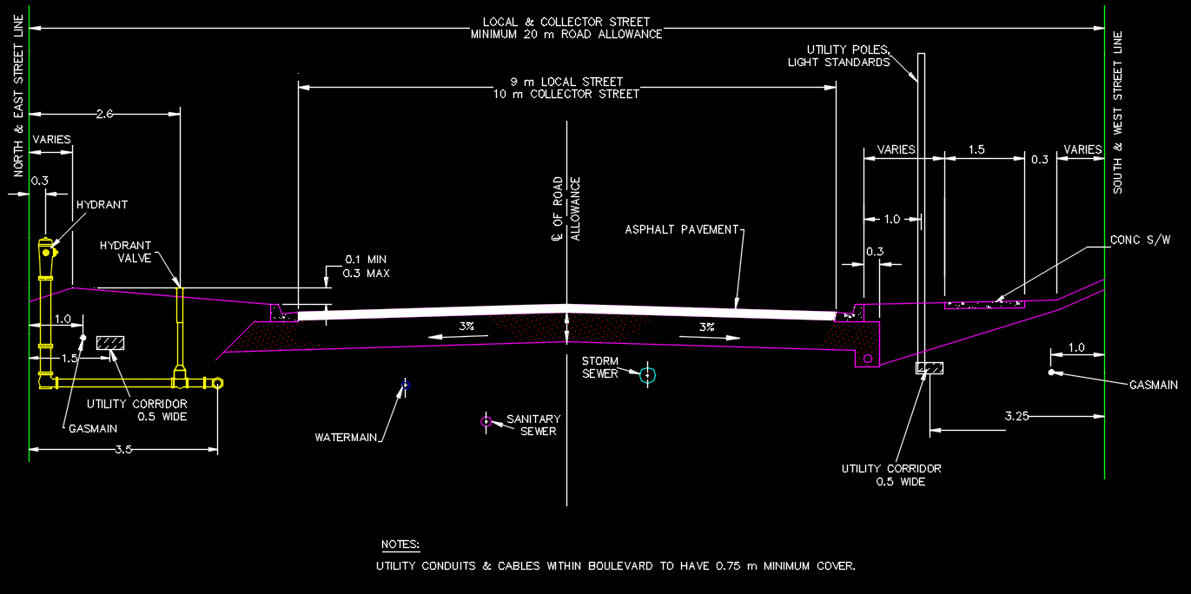

Slide 5
Road Occupancy Permit (ROP)
Physical changes to the 2023 ROP Form
Cost: $55.00 per calendar day. Payment by cash, cheque, debit, credit at TDS or Clerk can call and take C.C. payment by phone or monthly invoicing.
Timeline: 5 business days for processing.
Requirements: Traffic Control Plan (OTM Book 7).
Certificate of Insurance for $5 million.
Application – signed/initialed.

Slide 6
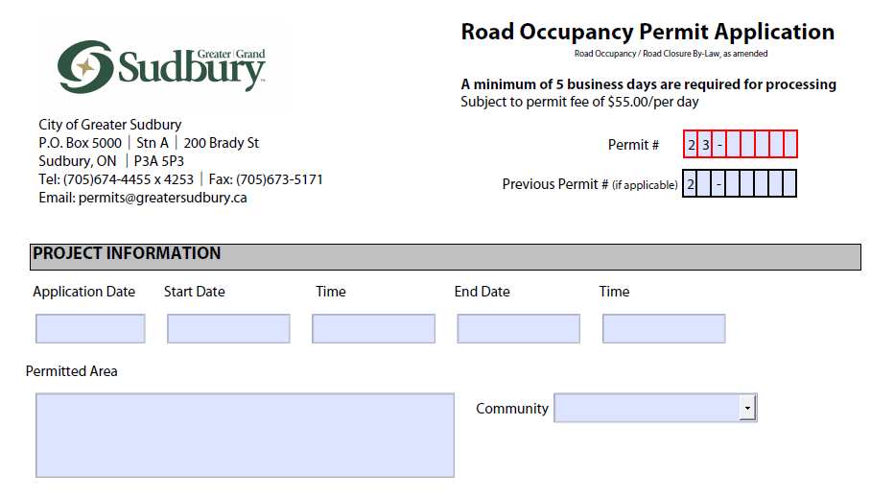
Road Occupancy

Slide 7
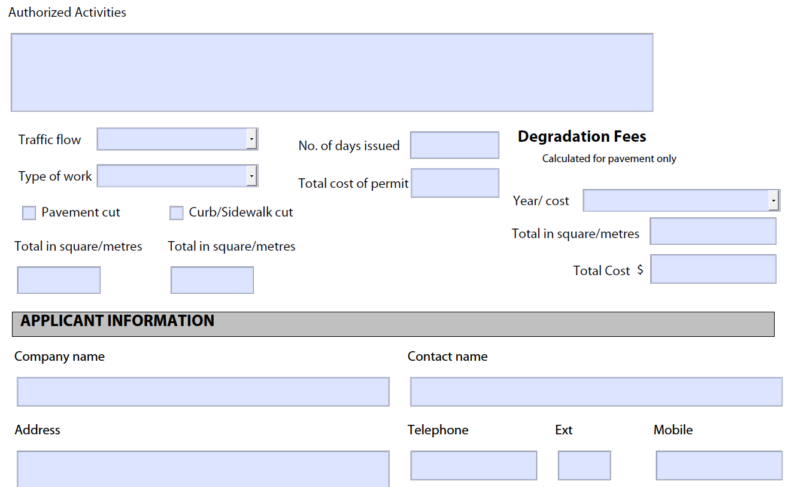

Slide 8
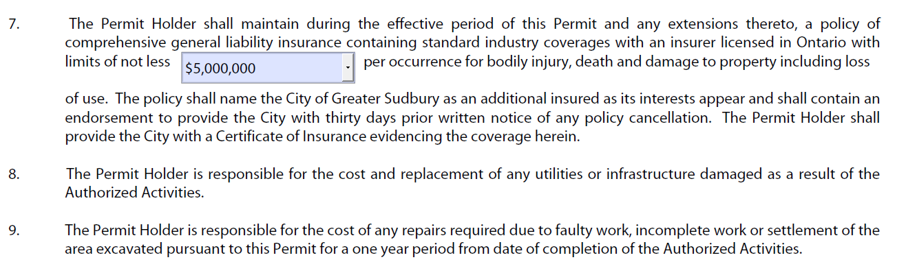
ROP cont’d – Cert. of Insurance

Slide 9
Road Closure Permit
Physical changes to the 2023 Permit form.
Cost: $113 flat rate, cash, debit, credit or cheque. Clerks can call for C.C. payment over the phone or monthly invoice.
Timeline: Minimum 3 weeks for processing.
Requirements: signage notifying public one week in advance of the closure.

Slide 10
Requirements (cont’d)
- Traffic Control Plan/Detour (OTM Book 7).
- Certificate of Insurance for $5 million, naming the City of Greater Sudbury as an additional insured.
- The application itself – signed and initialed.
- Notification letters to area residents.

Slide 11
Notification Letter
This includes the company or application name and contact
information, location of closure, purpose of closure, timeline and
any other pertinent information. The Notification Letter should be
submitted to the City of Greater Sudbury as well as any residents
and businesses in the area.

Slide 12
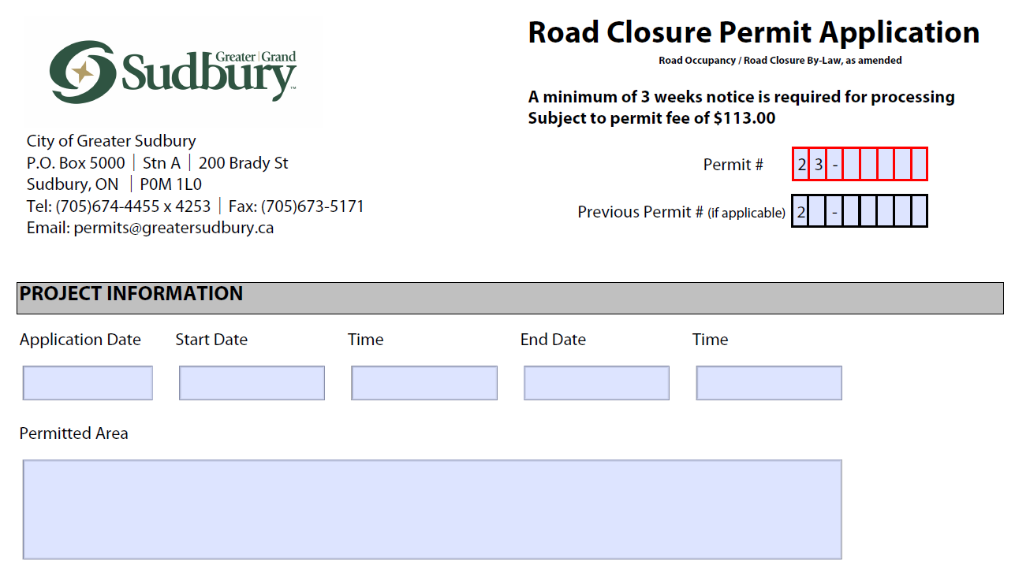

Slide 13
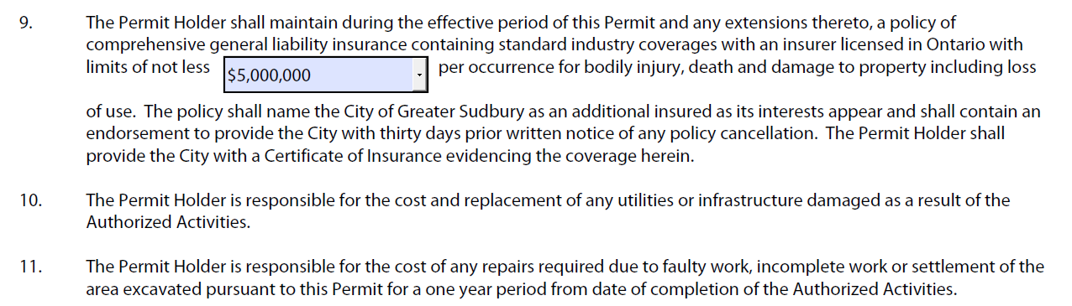
Road Closure pg.2 – Cert. of Insurance

Slide 14
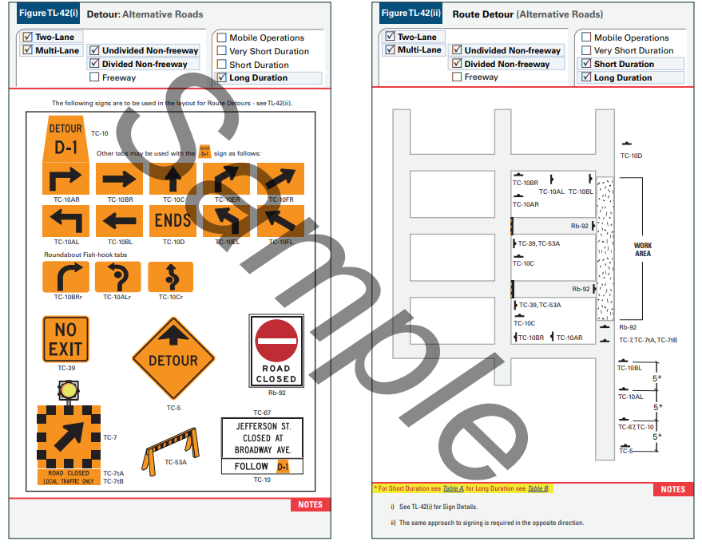

Slide 15
Traffic Control Plans
Anytime you are diverting vehicle or pedestrian traffic you will need to create a traffic control plan.
Traffic management plans need to be drafted based on the Ontario Traffic Manual’s Book 7 (Temporary Conditions).
The City does not provide assistance for the creation of traffic control plans. If you are unable to make your own traffic plan, you should hire a third party to create a plan.
Pedestrian and vehicle traffic must be addressed on the traffic control plan.

Slide 16
Asphalt Degradation
The City maintains a 3 year no-cut policy.
If there was a specific circumstance approved for the cut, there would be a $51 per sq.m. fee.
Greater than 3 and less than 5 yrs. = $43 per sq.m.
Greater than 5 and less than 7 yrs. = $35 per sq.m.
Greater than 7 and less than 10 yrs. = $21 per sq.m.
Greater than 10 yrs. = $9 per sq.m.

