Slide 1
Enbridge 2023 Proposed Projects
City of Greater Sudbury: Annual Utilities Co-ordination Meeting
Presented by Martin Rohde
Notes:
Only use title case for the title of your deck. Use sentence case everywhere else.

Slide 2
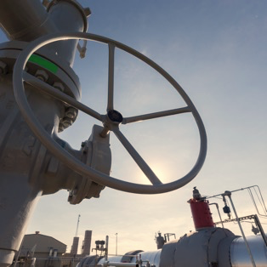
Overview of Planned Work in CGS 2023
Minimal gasmain projects this year (Relocations, Extensions, Repairs, etc.)
Various ongoing projects at mines.
  Vale Stobie mine service abandonment prior to eventual main relocation.
  FNX McCreedy mine rebuild
Typical customer connection work.
Integrity work on the Sudbury lateral transmission line, not within CGS city limits
City of Greater Sudbury: Annual Utilities Co-ordination Meeting

Slide 3
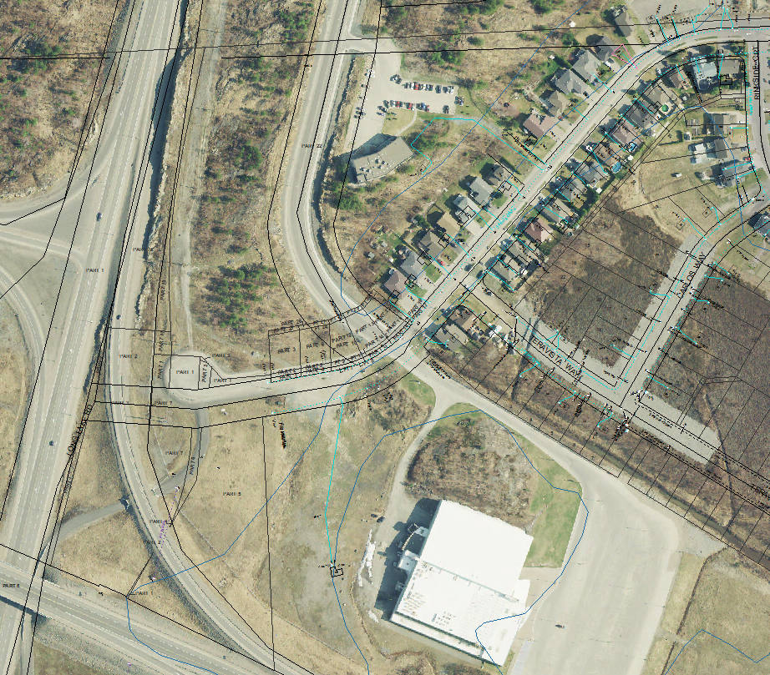
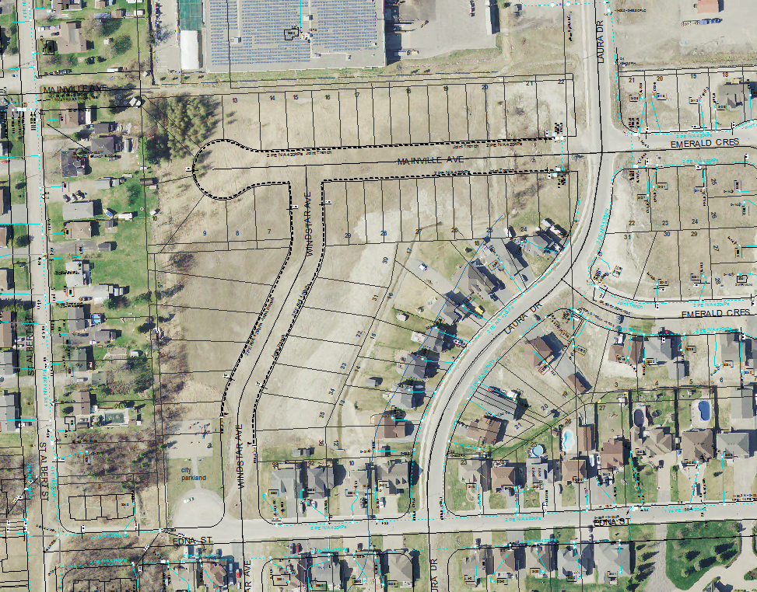
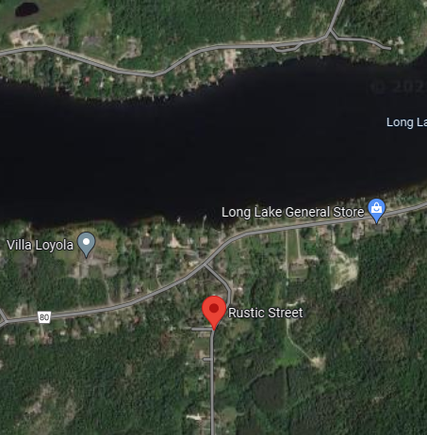
Preliminary Stage for CGS 2023
Countryside Phase III – Sudbury
  Subdivision servicing
  Joint trench
Marquis Park Phase V – Chelmsford
  Subdivision servicing
  Joint trench
Rustic Road – Sudbury
  South of Long Lake
  Short main install
City of Greater Sudbury: Annual Utilities Co-ordination Meeting

Slide 4
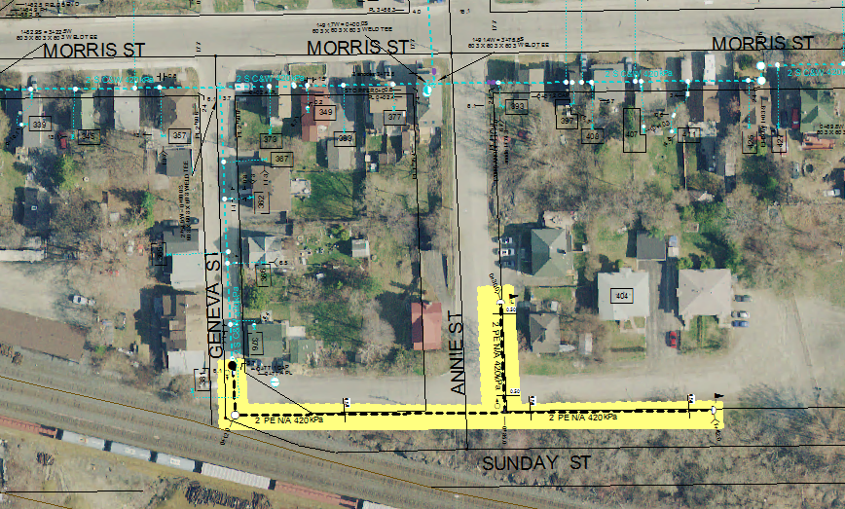
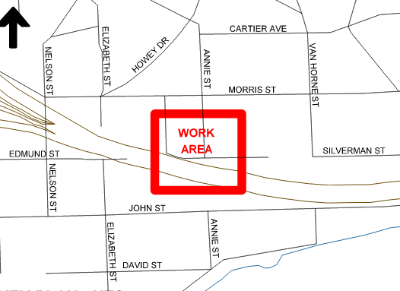
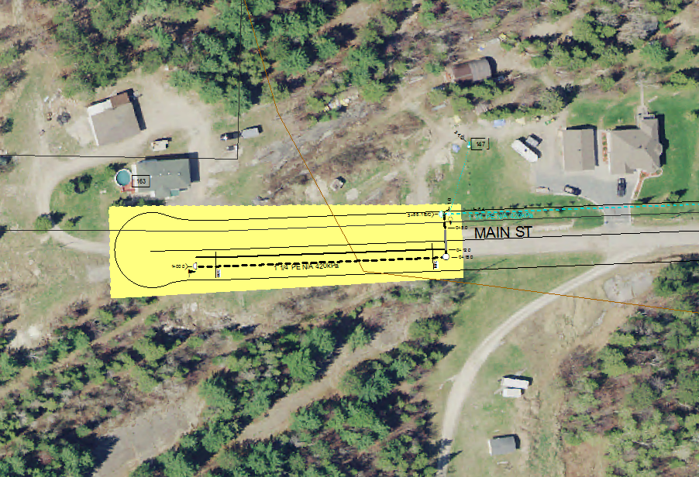
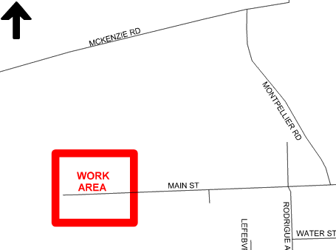
Sudbury - Sunday St. 172m PE Main
Planned for CGS 2023
Chelmsford - Main St. 100m PE Main
City of Greater Sudbury: Annual Utilities Co-ordination Meeting
Notes:
Gold accent bars can be used across the left side of boxes or images.
Minimum icon size is 0.25-inch diameter (0.635 cm)
Only use icons on a white or light grey (#EAEBEB) background

Slide 5

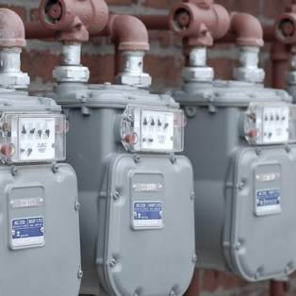




Larger Customer Station Work
Lasalle Secondary School - 1545 Kennedy Road
Sudbury Affordable Housing - 1179 Lorraine Ave.
Multi Unit Building - 1650 Dominion Drive
Freskiw - 2093 Skead Road
Laurentian University
City of Greater Sudbury: Annual Utilities Co-ordination Meeting
Notes:
Gold accent bars can be used across the left side of boxes or images.
Minimum icon size is 0.25-inch diameter (0.635 cm)
Only use icons on a white or light grey (#EAEBEB) background

Slide 6
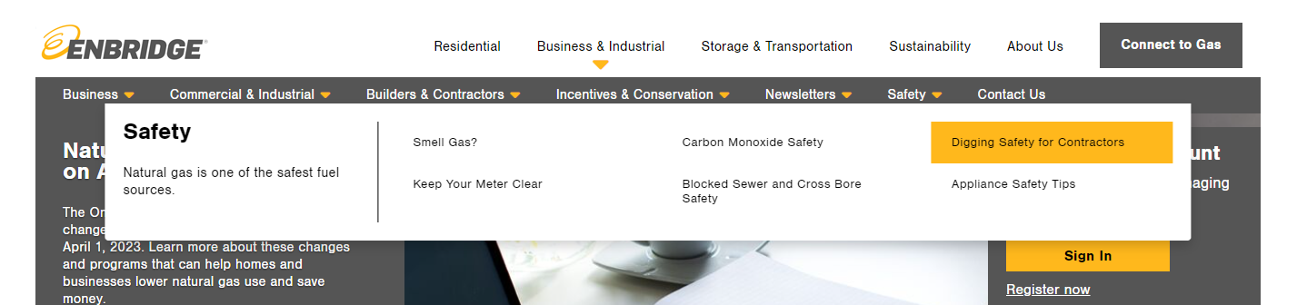
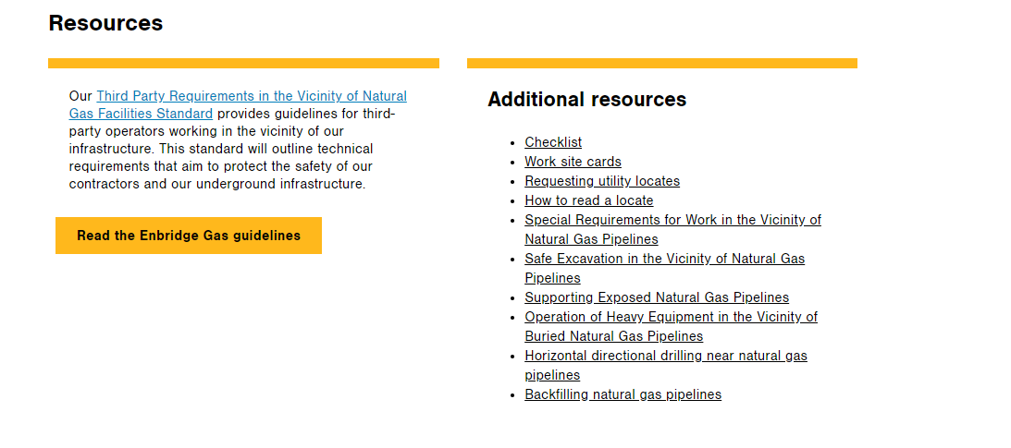
Third Party Guidelines
Safe excavation and observation requirements
Boundary clearances for Enbridge mains.
Blasting and pile driving requirements.
Equipment crossing guidelines.
Safe excavation and observation requirements
Working near vital pipelines?
Locate service providers may identify that a vital natural gas pipeline is within 30m of the proposed work area. Legally, work cannot begin until clearance is obtained.
City of Greater Sudbury: Annual Utilities Co-ordination Meeting

