Slide 1
2023 Construction Season
David Shelsted MBA, P.Eng.
Director of Engineering Services

Slide 2

2022 Carry-Overs
ENG22-13 Larch Street
ENG22-16 Lorne Street
ENG22-17 Walford Road
ENG22-36 Kingsway
ENG20-53 Paris St

Slide 3
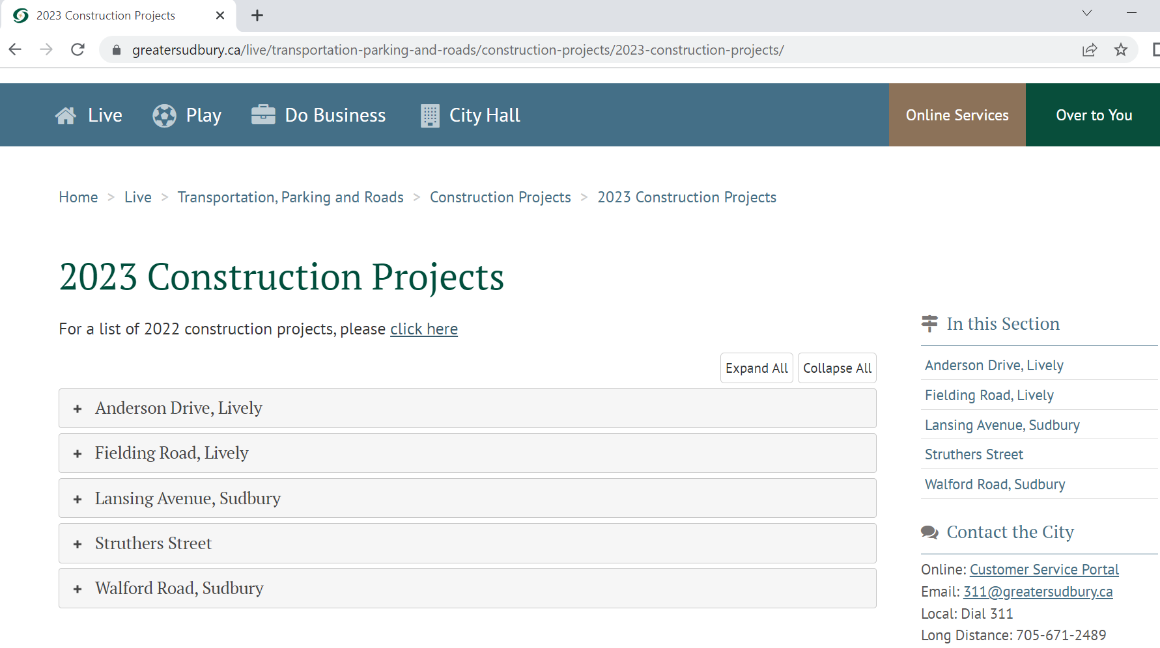
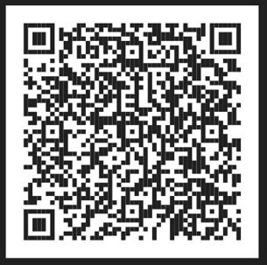
www.greatersudbury.ca/2023construction
Notes:
This site is populated as Pre-Construction Notices or Construction Notices are distributed for each project.
Listed will the scope of work, any pertinent information to residents and the Project Manager’s contact information.

Slide 4
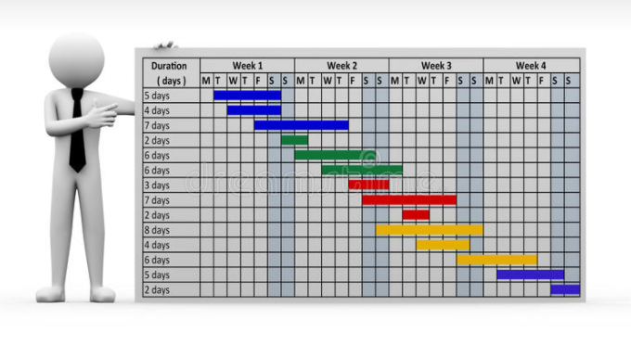
2023 Tender Schedule Highlights
Fielding Road- Surface Treatment
Kingsway - Booster Station Demolition and Silver Hills WM Realignment
Frood Rd at Lasalle Blvd – Roundabout
Paris/Notre Dame - Bikeway
Notes:
Budget was approved in March due to the election year

Slide 5
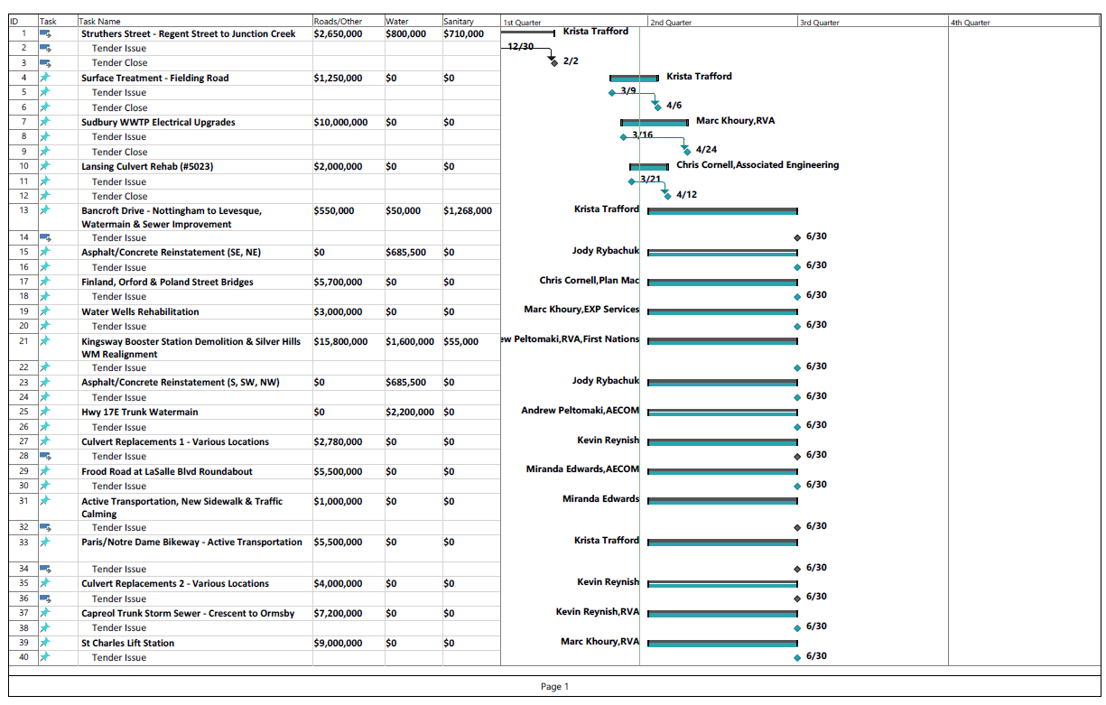
Notes:
You can also find the 2022 Tender Schedule listed in the 2022 Contractor’s Meeting tab. This illustrates the following:
Project Description identifies the scope of work
Values listed are the approved budgets. This can include consultant costs, material testing and other costs
Budgets are broken down by scope of work (Roads, Water and Wastewater)
If the project has been tendered or is in the process, the actual dates are listed, otherwise the quarter we anticipate it to be tendered is listed.
Projects in Q4 are at risk of being tendered in 2024

Slide 6
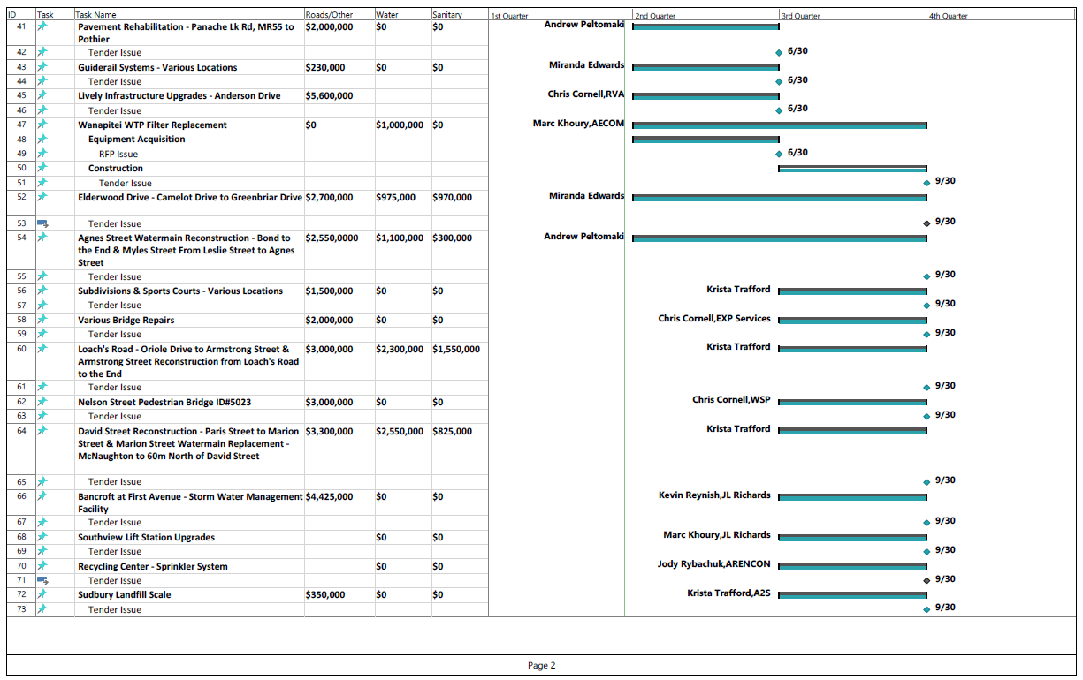

Slide 7
Questions?

