Slide 1
2023 Annual Utilities Coordination Meeting
Wednesday, May 03, 2023

Slide 2
Welcome!
Notes:
good

Slide 3



Housekeeping
Respectful and Engaged Conversations
Cell Phones
Washrooms/Emergency Exits

Slide 4
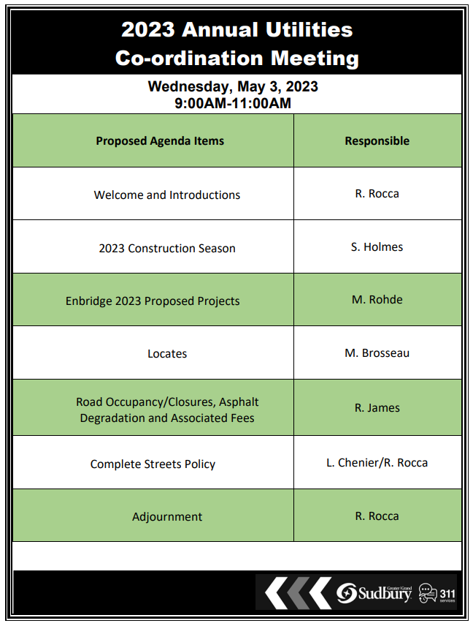
Agenda
www.greatersudbury.ca/2023utilities

Slide 5
Introductions

